Slide 1
Modeling the Impact of Complex, Multi-Vector Disruptions to the Marine Transportation System (MCAT)
PI: Fred Roberts
Rutgers University
PI: Adam Rose
USC
April 8, 2024

Slide 2
Project Overview
The Marine Transportation System (MTS) is a vital part of the nation’s supply chain. The vast majority of U.S. overseas trade is carried by the MTS, and this, in turn, plays a major role in the nation’s GDP and overall prosperity.
While the MTS is resilient, multiple disruptions can have unexpected impacts.
We know little about how these disruptions interact and how they impact downstream businesses dependent on a smooth functioning MTS.
Modeling multiple vector disruptions and identifying potential countermeasures can help policy makers, business leaders, and others anticipate, plan for, mitigate, recover from them.
We are identifying plausible complex disruptions, possible countermeasures, and building a decision-support tool called MCAT for use by the Coast Guard and others to improve risk management.
The Ever Given wedged in the Suez Canal, blocking traffic in both directions. Credit: Contains modified Copernicus Sentinel data 2021, CC BY 2.0, via Wikimedia Commons
Complex disruption: COVID + ship blocking Suez Canal
Notes:
Add summary of project

Slide 3
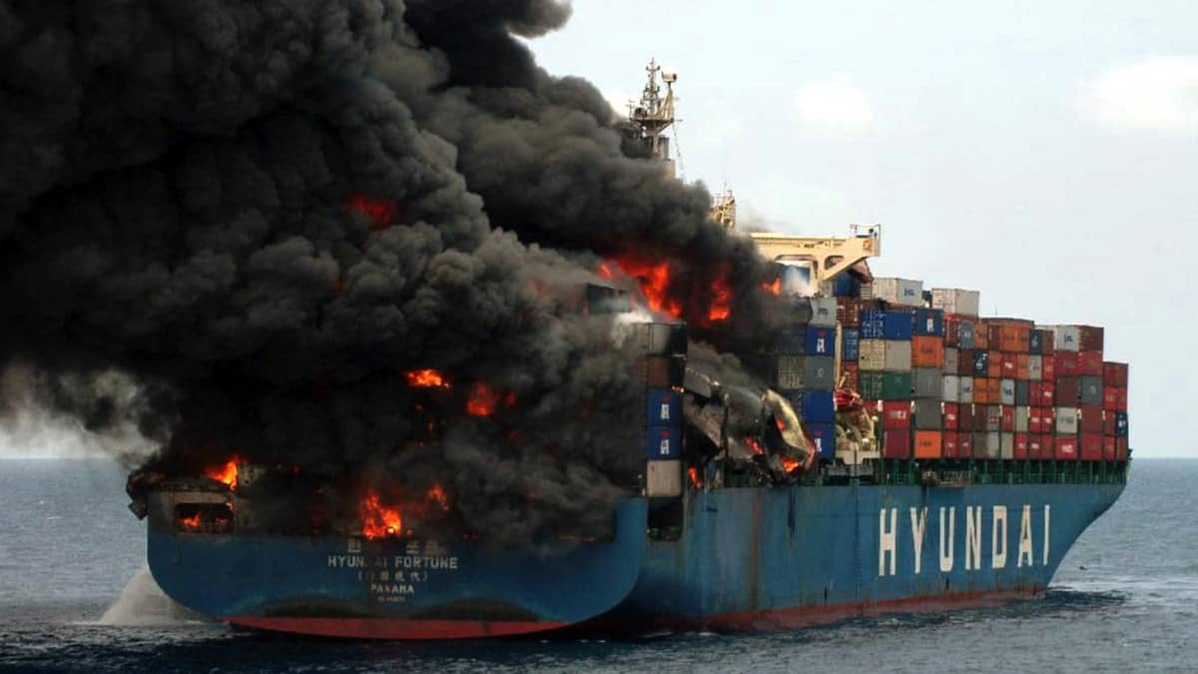
Complex Disruption Example: NY/NJ (KVK) Scenario
Background Scenario: Increased dwell time for containers
A combination of truck driver, chassis, and warehouse shortages has significantly increased terminal dwell time of containers in the NY/NJ area.
Initial Disruption: Container ship fire and blockage of the Kill van Kull
Ship carrying fireworks & industrial chemicals catches fire in the KVK; smoke from burning chemicals affects surrounding area. Escort tug loses connection; vessel runs aground. 4 days to extinguish fire and tow vessel to safety; 4 more days of daytime, one-way traffic on KVK.
Secondary Disruption: Malware impacts to terminal operating systems
Malware affects terminal OS at Port Newark-Elizabeth, affecting ability to track status, location, destination of containers, and further increases terminal dwell time issues resulting from background scenario. Other terminals take their systems offline for 24 hours to ensure that the malware has not affected them. Occasional rechecks slow down operations for another week.
Notes:
Add summary of project

Slide 4
Port of NY/NJ Complex Disruption: Kill van Kull Blockage: Stakeholder Engagement
Detailed input for KVK disruption from USCG Sector NY and Port Authority of NY/NJ.
USCG planned an exercise on just such a blockage and we were included.
Port Authority convened a panel of SMEs to help us develop the scenario.
Notes:
Add summary of project

Slide 5
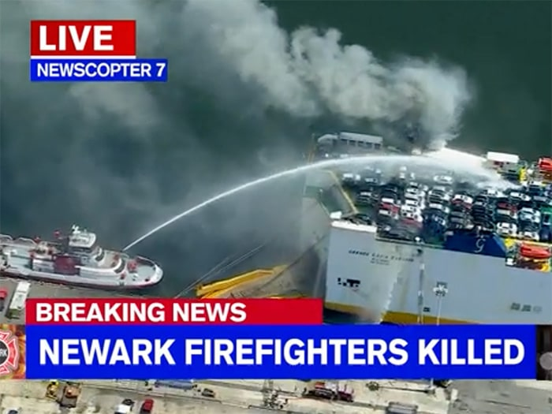
Port of New York Scenario
Unfortunately, an event similar to our ship fire scenario occurred in NY with the car carrier fire in July 2023:
Italian Flagged Grande Costa D’Avorio is a RORO car- carrying freighter. Loaded with 1200 non-electric used vehicles and 157 non-hazardous containers
Coast Guard Sector NY conducted an exercise that addressed some of the second portion of the scenario – a cyber attack spreading across multiple port operators
March 2023 discussion with RADM Mauger (Commandant of USCG District 1) about integrated cyber and physical attacks on key infrastructure
Led to invitation to participate in that CG cyber exercise in New York in October and hotwash in November
Notes:
Add summary of project

Slide 6
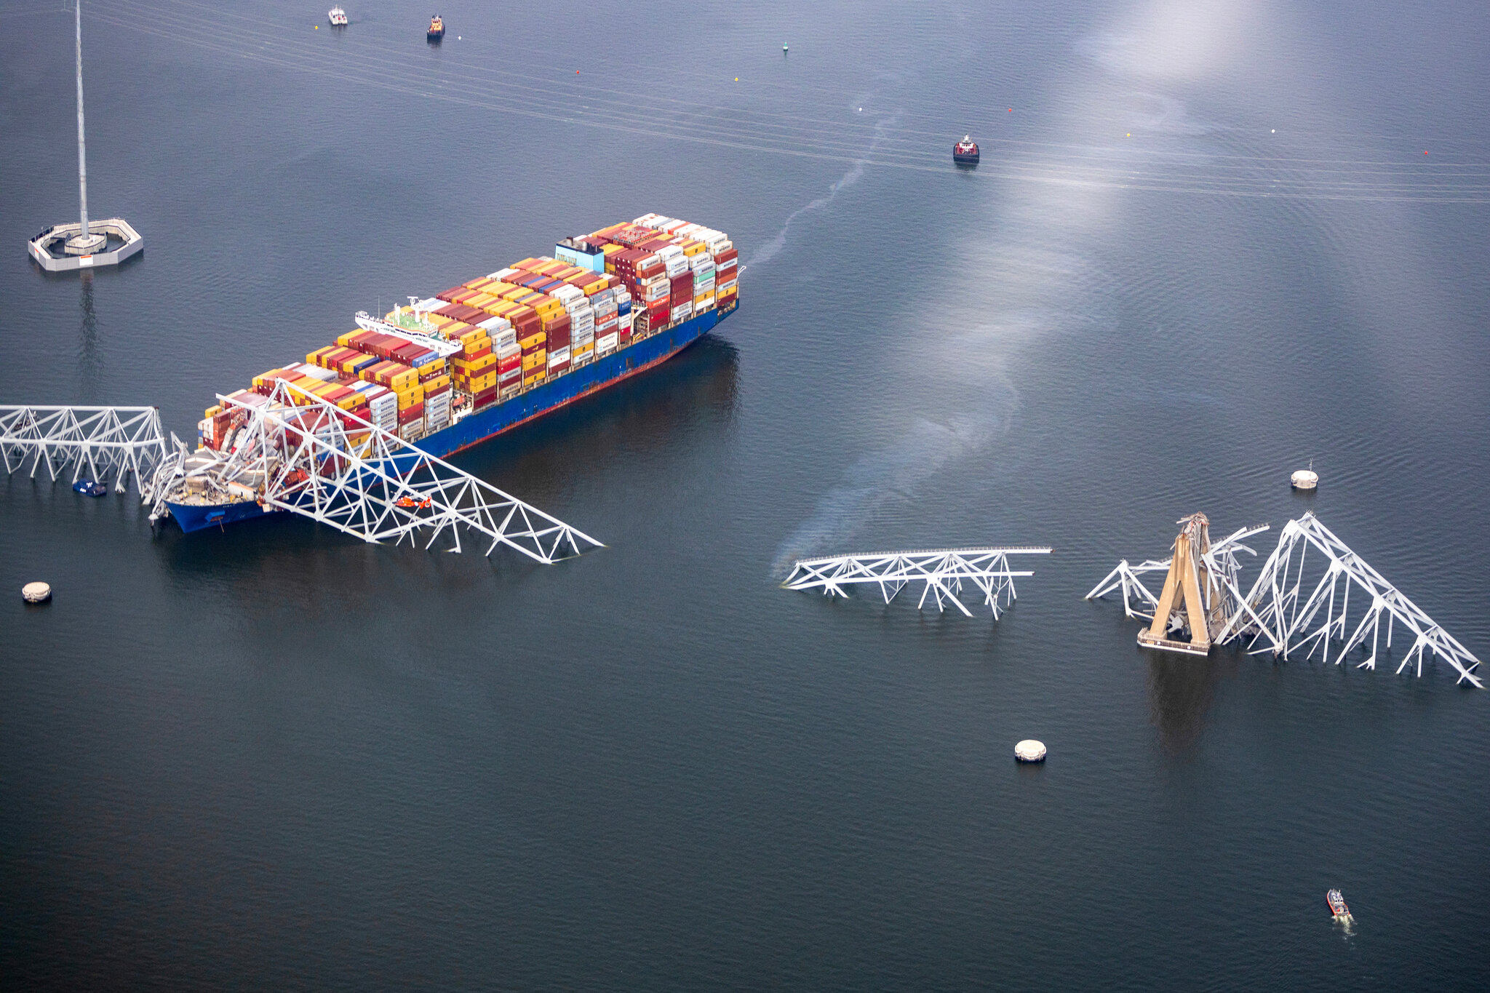
Unfortunately, Other Predictions Realized
March 26: container ship crashes into Baltimore’s Key Bridge, bridge collapses.
Scary: Our team was invited to an exercise in Baltimore in September where this was the very scenario.
Organized by CMTS and various agencies including Coast Guard and CISA.
Technically, not a complex incident with several disruptions.
A single incident with complex, cascading impacts.

Slide 7
Project Components
1. Scenarios:
Develop four detailed scenarios for complex disruptions
Prepare collection of complex disruptions at intermediate level of detail
Prepare collection of plausible complex disruptions
All with help of SMEs, Advisory Board, and stakeholders (e.g., USCG)
2. Countermeasures
Develop plausible countermeasures for all of the scenarios
Again with help of SMEs, Advisory Board, and stakeholders
7

Slide 8
Project Components (cont’d)
3. MCAT decision support tool
Develop and use tool to analyze economic impacts of the four detailed complex scenarios
Use tool to analyze reduction in impact of different countermeasures for those scenarios
Deliver the tool + users guide
4. Ukraine War
Study impacts of the Ukraine War on the MTS
Prepare a final report on those impacts
Analyze the economic impacts of the Ukraine War using the MCAT tool
5. Extensive Engagement with DHS components, other Government
Agencies, Private Sector
8

Slide 9
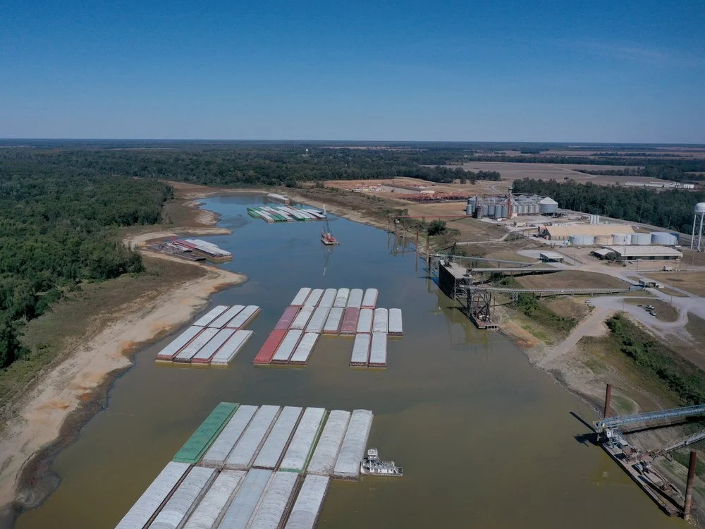
Complex Disruption Example: Low Water on the Mississippi River
Background: Increasing demand worldwide for food as a result of Ukraine; already high demand for corn and fertilizer due to ethanol and other needs
Initial Disruption: Hot, dry summer disrupting Western Rivers, leaves river levels below their 2022 record by several feet, especially the lower Mississippi River from Memphis to New Orleans; barge trains are shorter, barge loads are lighter; affects shipments of fertilizer and grain on the rivers
Secondary disruption: Lock and dam failure to Lock 27 (near St. Louis) just before Spring planting
Exacerbating Events: Exacerbated by reductions of fertilizer import at Port of New Orleans
Notes:
Add summary of project

Slide 10
Mississippi River Scenario
We were led to this scenario by discussions with U.S. Maritime Administration leaders
Summer 2022 situation:
Record low water
A trip between Cairo Illinois to New Orleans that normally takes between 13 and 14 days, took almost 27 days during that time
Barges that normally get loaded up to 12 ft or more, were down to 9ft causing a severe shrinking of towing capacity leading to a reduction of over 50%
Discussions with American Waterways Operators (tugboat, towboat and barge industry's advocate) and US Army Corps of Engineers led us to detailed scenario assumptions
Then summer of 2023 had a repeat of really low water
A good test of our MCAT model - leading to a detailed economic analysis of the resulting impacts on the fertilizer and grain markets
Details of this later
Notes:
Add summary of project

Slide 11
Mississippi River Scenario
Project PI Adam Rose was invited to testify before the Senate Budget Committee in October on the economic impacts of Climate Change on Supply Chains
His testimony was built around our Mississippi River low water scenario and economic analysis
Now we have seen drought in Panama leading to low water in the Panama Canal with dramatic impact on Canal capacity and major disruptions to shipping world-wide
New DHS Supply Chain Resilience Center making climate change impacts on supply chain a major theme
Notes:
Add summary of project

Slide 12
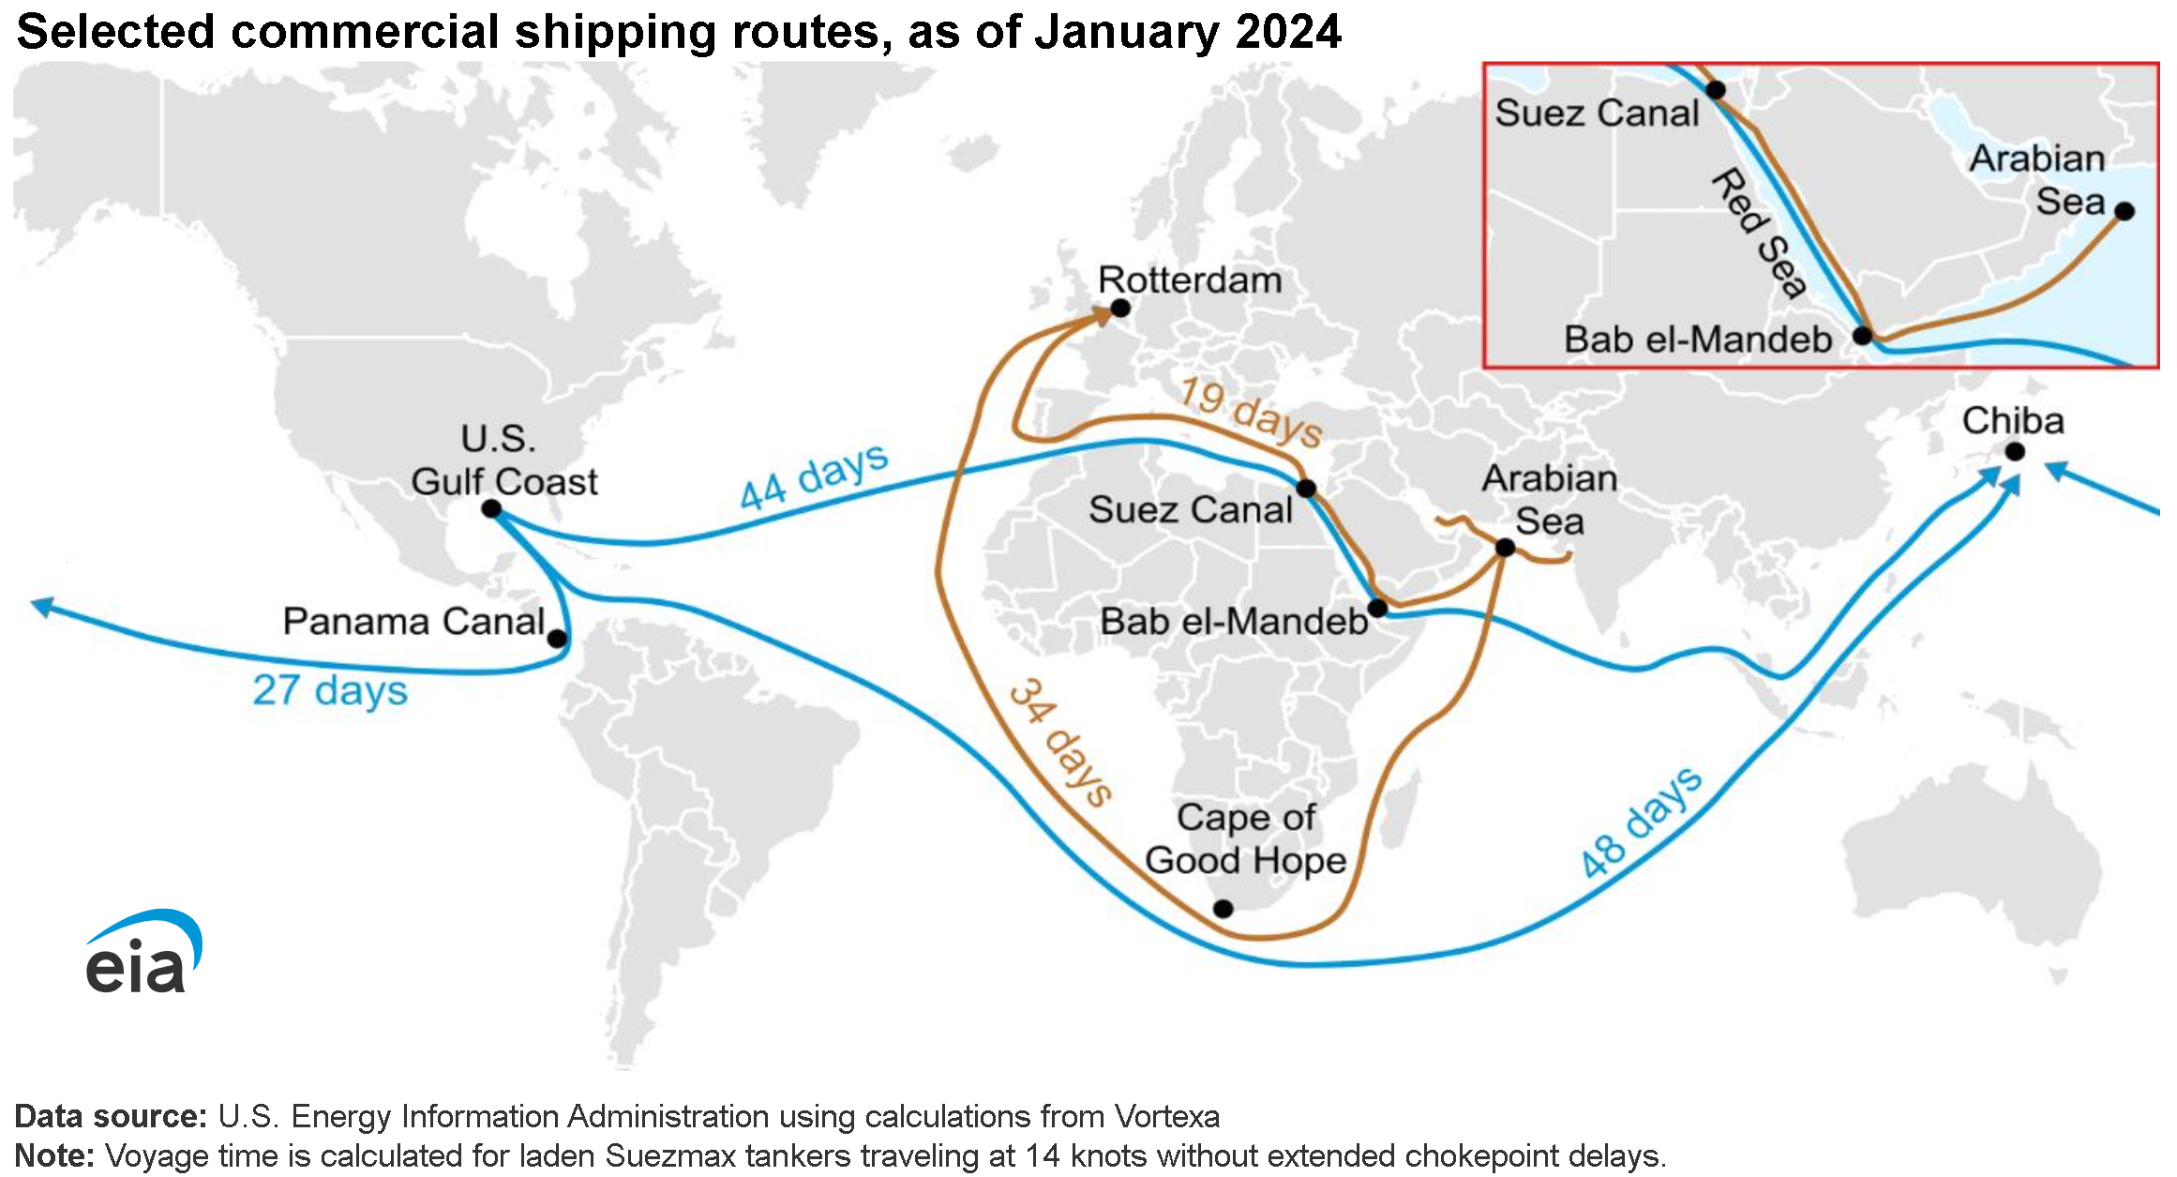
Panama Canal
Low Water Impacts: 30% less rainfall in Panama has reduced ships from 38 to 18 per day
Low Water Impacts: Shippers are paying millions to transit with priority
Countermeasures: Major shippers like Maersk are using land bridge across Panama, or air cargo, to avoid delays
Maersk interested in collaborating with us
Visited Maersk Innovation Center in Jersey City in March
Maersk Global Head of Innovation (Logistics & Services) joined project Advisory Board
Countermeasures: Panama Canal Board considering new, exclusive reservoir to provide water for Canal when needed
Notes:
Add summary of project

Slide 13
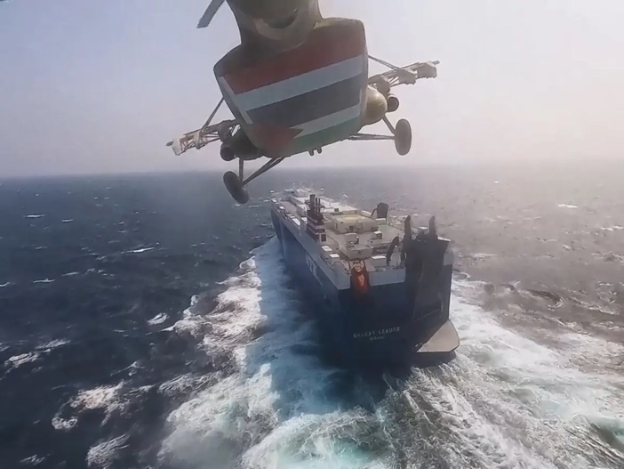
Red Sea Attacks Make things Worse for Global Shipping
On November 19th, Houthi forces hijacked the car carrier Galaxy Leader. Since that date, Houthis have attacked many other commercial vessels by missile and drone
But now access to the Suez Canal is affected
Panama Canal + Suez Canal blockages create a really complex disturbance
13

Slide 14
The MCAT Economic Consequence Analysis Tool and its Fertilizer Scenario Application
We are developing a user-friendly, decision-support tool for use by the Coast Guard and others to improve risk management.
The MCAT Tool
Based on an Economic Consequence Analysis Tool (E-CAT) developed by our partner center CREATE to identify direct and indirect economic impacts of disruptive events.
Uses an internationally linked computable general equilibrium (CGE) model consisting of over 100 countries with 65 sectors each.
CGE models the economy as a set of interrelated supply chains
Helps determine economic impacts of complex disruptions and provide insight into how to minimize them.
For this scenario, also used a specialized TERM-USA CGE model consisting of 5 Mississippi River regions
Notes:
Add summary of project

Slide 15
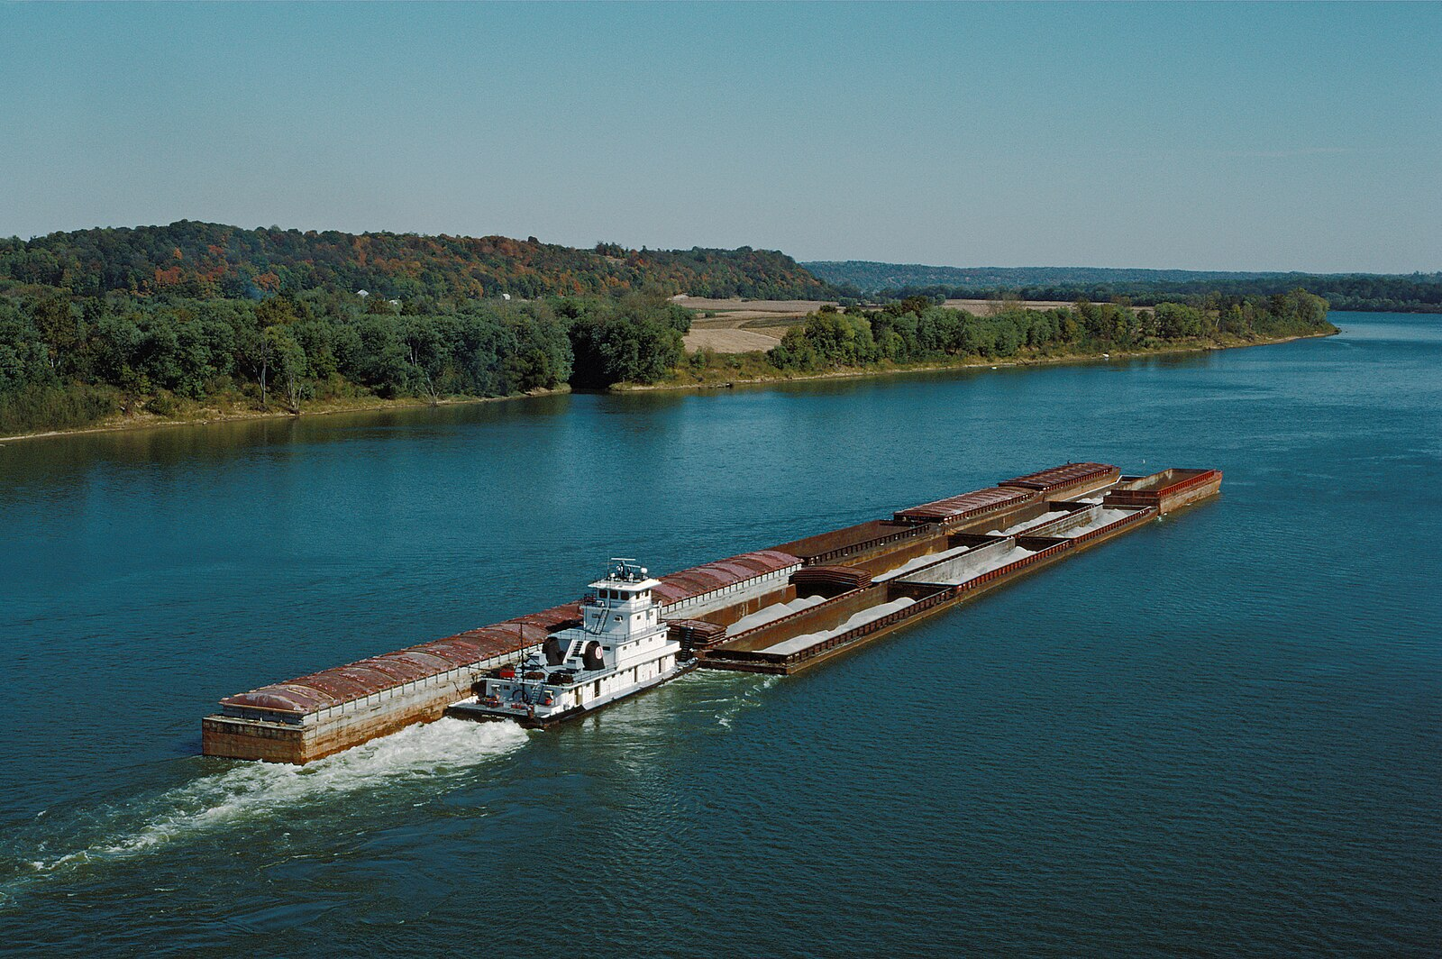
Fertilizer Application: Barges and Fertilizer
Barges on the Mississippi are an extremely cost-effective method of transportation for fertilizer.
A tow of 15 barges can move more than 22,000 tons of fertilizer using 44 gallons of fuel per mile (on a tugboat).
In contrast, it would take about 800 gallons to move that much fertilizer a mile by truck (Jenkins, 2022).
A 15-barge tow, pushed by a single towboat, can carry as much cargo as 870 large trucks, or over 200 rail cars
Credit: Wikimedia commons, William Alden III, no changes

Slide 16
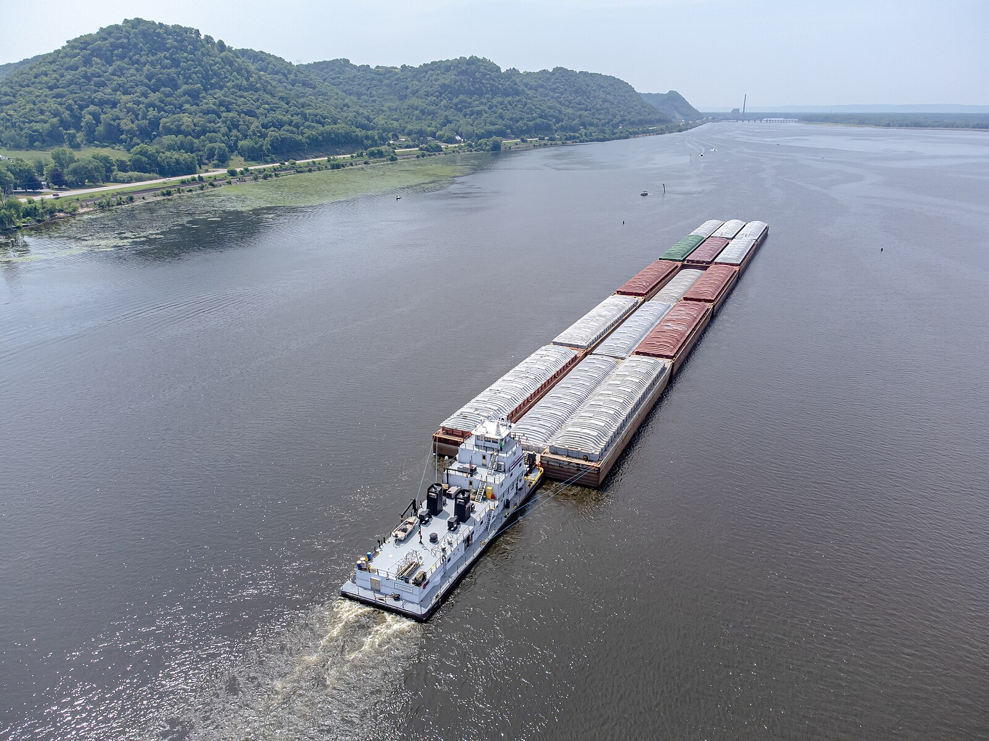
Barges and Fertilizer
Low water led to barges becoming stranded in mud and sand
Necessitating lighter barge loads, shorter barge trains and the implementation of one-way traffic in certain river sections
At the low water level of October 2022, approximately 2,000 barges were backed up along the river waiting passage
Consequently, barge transportation rates soared to more than 400% above average
Barge labor productivity (the work or output achieved by a unit of labor within a specific timeframe) dropped significantly
credit: Wikimedia commons, Wikideas1

Slide 17
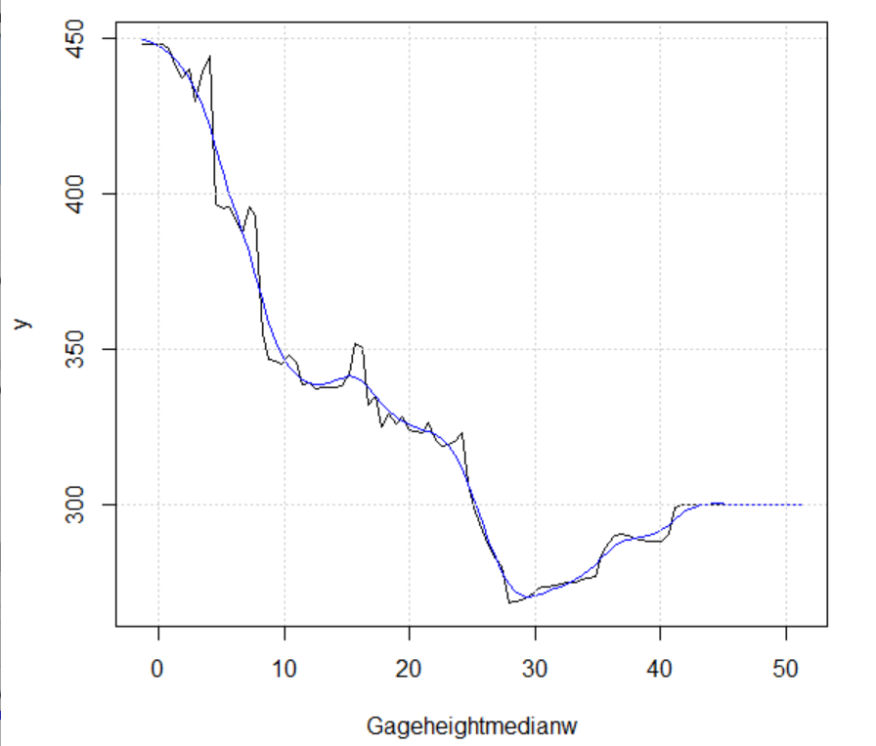
Three Components of the Complex Disruption
Scenario 1: Low water on the Mississippi due to drought:
Our models made assumptions about water levels at Memphis
Then estimated changes in barge transportation rates and barge labor productivity rates as a function of water level
Scenario 1a. River Gage Level Decrease, Causing Upriver Barge Rate Increase
Scenario 1b. River Gage Level Decrease, Causing Barge Labor Productivity Decrease

Slide 18
Three Components of the Complex Disruption
Scenario 2: Lock and Dam Failure
Locks and dams on the Mississippi are old and subject to failure
We used Lock and Dam 27 at Granite City Illinois for failure – a large portion of fertilizer and grain loads use this lock
When a lock fails, things are held up. We estimated effect on barge transportation rates and barge labor productivity rates of this failure, as a function of length of time of outage.
Scenario 2a. Navigation Bottleneck, Causing Upriver Barge Rate Increase
Scenario 2b. Navigation Bottleneck, Causing Barge Labor Productivity Decrease
Scenario 3: Disruption of fertilizer imports in New Orleans
Cause not identified, but could be hurricane, labor strike, cyber attack heat event, etc.
Studied different assumptions about percentage of import reduction

Slide 19
Three Components of the Complex Disruption
Different assumptions about water levels, duration of lock failure, and percent import reduction define different cases:
Base case, lower bound case, upper bound case
To analyze the complex disruption, we estimate the resulting direct and indirect (supply-chain) impacts on the regional and national economy as a whole in terms of decreases in GDP and inflationary pressures

Slide 20
Simulation results of the fertilizer shipment disruptions for the Base Case
Scenario | GDP Level Change (millions of dollars) |  |  |  |  |  |  |  | GDP Percent change
 | Illinois | Iowa | Minnesota | Missouri | Wisconsin | RoUSA | National |  | Illinois | Iowa | Minnesota | Missouri | Wisconsin | RoUSA | National
1a | -4,611 | -1,609 | -4,050 | -2,006 | -2,833 | 2,475 | -12,634 |  | -0.427 | -0.867 | -1.003 | -0.701 | -0.786 | 0.012 | -0.056
1b | -167 | -32 | -108 | -64 | -60 | -1,107 | -1,538 |  | -0.016 | -0.017 | -0.027 | -0.022 | -0.017 | -0.006 | -0.007
2a | -1,164 | -417 | -1,035 | -167 | -750 | 612 | -2,921 |  | -0.108 | -0.225 | -0.256 | -0.058 | -0.208 | 0.003 | -0.013
2b | -143 | -27 | -92 | -54 | -51 | -938 | -1,305 |  | -0.013 | -0.015 | -0.023 | -0.019 | -0.014 | -0.005 | -0.006
3 | -6 | -1 | -2 | -2 | -3 | -161 | -176 |  | -0.001 | -0.001 | -0.001 | -0.001 | -0.001 | -0.001 | -0.001
Sum Total | -6,092 | -2,087 | -5,287 | -2,292 | -3,696 | 881 | -18,575 |  | -0.564 | -1.124 | -1.309 | -0.802 | -1.026 | 0.004 | -0.083
Sim Total | -5,931 | -2,001 | -5,096 | -2,272 | -3,511 | 704 | -18,108 |  | -0.549 | -1.078 | -1.262 | -0.795 | -0.975 | 0.004 | -0.081

Slide 21
Results
The overall negative impact on US GDP is 0.083%.
Seems rather minor, but percentage impacts at the state level are several-fold higher; e.g., Minnesota is -1.309%
Aggregate employment impact is only -0.025%
Still, this lower percentage impact corresponds to an employment decrease of 51,267 people throughout the U.S economy, and each of them is 100% unemployed.
The overall effect on prices (inflation) is estimated to cause a 0.299% increase in the Producer Price Index (PPI), and a 0.257% increase in the Consumer Price Index (CPI).
At a time when we are especially sensitive to inflationary pressures, such small impacts have relatively greater meaning.
These seemingly small amounts represent a 5% increase in current inflation, so they are quite notable.

Slide 22
Stakeholder Engagement
Distinguished Advisory Board including USCG, port security, private sector
Project has been going in many new directions.
Led us to recently add six new Advisory Board members reflecting breadth of involvement of stakeholders:
Dr. Erez Agmoni, Global Head of Innovation (Logistics & Services), Maersk
Mr. Joe Farley, VP Safety and Security, Maher Terminals, Port of New York/New Jersey
CDR Michael Metz, USCG Sector Corpus Christi
Mr. Jeff Milstein, Director of Security and Vessel Operations, VITOL Inc. – Houston
Mr. Charles Tenney, USCG Sector Lake Michigan
RADM Richard Timme, USCG-ret
Notes:
Add summary of project

Slide 23
Stakeholder Engagement
Interviews with over 30 SMEs from government, industry, and nonprofits
Presentations to practitioner groups have informed our work (and theirs)
Examples:
USCG Sector New York including tabletop
USCG Sector Los Angeles-Long Beach including tabletop
Port Authority of NY/NJ
US Committee on the Marine Transportation System (CMTS)
CISA Committee on the Continuity of the Economy
CISA Resilience Services Branch
US Maritime Administration (MARAD)
Interagency Supply Chain Working Group run by DOT
Emergency Support Function – Transportation, run by FEMA
Interagency Port of Baltimore Multiple Disruptions Tabletop
Notes:
Add summary of project

Slide 24
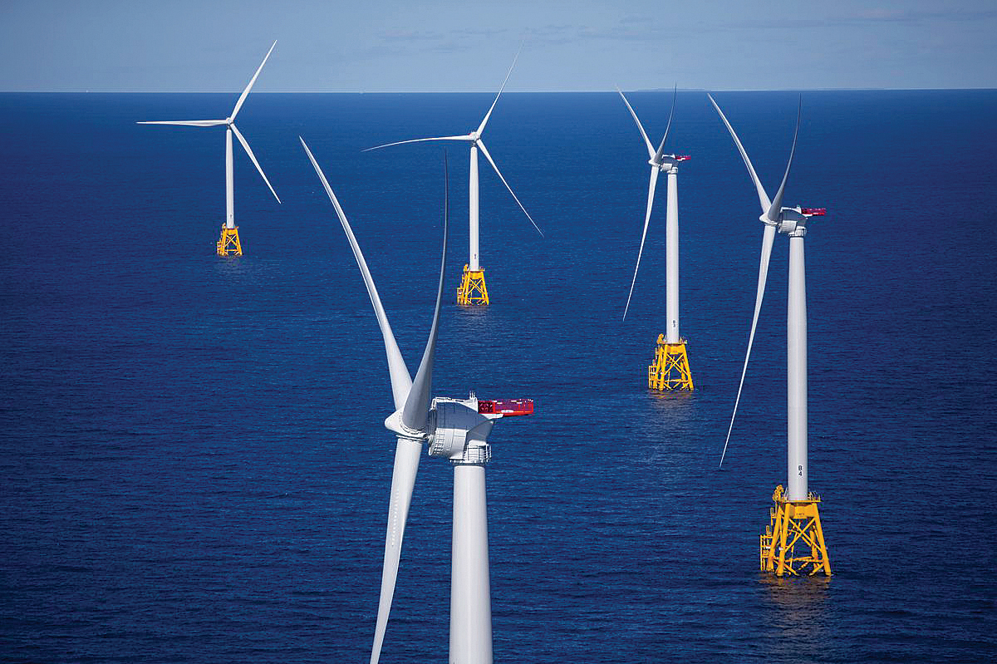
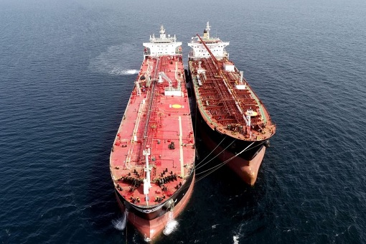
A Selection of New Directions Arising from Stakeholder Engagement: Offshore Wind
Offshore wind disruptions, including cables cut + cyber
Smart ports: AI, digital twins, modern info sharing; but: cyber attacks, power failures, and Chinese cranes
Great Lakes: ice cutters break + Soo Lock damage
Dark Fleet (resulting from Ukraine War): Avoiding sanctions: accidents with old & uninsured vessels + oil spills + all kinds of crime
Crowded Offshore MTS: conflicting uses + increasingly crowded maritime traffic + ambiguous jurisdiction issues (USCG Evergreen)
Wind farms
Commercial space/rocket launches
Offshore ports to handle mega container ships, very large crude carriers, even offshore cargo inspection
Offshore subsea storage for hydrogen fuel
Offshore aquaculture
Notes:
Add summary of project

Slide 25
A Selection of New Directions Arising from Stakeholder Engagement
There are many others.
Our tools seem very appropriate for analyzing complex disruptions related to these new directions.
We look forward to investigating them.
Notes:
Add summary of project

Slide 26
For More Information: Other Team Members
Fred Roberts
froberts@dimacs.rutgers.edu
908-803-7851
Adam Rose
adamzros@usc.edu
814-777-6789‬
Andrew Tucci (USCG, ret.)
Dennis Egan (Rutgers)
Peter March (Rutgers)
Christie Nelson (Rutgers)
Ryan Whytlaw (consultant)
Zenhua Chen (Ohio State)
Noah Miller (USC) student
Chris Di Paolo (Rutgers) student
Latha Vijayagopal (Rutgers) student
Notes:
Add summary of project

