Slide 1
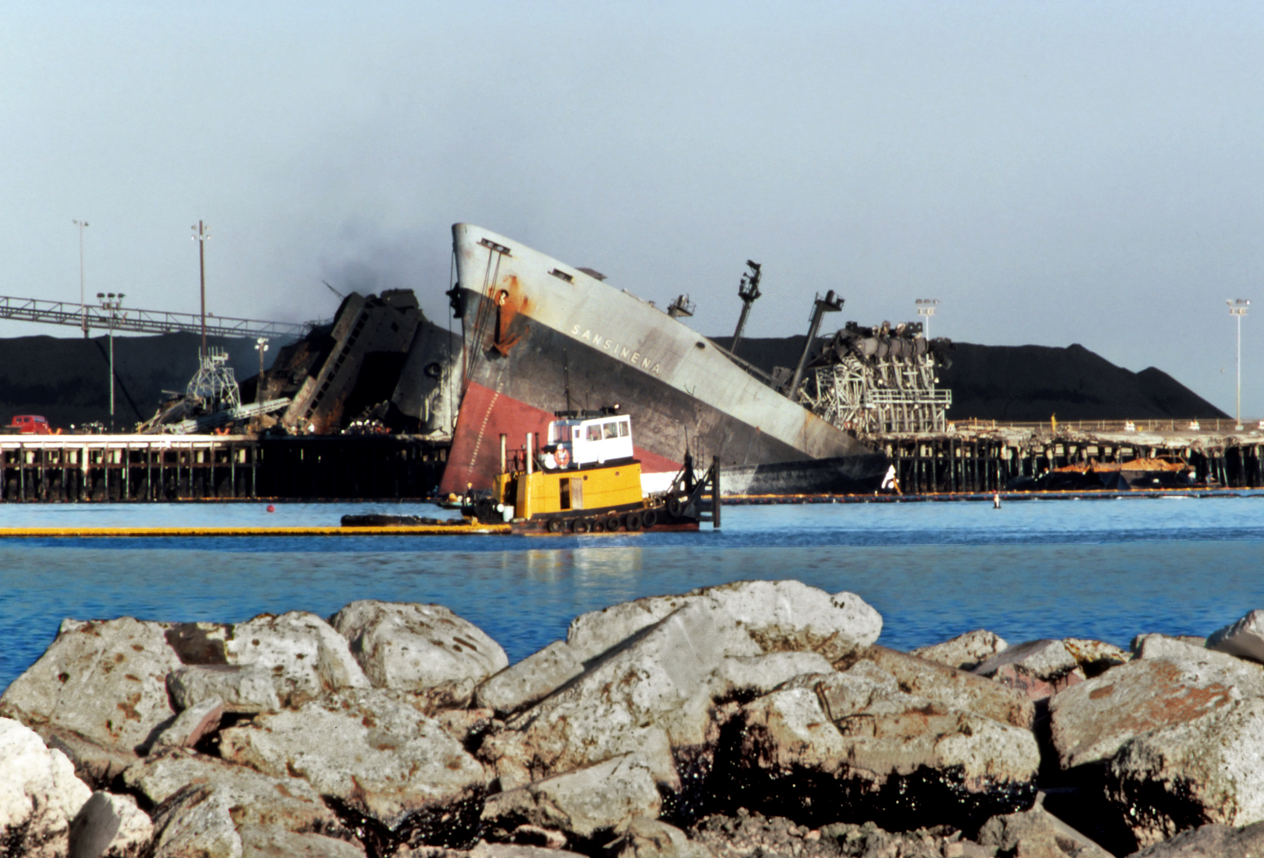
Modeling the Impact of Complex, Multi-Vector Disruptions to the Marine Transportation System (MCAT)
Fred Roberts (Rutgers University)
Andrew Tucci (USCG, ret)
April 11, 2023
SS Sansinena Explosion, Port of LA
Photo credit: Wikimedia commons
Notes:
Add summary of project

Slide 2
Project Overview
Project is a partnership among three DHS university centers of excellence:
  CAOE: Center for Accelerating Operational Efficiency, led by Arizona State University
  CCICADA: Command, Control, and Interoperability Center for Advanced Data Analysis, led by Rutgers University (Fred Roberts, Director)
  CREATE: Center for Risk and Economic Analysis of Threats and Emergencies, led by University of Southern California
Notes:
Add summary of project

Slide 3
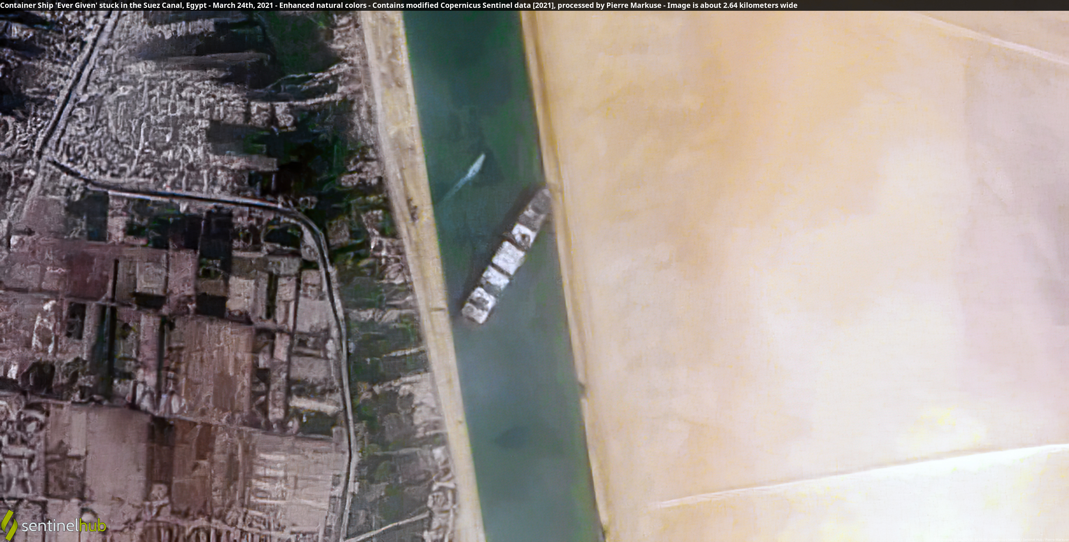
Project Overview
While the MTS is resilient, multiple disruptions can have unexpected impacts.
We know little about how these disruptions interact and how they impact downstream businesses dependent on a smooth functioning MTS.
Modeling multiple vector disruptions and identifying potential countermeasures can help policy makers, business leaders, and others anticipate, plan for, mitigate, recover from them.
We are identifying plausible complex disruptions, possible countermeasures, and developing a decision-support tool called MCAT for use by the Coast Guard and others to improve risk management.
The Ever Given wedged in the Suez Canal, blocking traffic in both directions. Credit: Contains modified Copernicus Sentinel data 2021, CC BY 2.0, via Wikimedia Commons
Complex disruption: COVID + ship blocking Suez Canal
Notes:
Add summary of project

Slide 4
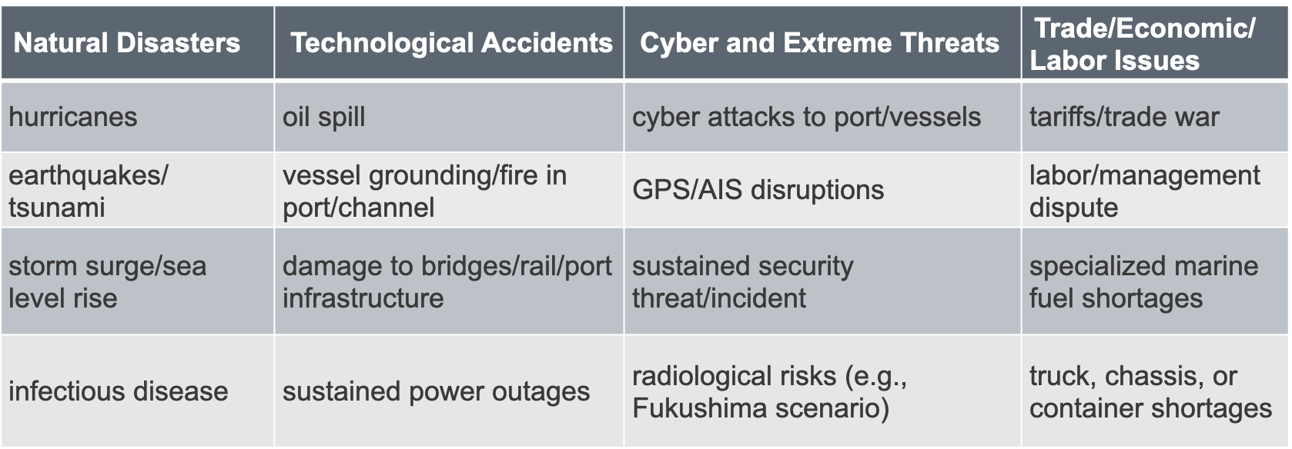
“Simple” Disruptions
(not comprehensive)
When “simple” disruptions occur together, along a common supply chain, they become “complex” and may have surprising consequences or require novel mitigation approaches.

Slide 5
Complex Disruption Examples
  Ship fire in New York combined with a cyber attack
  Power outage in LA/LB combined with a security event
  Energy market impacts of Colonial Pipeline, Freeport LNG facility accident, refinery downtimes, and Ukraine invasion
  Low water on the Mississippi combined with a fertilizer shortage
  Russian invasion of Ukraine, impact to maritime supply chains
Notes:
Add summary of project

Slide 6
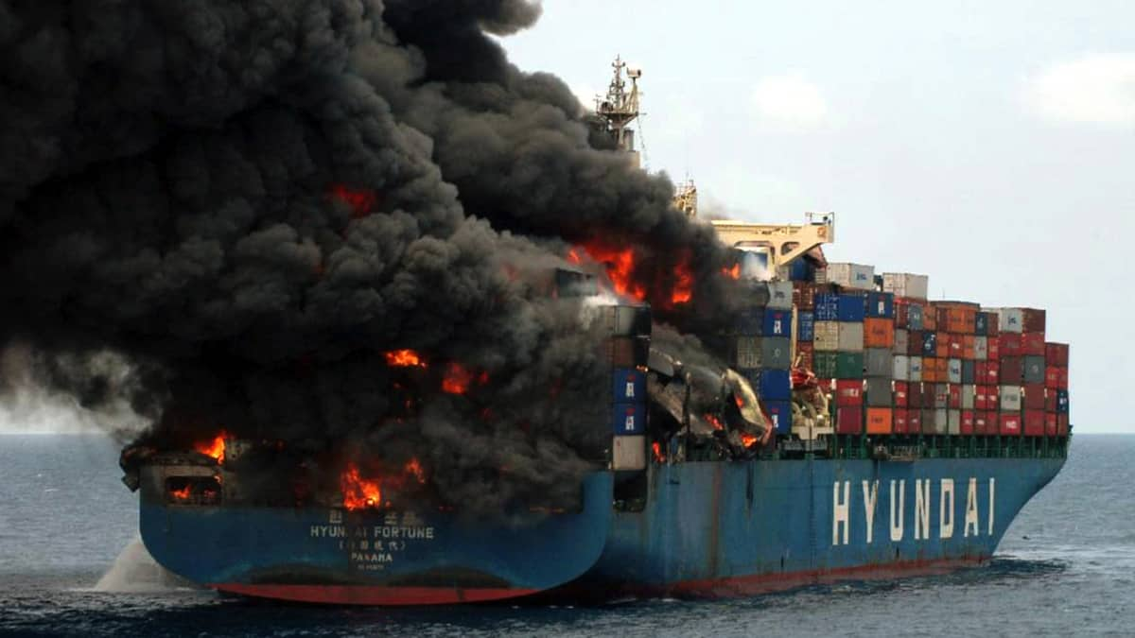
NY/NJ (KVK) Scenario
Background Scenario: Increased dwell time for containers
A combination of truck driver, chassis, and warehouse shortages has significantly increased terminal dwell time of containers in the NY/NJ area.
Initial Disruption: Container ship fire and blockage of the Kill van Kull
Ship carrying fireworks & industrial chemicals catches fire in the KVK; smoke from burning chemicals affects surrounding area. Escort tug loses connection; vessel runs aground. 4 days to extinguish fire and tow vessel to safety; 4 more days of daytime, one-way traffic on KVK.
Secondary Disruption: Malware impacts to terminal operating systems
Malware affects terminal OS at Port Newark-Elizabeth, affecting ability to track status, location, destination of containers, and further increases terminal dwell time issues resulting from background scenario. Other terminals take their systems offline for 24 hours to ensure that the malware has not affected them. Occasional rechecks slow down operations for another week.
We expect the combination of events would significantly challenge port activity and cargo movement.
What pre- and post- mitigation measures/resilience tactics short term or long term might reduce risk?
What economic or other factors could make mitigation/resilience measures more or less likely to succeed?
Notes:
Add summary of project

Slide 7
Port of NY/NJ Complex Disruption: Kill van Kull Blockage: Stakeholder Engagement
Detailed input for KVK disruption from USCG Sector NY and Port Authority of NY/NJ.
USCG plans an exercise on just such a blockage and we are invited.
Our report on this scenario and results of MCAT modeling to be shared with USCG Sector NY and Port Authority of NY/NJ and our input should help shape the exercise and the post-exercise planning.
Notes:
Add summary of project

Slide 8
West Coast Scenario
Background Scenario: Labor dispute
  Labor dispute at POLA/LB leads to cargo diversions, ocean shipping spot rates almost $9K/40ft container (vs. 5-yr average of ~$3,500), and a wait time as high as 26 days.
  Initial Disruption: Wildfires and power loss
  Wildfires damage transmission lines and substations servicing the port area leading to 3 days of blackouts/brownouts in the port area; 2 more days for full power to be restored.
  Secondary Disruption: Sustained security requirements
  Two days after power is restored, a bomb explodes in a container at POLA/LB, damaging cranes. Threats of further explosions lead to MARSEC 2 conditions for the port area for all West Coast ports for one week. Workers reluctant to work until safety is assured. Debris clearing takes 3 days, but replacing cranes much longer.
What are some mitigations/resilience tactics (short-term or long-term) you might think of for this scenario?
What are economic or other considerations that might make these feasible or infeasible?
Notes:
Add summary of project

Slide 9
West Coast Complex Disruption:
Stakeholder Engagement
Detailed discussion of West Coast disruption with Director of Security Services at Port of Long Beach
They are very concerned with exactly this scenario
USCG Sector Los Angeles-Long Beach plans exercise on sustained loss of electrical power; we are invited to participate
Our report on this scenario and results of MCAT modeling to be shared with POLA-POLB partners and USCG as input to their planning.
Notes:
Add summary of project

Slide 10
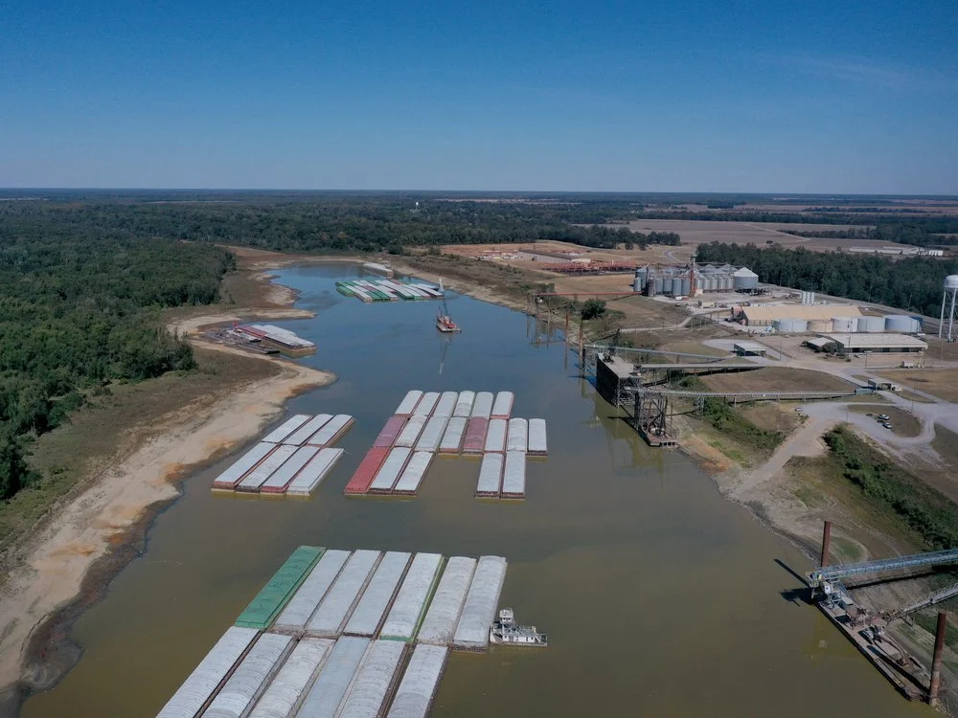
Fertilizer Disruption Scenario
Background Scenario:
Increasing demand worldwide for food as a result as a result of Ukraine War.
Ukraine had been world’s 6th largest producer of corn
Resulting shortages come on top of already higher demand for corn production in US as a result of biofuels initiative and use of corn for ethanol.
Resulting significant increase in demand for nitrogen fertilizer in U.S.
Primary Disruption:
Hot, dry summer disrupting Western Rivers, leaves river levels below their previous 2022 record by several feet, especially the lower Mississippi River from Memphis to New Orleans.
Barge trains are shorter, barge loads are lighter, there are delays in barge traffic.
Affects shipments of fertilizer imported through or produced near Port of New Orleans.
Secondary Disruption:
Version 1:
Low water in the summer makes it difficult for farmers to store the usual amounts of fertilizer in the Fall, pushing demand to the Spring.
Just before fertilizer is needed for Spring planting, one of the aging locks on the Mississippi suffers serious damage and has to be closed, affecting fertilizer transportation to places like Wisconsin, Minnesota, and South Dakota and causing local disruptions.

Slide 11
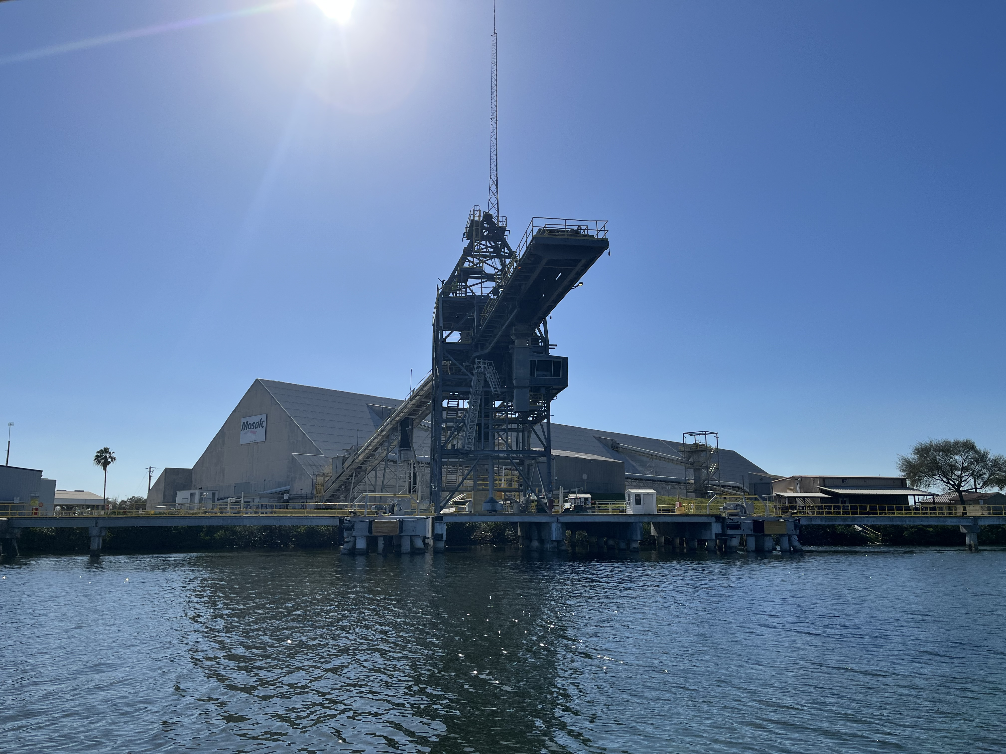
Fertilizer Disruption Scenario
Secondary Disruption:
Version 2:
Low water in the summer makes it difficult for farmers to store the usual amounts of fertilizer in the Fall, pushing demand to the Spring.
Instead of lock damage, a rail strike affects ability to move fertilizer from barges to final destinations.
Version 3:
Instead of lock damage, the highly volatile ammonia/nitrogen fertilizer being produced at a major plant in Oklahoma explodes, causing a 2-week shutdown. Resulting safety inspections at other domestic plants contribute to shortages.
Version 4
Instead of lock damage, data breach makes it difficult to get spot prices for barge transportation for several days.
Photo Credit: Andrew Tucci. Fertilizer terminal in Tampa

Slide 12
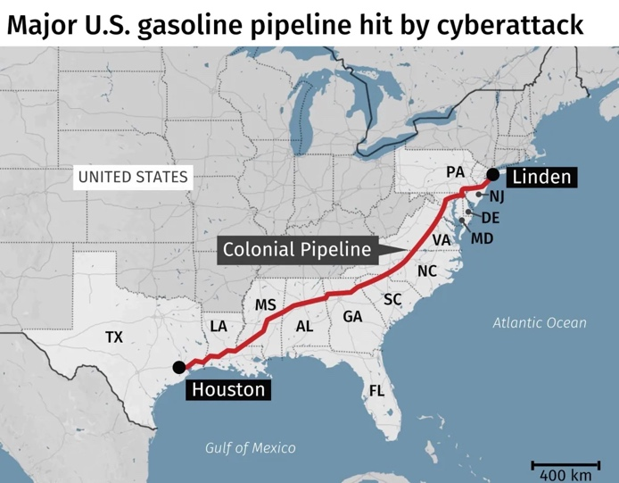
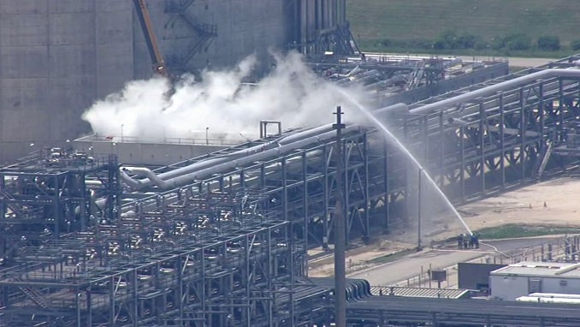
Energy Disruptions Scenarios
(based on actual events)
High energy prices due to Ukraine invasion, OPEC, emergence from pandemic
Colonial Pipeline Cyber Attack (May 2021)
Explosion at LNG Export facility (June 2022)
Loss of ~ 1 million bpd refining capacity in U.S., primarily due to individual business decisions (2021-2022)
Nord Stream LNG Pipeline attack (Sep 2022)
Estimate combined impact of these and plausible future disruptions.

Slide 13

Complex Future Disruptions
What are the risk factors that will be relevant in 5-10 years?
  EV fire risks on ships and in ports
  Climate Change
  Governance and Deceptive Shipping Practices
  Cyber, AI, autonomous vessels and facilities
  New fuel risks (firefighting, salvage, availability)
  More armed conflicts (Taiwan?)
How can we make this useful for future planning?
Image credit: Wikimedia Commons
Notes:
Add summary of project

Slide 14
Mitigations and Resilience Strategies
Notes:
Add summary of project

Slide 15
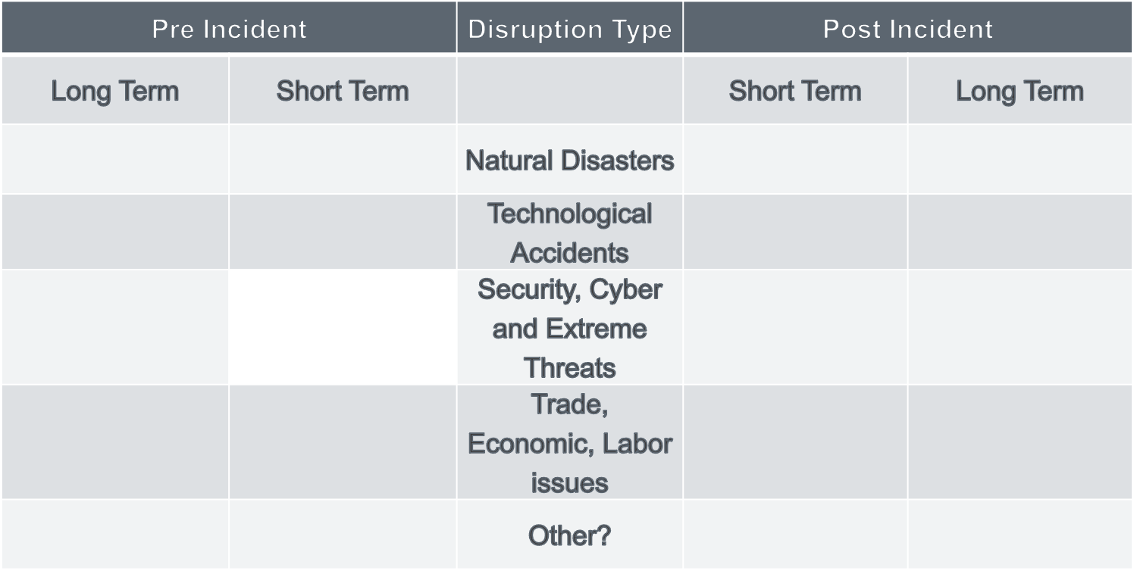
What are Possible Mitigation and Resilience Tactics?
Asking SMEs to help
Start with “simple” disruptions
Distinguish pre-disruption/post-disruption
Distinguish long term and short term
Emergency funding/hiring
Waterway survey/soundings
Regulatory relief
Better agency coordination
Ship rerouting/slow steaming
Coordination with shippers, cargo owners
Short term funding/grants
Multi-year funding/grants
Legal or regulatory constraints
Environmental Objectives
Competition
Technology challenges
Training and exercises
Infrastructure improvements
More warehouse capacity
Early ship rerouting
Specialized skills recruiting
Better port/vessel coordination
Regulatory changes
Economic incentives
Labor/Management contracts
Tax and insurance incentives
Notes:
Add summary of project

Slide 16
Impacts of the Ukraine War
Notes:
Add summary of project

Slide 17
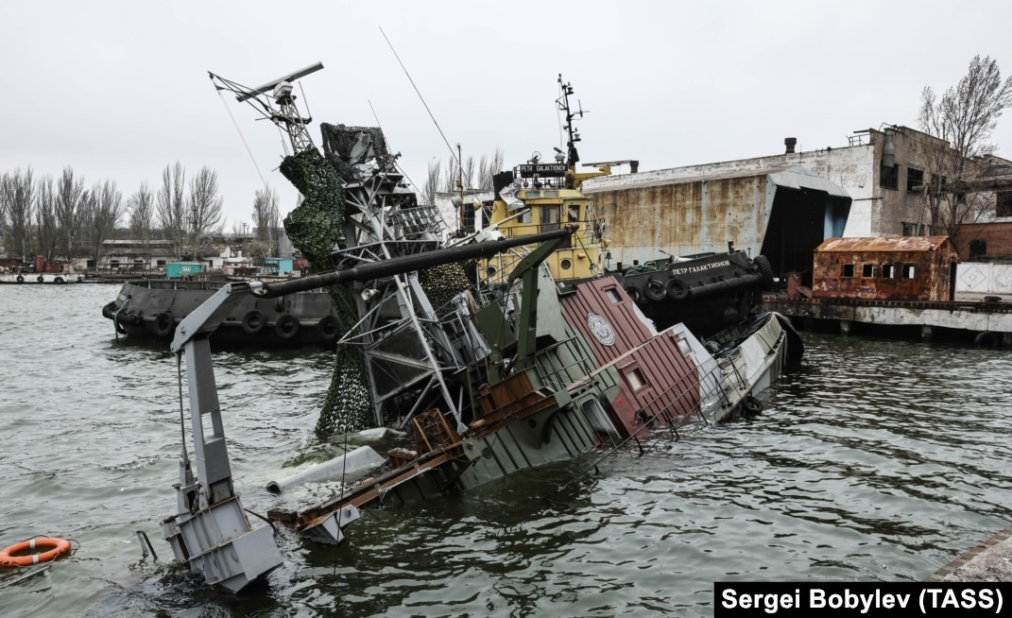
Ukraine War: Impacts to Maritime Supply Chains
We are preparing a report on the impacts of the Ukraine War on the MTS.
Attacks on seafarers, ships, ports, and maritime infrastructure
Food and energy
Economic sanctions
Other general impacts

Slide 18
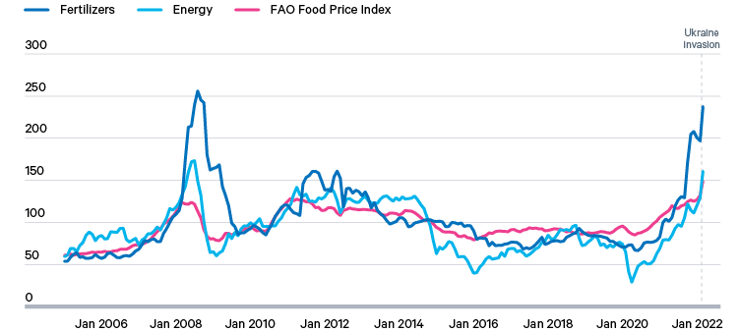
Ukraine War: Background Conditions
At the start of the war, energy, food, and fertilizers were all at or near record prices.
Source: World Bank Research & Outlook (2022), ‘Commodity Markets’, https://www.worldbank.org/en/research/commodity-markets

Slide 19
Ukraine War: Impacts to Seafarers, ships, ports, and maritime infrastructure
50,000 Ukrainian and Russia seafarers found themselves stranded at the start of the war.
Seafarers from various countries came under fire in the Black Sea region.
Russian attacks killed workers and damaged infrastructure in Mariupol, Odessa, and other port areas.
Russia employed “old technology” mines and sophisticated electronic/GPS interference to disrupt maritime commerce.
Damage to Nord Stream Pipelines and the Kerch Bridge.

Slide 20
Ukraine War: Impacts to Energy
EU was heavily dependent on Russian energy, including natural gas, crude oil, and refined products.
Crude oil imports prohibited in December 2022.
Refined product imports prohibited in February 2023.
Damage to Nord Stream Pipelines in September 2022.
EU is now buying LNG and crude oil from the U.S., built several new import facilities.
EU dominance in marine insurance and finance enabled the “Price Cap” system which allows Russian crude oil on the market at or below $60/bbl.
Russian exports have shifted to India and China, but at a reduced price.

Slide 21
Ukraine War: Impacts to Food
Pre-invasion, Russia and Ukraine supplied a large portion of the world’s food and fertilizer.
Russia targeted Ukrainian grain terminals and ports, and has allowed only a small portion of food to be exported via the UN brokered deal.
Ukraine has had only limited success exporting via rail.
  “An enduring global food crisis has become one of the farthest-reaching consequences of Russia’s war, contributing to widespread starvation, poverty and premature deaths.”
  New York Times, Jan 2, 2023.

Slide 22
Ukraine War: General Maritime Impacts
When the war broke out, various EU ports experienced short term but significant congestion as they struggled to meet the economic sanctions.
Many western maritime and energy companies pulled out of Russia voluntarily, or as a result of sanctions.
Increased use of “Deceptive Shipping Practices” by Russian affiliated ships as a way to avoid sanctions.
IMO, USCG, other agencies, and various maritime companies and organizations will continue to be involved in the conflict to manage sanctions and the energy and food trade deals.

Slide 23
The MCAT Economic Consequence Analysis Tool
Notes:
Add summary of project

Slide 24
The MCAT Economic Consequence Analysis Tool
We are working to transform the analysis into a user-friendly, decision-support tool for use by the Coast Guard and others to improve risk management.
The Tool (Complex Maritime Economic Consequence Analysis Tool – MCAT) is based on an Economic Consequence Analysis Tool (E-CAT) developed by our partner center CREATE to identify direct and indirect economic impacts of disruptive events.
  Uses an internationally linked computable general equilibrium (CGE) model consisting of over 100 countries with 65 sectors each.
  Extends the well-known Global Trade Analysis Project (GTAP) CGE model.
  This model will enable us to examine the international supply-chain linkages that affect economic impacts of complex disruptions and provide insight into how to minimize them.
Notes:
Add summary of project

Slide 25
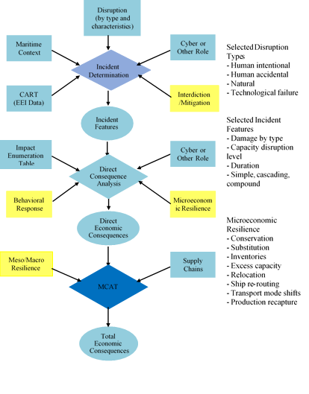
MCAT Modeling System
25

Slide 26
GTAP (Global Trade Analysis Project) Model: Primary Source of U.S. Trade Data
USA Trade Online (UTO) database
  Provided and maintained by U.S. Census Bureau
  Monthly data on value and weight of U.S. international imports and exports
  Data available from 2002 through September 2021
  Trade data at both district-level and port-level
  Uses both Harmonized System (HS) code and NAICS code
  High resolution of commodity types
  Also provides import and export data by state of destination and state origin of movement, respectively
26

Slide 27
MCAT Modeling/Economics Application: Economic Impacts of the Ukraine War
Tested out our preliminary ideas for the MCAT tool to study economic impacts of the Ukraine War on Grain and Metal Markets
Applied GTAP Computable General Equilibrium Modeling System
Results in terms of GDP impacts:
- Ukraine projected to lose $2.6 billion (2%) in first year of the War
- Russia projected to lose only $0.6 billion (0.3%) in first-year
- Losses to Ukraine much larger because of its greater trade dependency
- Other countries/regions to suffer losses: Rest of Asia, China, RFSU, Africa
- Countries/regions expected to gain: India, Latin America, NATO, Oceana, Japan
27

Slide 28
Real GDP Impacts of Export Reduction in Grains and Metal Commodities from the Ukraine-Russia War (in millions of 2014 U.S. dollars)
Scenario | Export Reduction from Russia |  |  | Export Reduction from Ukraine |  |  | Export Reduction from both Russia and Ukraine
Region | quantity change | percent change |  | quantity change | percent change |  | quantity change | percent change
USA | 0 | 0.0000 |  | 18 | 0.0001 |  | 16 | 0.0001
Rest of North America | 12 | 0.0009 |  | 1 | 0.0001 |  | 14 | 0.0010
China | -95 | -0.0009 |  | 32 | 0.0003 |  | -81 | -0.0008
Japan | 29 | 0.0006 |  | 61 | 0.0013 |  | 86 | 0.0019
India | 0 | 0.0000 |  | 213 | 0.0104 |  | 209 | 0.0102
Rest of Asia | -52 | -0.0010 |  | -487 | -0.0096 |  | -567 | -0.0111
Canada | -7 | -0.0004 |  | 17 | 0.0010 |  | 13 | 0.0007
Latin America | 57 | 0.0011 |  | 79 | 0.0015 |  | 140 | 0.0027
Oceania | 56 | 0.0033 |  | 63 | 0.0037 |  | 126 | 0.0074
NATO (except US, Canada) | -76 | -0.0004 |  | 236 | 0.0013 |  | 126 | 0.0007
Rest of Europe | 6 | 0.0002 |  | 54 | 0.0022 |  | 59 | 0.0024
Russia | -300 | -0.0148 |  | -261 | -0.0128 |  | -559 | -0.0275
RFSU | -19 | -0.0034 |  | -69 | -0.0129 |  | -87 | -0.0162
Ukraine | 16 | 0.0124 |  | -2602 | -1.9745 |  | -2596 | -1.9697
Mid-East | -16 | -0.0006 |  | -12 | -0.0004 |  | -31 | -0.0011
Africa | -7 | -0.0003 |  | -55 | -0.0022 |  | -67 | -0.0027
Rest of World | 0 | 0.0000 |  | 0 | 0.0000 |  | 0 | 0.0060
Total | -397 | -0.0005 |  | -2712 | -0.0035 |  | -3200 | -0.0041

Slide 29
A Selection of Preliminary Observations from Interviews
Changes in trade activity are a large driver of cascading impacts. This includes “just in time” inventory, which is shifting to “just in case” for many businesses. Capacity is a challenge, and a single, low-capacity link in a supply chain can make improvements in other areas irrelevant.
  Case in point: No way to get ports to operate 24/7 because we don’t have enough warehouse space.
  The shift to “just in case” may improve resilience, but only as long as businesses continue this practice.
  Capacity requirements change in a cyclical fashion, making it possible that increasing capacity (whether in chassis, ships, containers, warehouses, etc.) can overshoot the mark causing excess capacity in the next cycle.
Notes:
Add summary of project

Slide 30
A Selection of Preliminary Observations from Interviews
Better coordination between shippers, vessels, and port facility operators could improve port efficiency; technology provides promising information-sharing solutions.
  However, business confidentiality concerns are limiting progress in this area.
Port inefficiencies are the result of both policy and infrastructure factors; they also translate to reduced resilience.
Notes:
Add summary of project

Slide 31

A Selection of Preliminary Observations from Interviews
The combination of cyber and physical disruptions, particularly in critical areas (such as chokepoints), is a significant risk.
Sustained power outages are also a concern, particularly where automation and air quality requirements may limit the ability to return to manual operations at the desired throughput.
credit Commons.wikimedia commons Camerafiend at English Wikipedia no changes
Notes:
Add summary of project

Slide 32

A Selection of Preliminary Observations from Interviews
Security complacency may be an issue. For several years, the focus has been on COVID and its impacts, and on issues such as automation and electrification.
The ability of some ports and maritime stakeholders to conduct efficient MTS activity during a sustained security threat is uncertain. A security threat could therefore lead to greater than expected disruptions.
Image credit: Wikimedia Commons
Notes:
Add summary of project

Slide 33
A Selection of Preliminary Observations from Interviews
COVID forced a certain amount of remote work and automation as solutions; however, long-term viability of those strategies remains uncertain. And to what extent is it possible for many jobs in the MTS?
There has been tremendous innovation on specialized low and no-carbon marine fuels, but less attention on how to respond to a salvage or firefighting incident, or a lack of their availability at critical times.
Notes:
Add summary of project

Slide 34
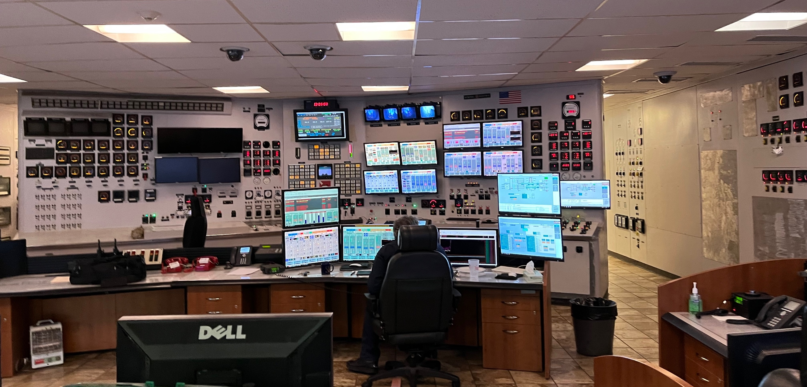
A Selection of Preliminary Observations from Interviews
With the increasingly complex technologies used in ports and vessels, highly trained labor becomes increasingly important. Competition for skilled labor is driving costs up.
Control room at a port facility showing the need for skilled operators (photo by Andrew Tucci)
Notes:
Add summary of project

Slide 35
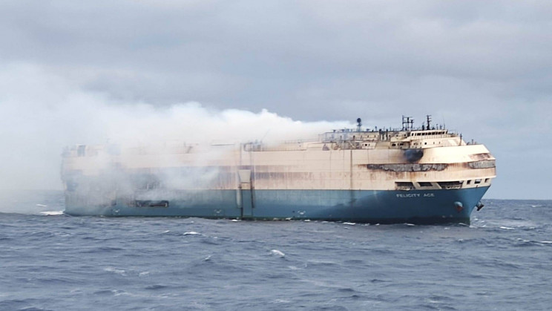
A Selection of Preliminary Observations from Interviews
Cyberattacks that compromise data integrity can have a significant impact on operations, even in systems where no direct, kinetic impact is possible. There is increasing concern that simply creating the perception of a data integrity problem could be sufficient to shut down operations or cause major disruptions.
Undeclared or improperly packaged hazardous
materials, including lithium-ion batteries, are
a growing concern and could lead to a fire or
other incident.
Image credit: Wikimedia Commons
Notes:
Add summary of project

Slide 36
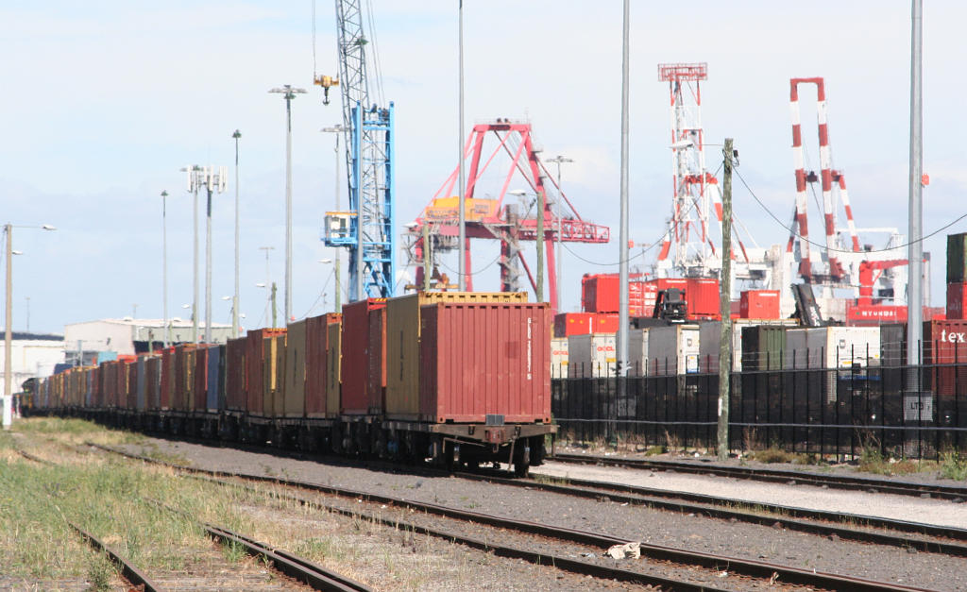
A Selection of Preliminary Observations from Interviews
Ports are affected by disruptions in surrounding regions (e.g., traffic delays, railroad strikes).
It is very inefficient to keep moving containers around a terminal. So, it’s important to coordinate container location with vessel arrivals.
Notes:
Add summary of project

Slide 37
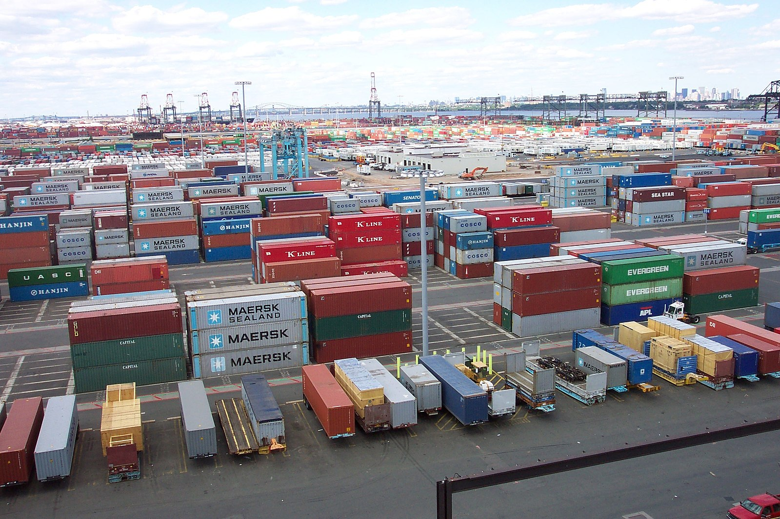
A Selection of Preliminary Observations from Interviews
The only way to expand terminal capacity in ports like New York is vertical, meaning higher stacks of containers.
But higher has its limits, is a poor use of space, and adds risks during wind events and routine handling.
Ports are at capacity!
Container terminal, Port of Elizabeth, credit: Wikimedia Commons, NOAA
Notes:
Add summary of project

Slide 38
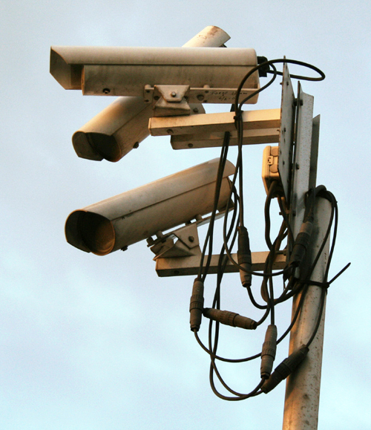
A Selection of Preliminary Observations from Interviews
While there is legitimate concern about cyber attacks on critical infrastructure, more sophisticated attacks could be multi-modal, including some combination of a cyber and physical attack. The cyber attack may not be an end in itself; just aimed to make the physical attack more successful. Or vice versa
Simple MTS example: hacking into security cameras at a port increases vulnerability to a physical intrusion
Or: Introduce malware into navigation, cargo, ballast, or engine management systems of a vessel, leaving it especially vulnerable to physical attacks
CCICADA plans a new project on integrated cyber and physical attacks on critical infrastructure, including the MTS, railroads, power systems, and sports and entertainment facilities
Credit:commons.wikimedia.org
38

Slide 39
For More Information:
Fred Roberts, CCICADA
  froberts@dimacs.rutgers.edu
  908-803-7851
Notes:
Add summary of project

