Slide 1
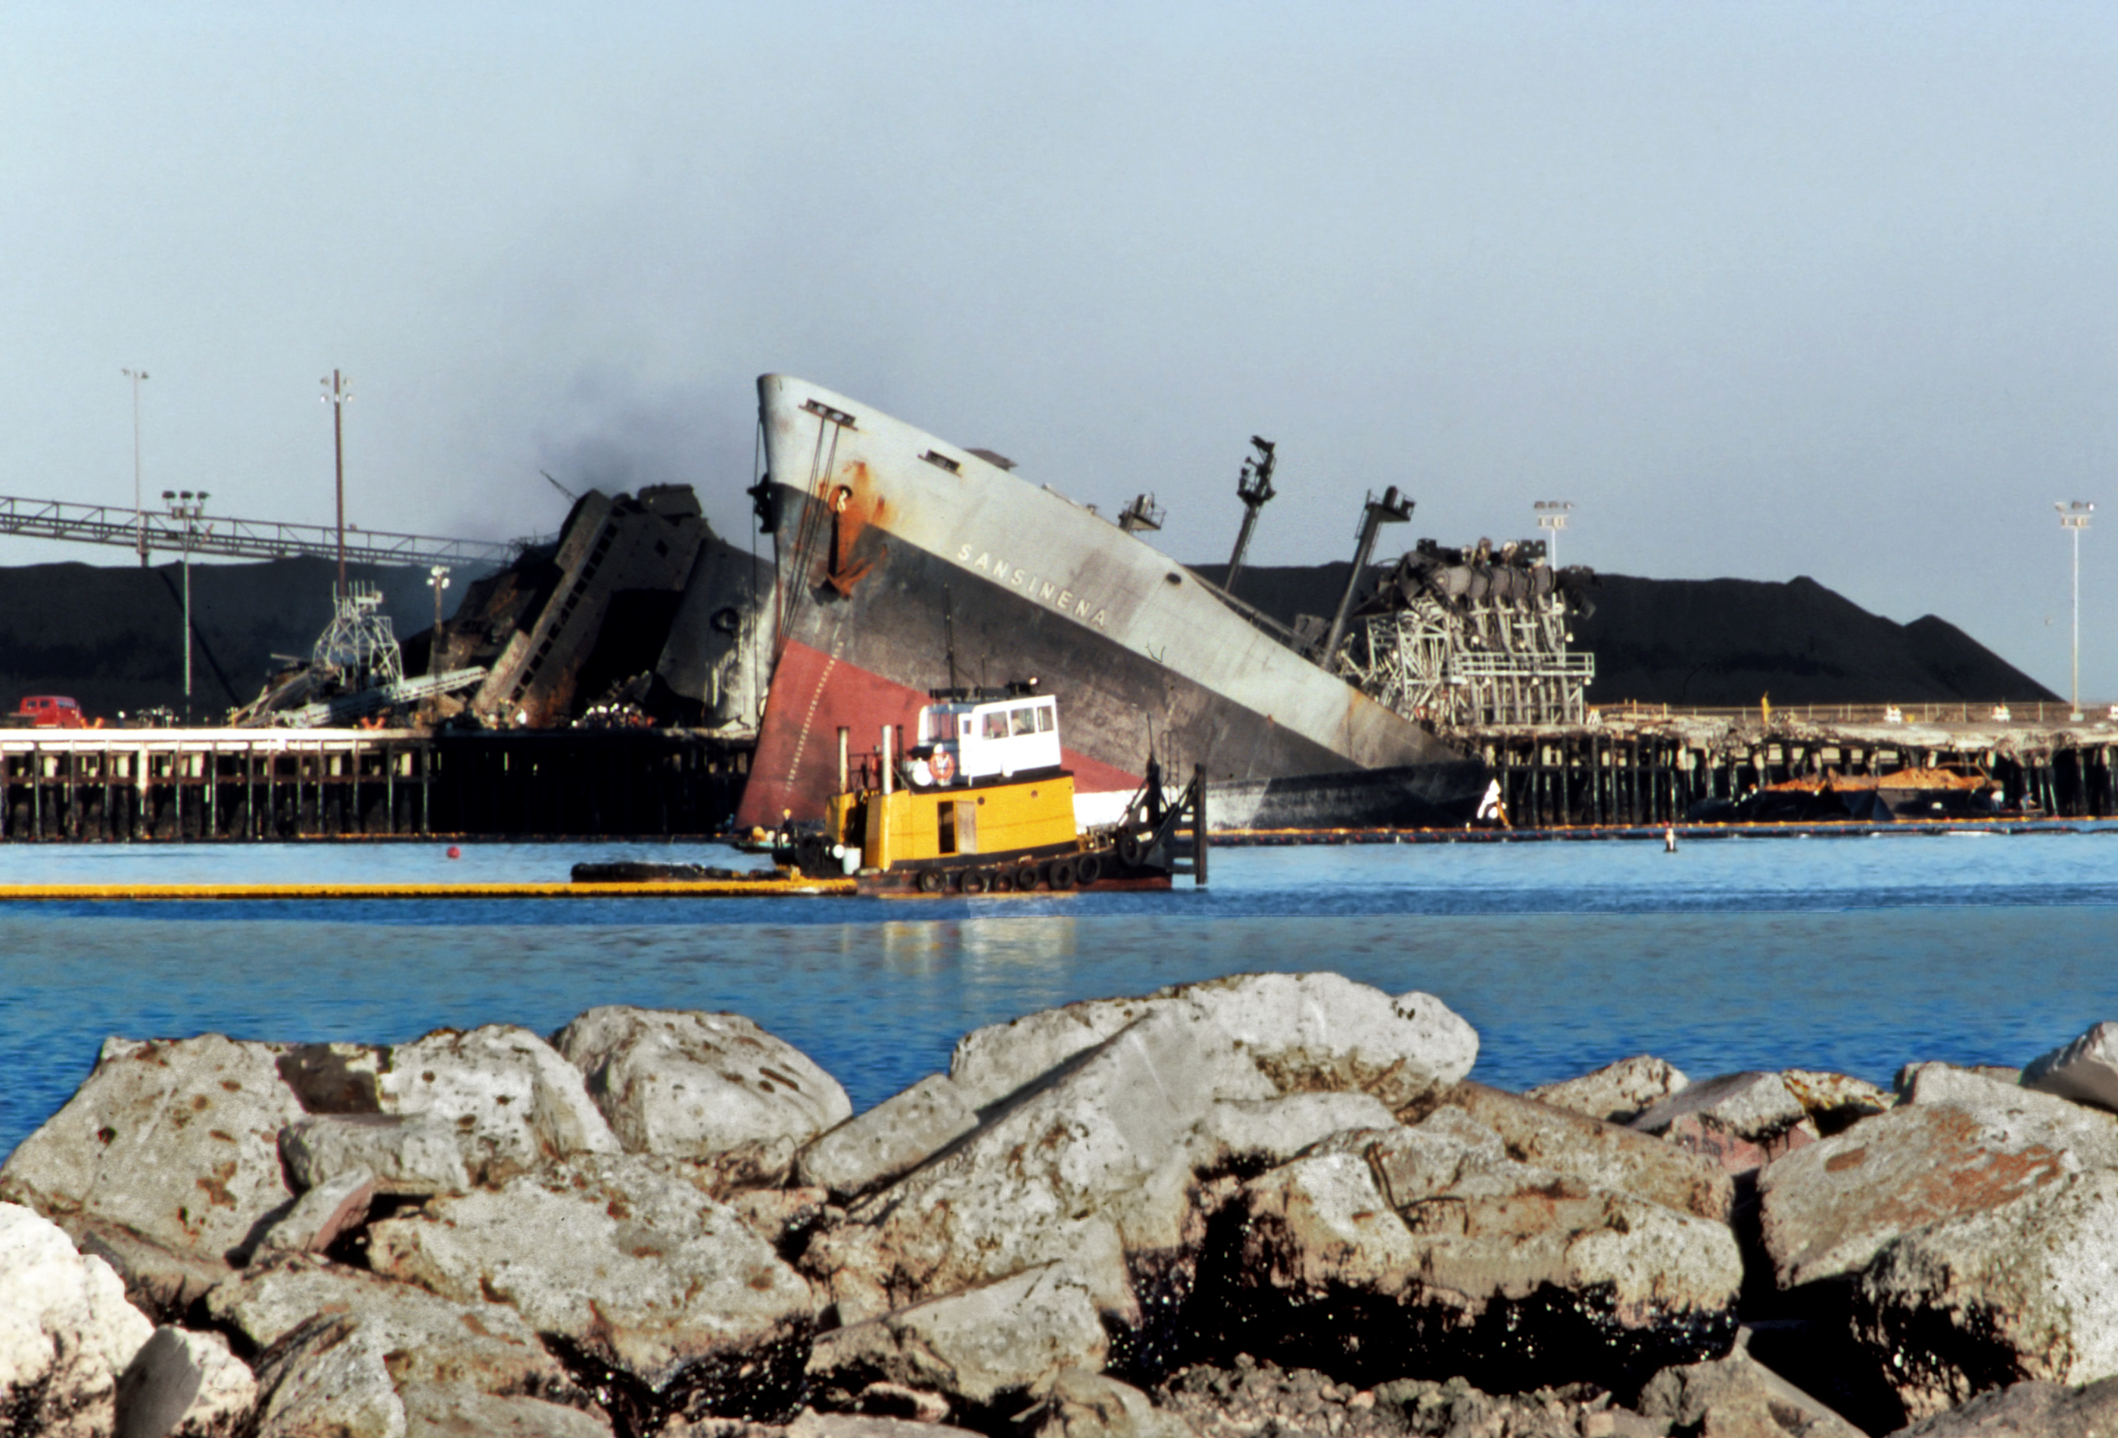
Modeling the Impact of Complex, Multi-Vector Disruptions to the Marine Transportation System (MCAT)
Fred Roberts (Rutgers University)
Dennis Egan (Rutgers University)
March 10, 2023
SS Sansinena Explosion, Port of LA
Photo credit: Wikimedia commons
Notes:
Add summary of project

Slide 2
Project Overview
Project is a partnership among three DHS university centers of excellence:
  CAOE: Center for Accelerating Operational Efficiency, led by Arizona State University
  CCICADA: Command, Control, and Interoperability Center for Advanced Data Analysis, led by Rutgers University (Fred Roberts, Director, Dennis Egan, Assistant Director)
  CREATE: Center for Risk and Economic Analysis of Threats and Emergencies, led by University of Southern California
Notes:
Add summary of project

Slide 3
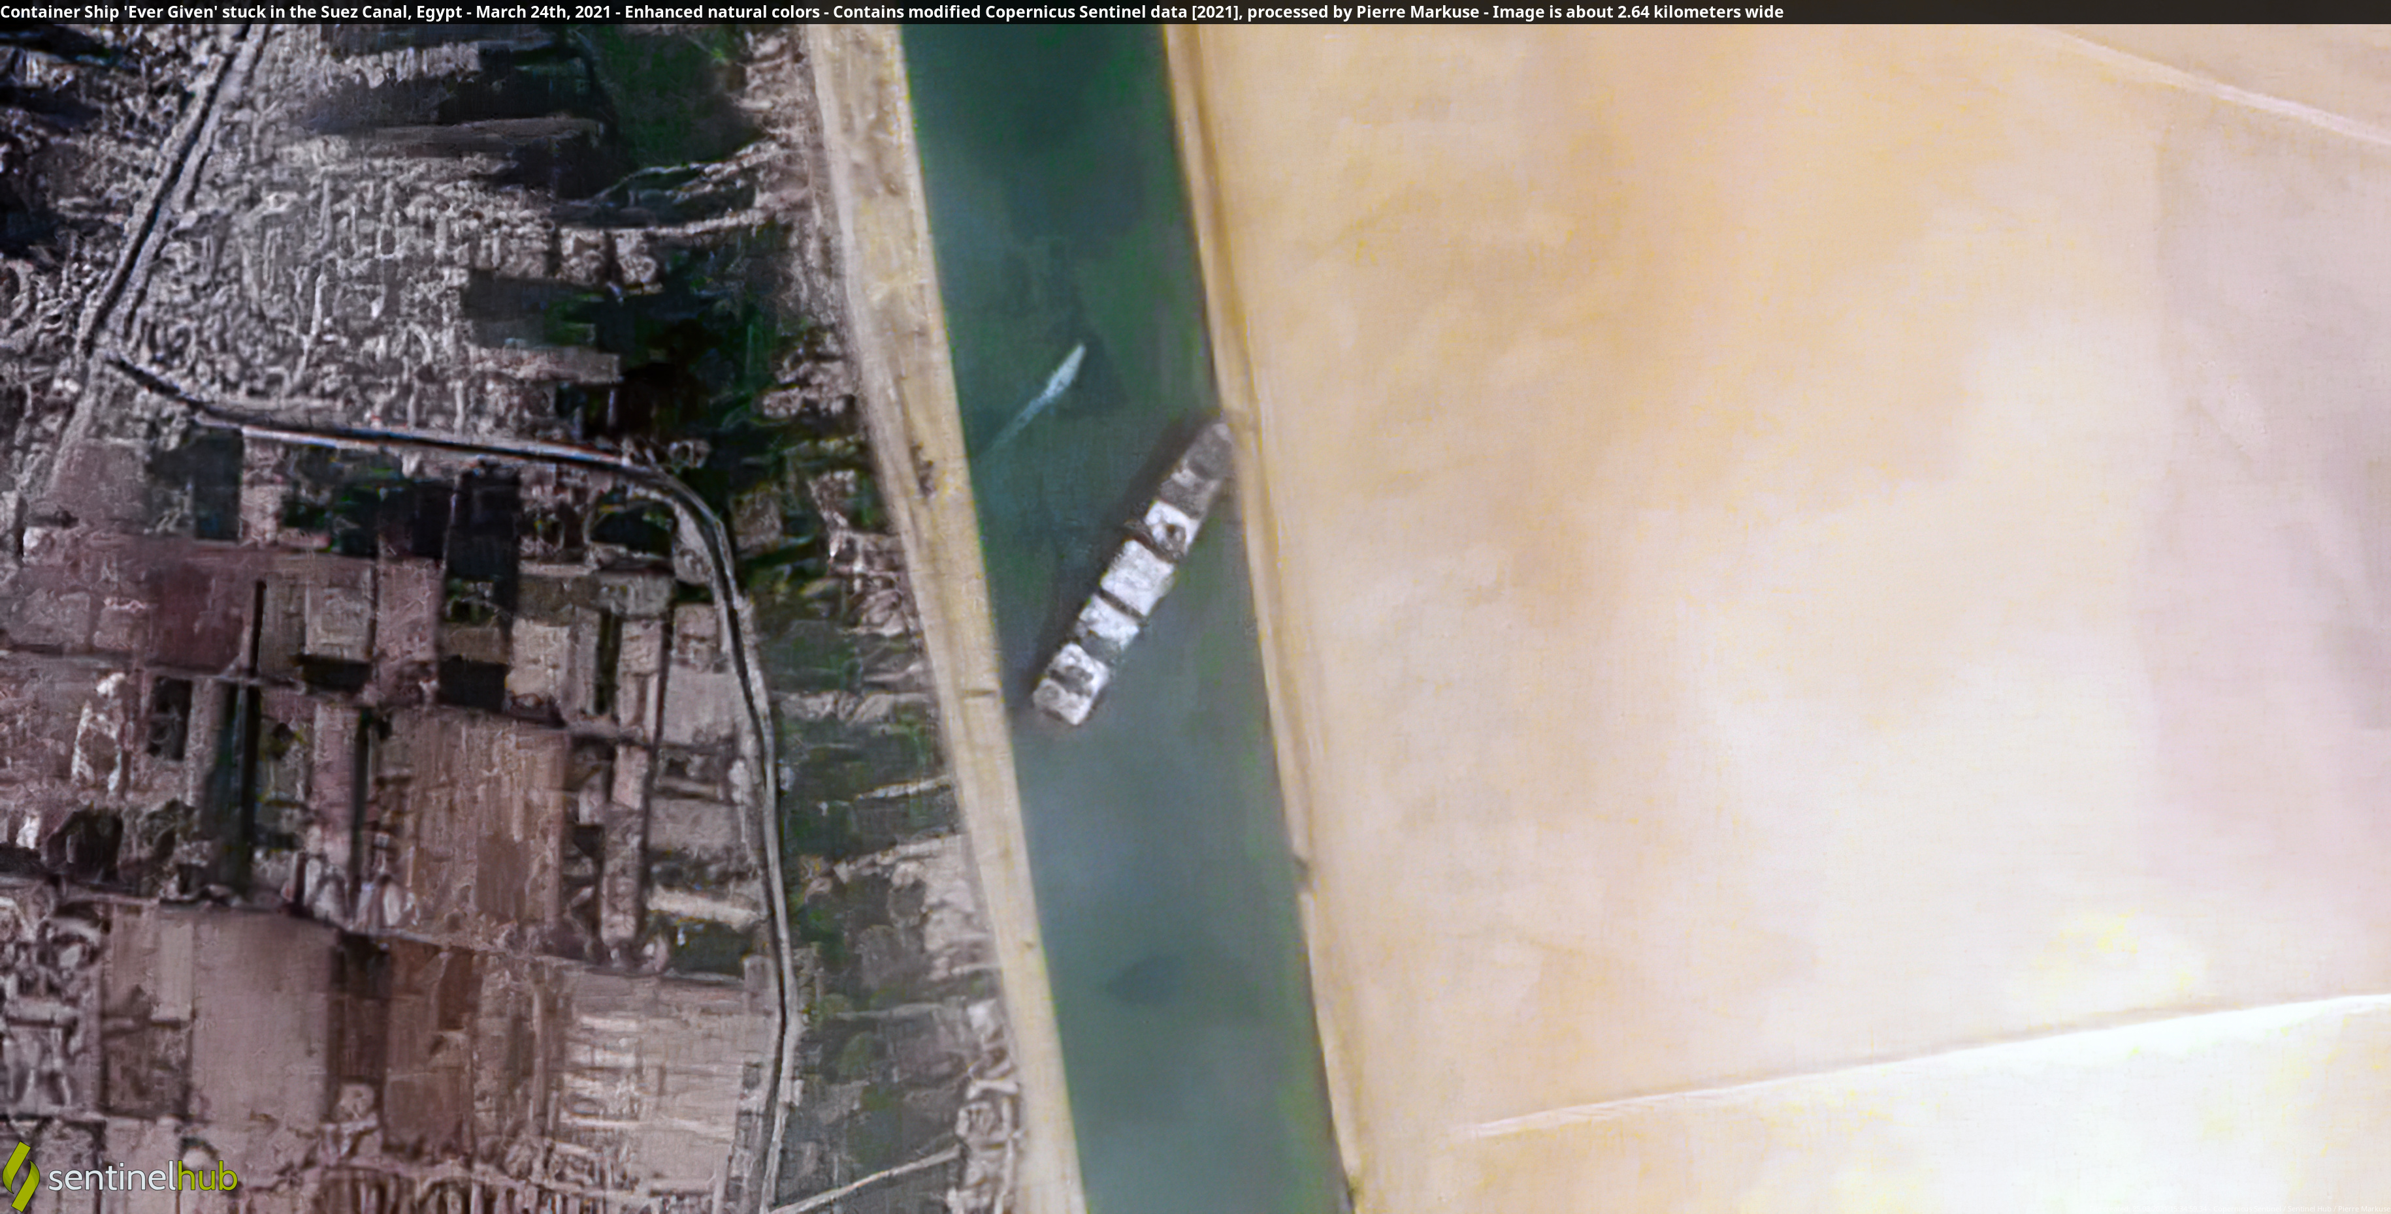
Project Overview
While the MTS is resilient, multiple disruptions can have unexpected impacts.
We know little about how these disruptions interact and how they impact downstream businesses dependent on a smooth functioning MTS.
Modeling multiple vector disruptions and identifying potential countermeasures can help policy makers, business leaders, and others anticipate, plan for, mitigate, recover from them.
We are identifying plausible complex disruptions, possible countermeasures, and developing a decision-support tool called MCAT for use by the Coast Guard and others to improve risk management.
The Ever Given wedged in the Suez Canal, blocking traffic in both directions. Credit: Contains modified Copernicus Sentinel data 2021, CC BY 2.0, via Wikimedia Commons
Complex disruption: COVID + ship blocking Suez Canal
Notes:
Add summary of project

Slide 4
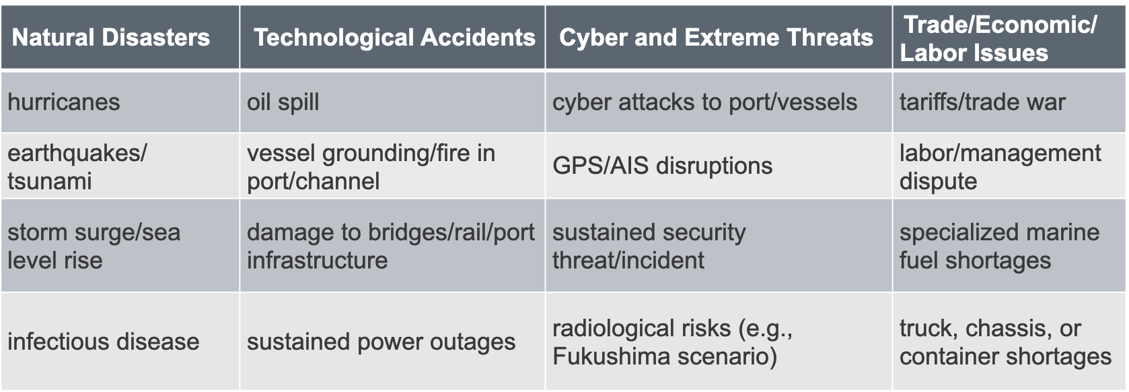
“Simple” Disruptions
(not comprehensive)
When “simple” disruptions occur together, along a common supply chain, they become “complex” and may have surprising consequences or require novel mitigation approaches.

Slide 5
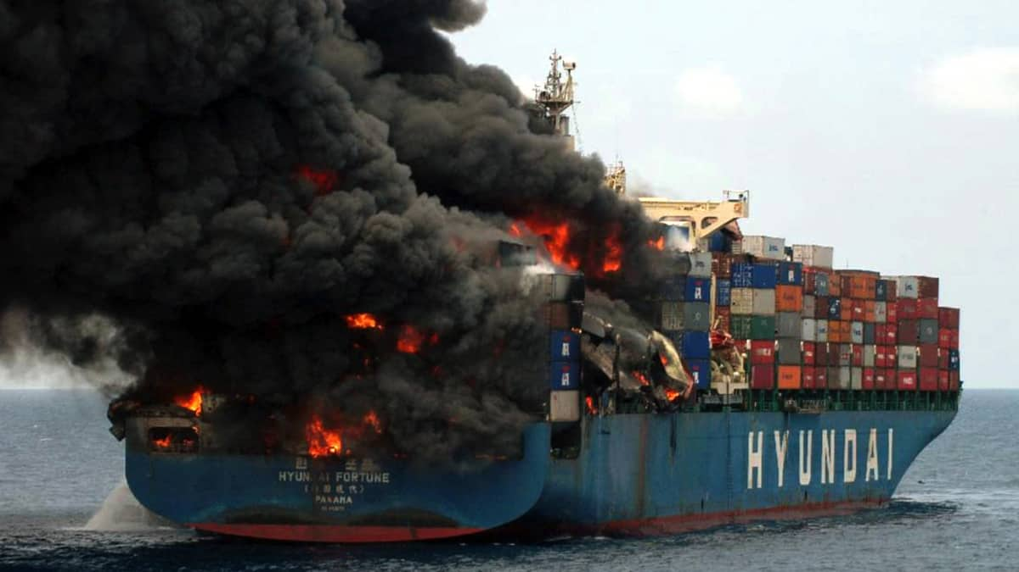
NY/NJ (KVK) Scenario
Background Scenario: Increased dwell time for containers
A combination of truck driver, chassis, and warehouse shortages has significantly increased terminal dwell time of containers in the NY/NJ area.
Initial Disruption: Container ship fire and blockage of the Kill van Kull
Ship carrying fireworks & industrial chemicals catches fire in the KVK; smoke from burning chemicals affects surrounding area. Escort tug loses connection; vessel runs aground. 4 days to extinguish fire and tow vessel to safety; 4 more days of daytime, one-way traffic on KVK.
Secondary Disruption: Malware impacts to terminal operating systems
Malware affects terminal OS at Port Newark-Elizabeth, affecting ability to track status, location, destination of containers, and further increases terminal dwell time issues resulting from background scenario. Other terminals take their systems offline for 24 hours to ensure that the malware has not affected them. Occasional rechecks slow down operations for another week.
Coast Guard and Port Authority of NY/NJ are concerned about a similar scenario.
We expect the combination of events would significantly challenge port activity and cargo movement.
What pre- and post- mitigation measures/resilience tactics short term or long term might reduce risk?
Notes:
Add summary of project

Slide 6
Complex Disruption Example: West Coast Scenario
Background Scenario: Labor dispute
  Labor dispute at POLA/LB leads to cargo diversions, increasing shipping spot rates and a wait time as high as 26 days.
  Initial Disruption: Wildfires and power loss
  Wildfires damage transmission lines and substations servicing the port area leading to 3 days of blackouts/brownouts in the port area; 2 more days for full power to be restored.
  Secondary Disruption: Sustained security requirements
  Two days after power is restored, a bomb explodes in a container at POLA/LB, damaging cranes. Threats of further explosions lead to MARSEC 2 conditions for the port area for 10 days, and security advisories for all West Coast ports for one week. Workers reluctant to work until safety is assured. Evidence collection and debris clearing takes 3 days, but replacing cranes much longer.
What are the economic and supply chain impacts of this scenario, including down-stream businesses?
Beyond emergency management activity, what mitigation measures/resilience tactics might improve resilience for this scenario?
Coast Guard and Port Officials identified this as a high-risk scenario
Notes:
Add summary of project

Slide 7
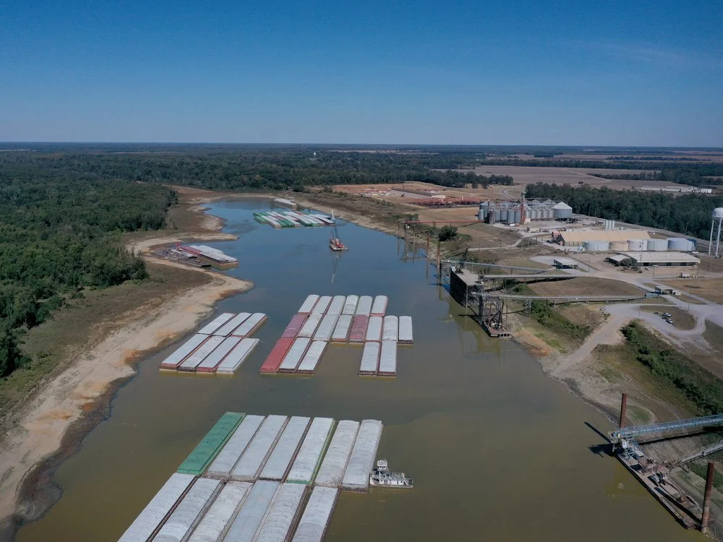
Food and Fertilizer Disruptions
Background Scenario:
Increasing demand worldwide for food as a result of Ukraine War.
Already high demand for corn and fertilizer due to ethanol and other needs.
Primary Disruption:
Hot, dry summer disrupting Western Rivers, leaves river levels below their 2022 record
by several feet, especially the lower Mississippi River from Memphis to New Orleans.
Barge trains are shorter, barge loads are lighter.
Affects shipments of fertilizer on the rivers.
Secondary Disruption:
Lock and dam failure just before fertilizer is needed for
Spring planting
Alternative: fertilizer production facility accident.

Slide 8

Complex Future Disruptions
What are the risk factors that will be relevant in 5-10 years?
  EV fire risks on ships and in ports
  Climate Change
  Governance and Deceptive Shipping Practices
  Cyber, AI, autonomous vessels and facilities
  New fuel risks (firefighting, salvage, availability)
How can we make this project useful for future planning?
Image credit: Wikimedia Commons
Notes:
Add summary of project

Slide 9
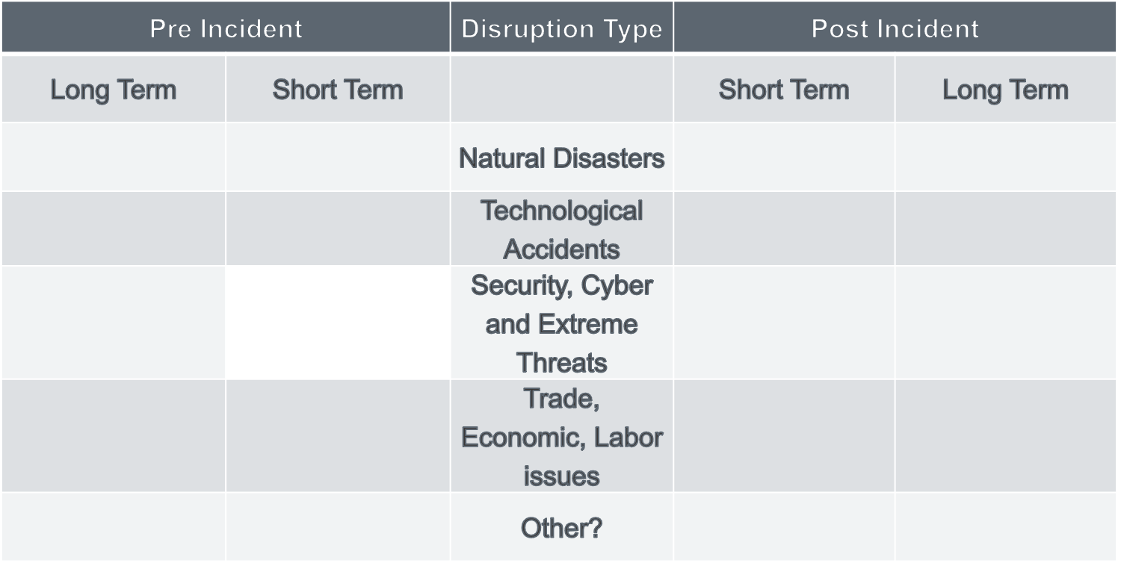
What are Possible Mitigation and Resilience Tactics?
Asking SMEs to help
Start with “simple” disruptions
Distinguish pre-disruption/post-disruption
Distinguish long term and short term
Emergency funding/hiring
Waterway survey/soundings
Regulatory relief
Better agency coordination
Ship rerouting/slow steaming
Coordination with shippers, cargo owners
Short term funding/grants
Multi-year funding/grants
Legal or regulatory constraints
Environmental Objectives
Competition
Technology challenges
Training and exercises
Infrastructure improvements
More warehouse capacity
Early ship rerouting
Specialized skills recruiting
Better port/vessel coordination
Regulatory changes
Economic incentives
Labor/Management contracts
Tax and insurance incentives
The challenge: Comparing mitigation and resilience tactics as to their ability to minimize impact of a complex disruption
Notes:
Add summary of project

Slide 10
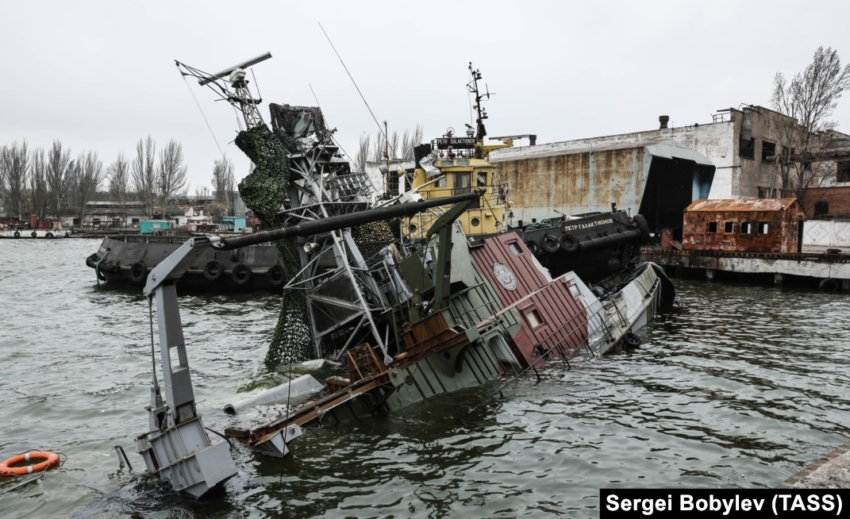
Ukraine War: Impacts to Maritime Supply Chains
We are preparing a report on the impacts of the Ukraine War on the MTS.
Attacks on seafarers, ships, ports, and maritime infrastructure
Food and energy
Economic sanctions
Deceptive shipping practices
Example: Food:
Russia and Ukraine produce much of the world’s food and fertilizer.
Russia targeted port facilities in Ukraine.
Ukraine struggled to export grain via rail.
Russia is allowing only limited Ukrainian exports via the UN brokered grain deal.
“An enduring global food crisis has become one of the farthest-reaching consequences of Russia’s war, contributing to widespread starvation, poverty and premature deaths.”
  New York Times, Jan 2, 2023.

Slide 11
Ukraine War: General Maritime Impacts
When the war broke out, various EU ports experienced short term but significant congestion as they struggled to meet the economic sanctions.
Many western maritime and energy companies pulled out of Russia voluntarily, or as a result of sanctions.
Increased use of “Deceptive Shipping Practices” by Russian affiliated ships as a way to avoid sanctions.
IMO, USCG, other agencies, and various maritime companies and organizations will continue to be involved in the conflict to manage sanctions and the energy and food trade deals.
A conflict in Asia would have a much greater impact on the world economy, U.S. trade, and West Coast ports

Slide 12
The MCAT Economic Consequence Analysis Tool
We are working to transform the analysis into a user-friendly, decision-support tool for use by the Coast Guard and others to improve risk management.
The Tool (Complex Maritime Economic Consequence Analysis Tool – MCAT) is based on an Economic Consequence Analysis Tool (E-CAT) developed by our partner center CREATE to identify direct and indirect economic impacts of disruptive events.
  Uses an internationally linked computable general equilibrium (CGE) model consisting of over 100 countries with 65 sectors each.
  Extends the well-known Global Trade Analysis Project (GTAP) CGE model.
  Will help determine economic impacts of complex disruptions and provide insight into how to minimize them.
Notes:
Add summary of project

Slide 13
MCAT Modeling/Economics Application: Economic Impacts of the Ukraine War
Tested out our preliminary ideas for the MCAT tool to study economic impacts of the Ukraine War on Grain and Metal Markets
Applied GTAP Computable General Equilibrium Modeling System
Results in terms of GDP impacts:
- Ukraine projected to lose $2.6 billion (2%) in first year of the War
- Russia projected to lose only $0.6 billion (0.3%) in first-year
- Losses to Ukraine much larger because of its greater trade dependency
- Other countries/regions to suffer losses: Rest of Asia, China, RFSU, Africa
- Countries/regions expected to gain: India, Latin America, NATO, Oceana, Japan
13

Slide 14

A Selection of Preliminary Observations from Interviews
The combination of cyber and physical disruptions, particularly in critical areas (such as chokepoints), is a significant risk.
Sustained power outages are also a concern, particularly where automation and air quality requirements may limit the ability to return to manual operations at the desired throughput.
credit Commons.wikimedia commons Camerafiend at English Wikipedia no changes
Notes:
Add summary of project

Slide 15

A Selection of Preliminary Observations from Interviews
Security complacency may be an issue. For several years, the focus has been on COVID and its impacts, and on issues such as automation and electrification.
The ability of some ports and maritime stakeholders to conduct efficient MTS activity during a sustained security threat is uncertain. A security threat could therefore lead to greater than expected disruptions.
Image credit: Wikimedia Commons
Notes:
Add summary of project

Slide 16
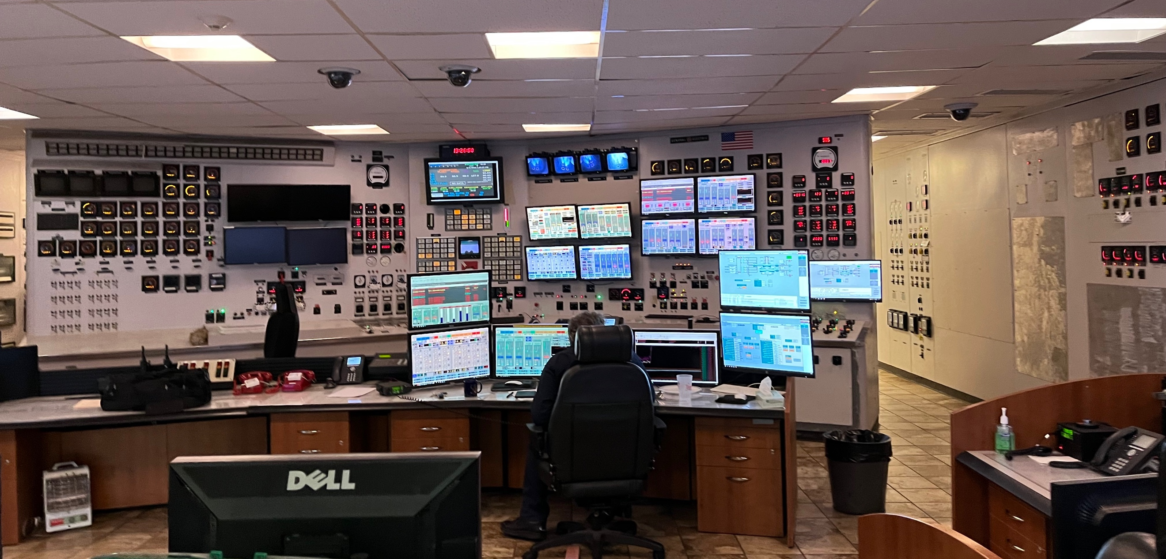
A Selection of Preliminary Observations from Interviews
With the increasingly complex technologies used in ports and vessels, highly trained labor becomes increasingly important. Competition for skilled labor is driving costs up.
There has been tremendous innovation on specialized low and no-carbon marine fuels, but less attention on how to respond to a salvage or firefighting incident, or a lack of their availability at critical times.
Control room at a port facility showing the need for skilled operators (photo by Andrew Tucci)
Notes:
Add summary of project

Slide 17
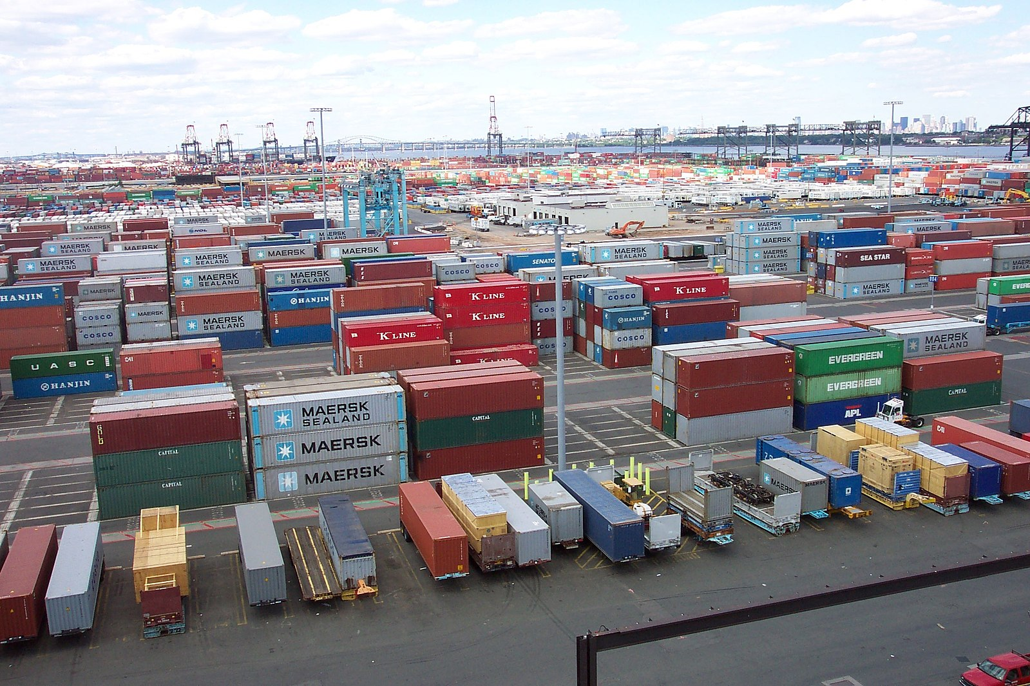
A Selection of Preliminary Observations from Interviews
The only way to expand terminal capacity in ports like New York is vertical, meaning higher stacks of containers.
  But higher has its limits, is a poor use of space, and adds risks during wind events and routine handling.
Better coordination between shippers, vessels, and port facility operators could improve port efficiency; technology provides promising information-sharing solutions.
  However, business confidentiality concerns are limiting progress in this area.
Container terminal, Port of Elizabeth, credit: Wikimedia Commons, NOAA
Notes:
Add summary of project

Slide 18
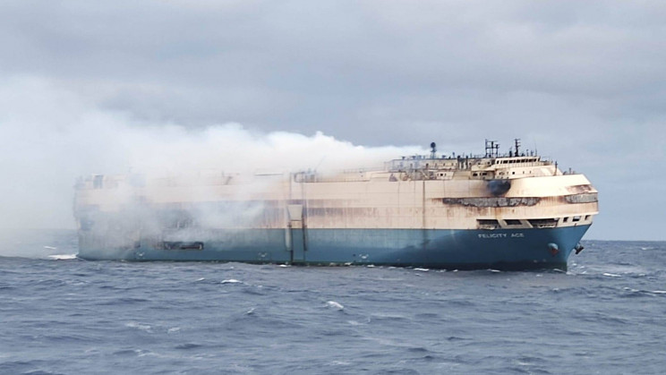
A Selection of Preliminary Observations from Interviews
Cyberattacks that compromise data integrity can have a significant impact on operations, even in systems where no direct, kinetic impact is possible. There is increasing concern that simply creating the perception of a data integrity problem could be sufficient to shut down operations or cause major disruptions.
Undeclared or improperly packaged hazardous
materials, including lithium-ion batteries, are
a growing concern and could lead to a fire or
other incident.
Image credit: Wikimedia Commons
Notes:
Add summary of project

Slide 19
For More Information:
Fred Roberts, CCICADA
  froberts@dimacs.rutgers.edu
  908-803-7851
Notes:
Add summary of project

