Slide 1
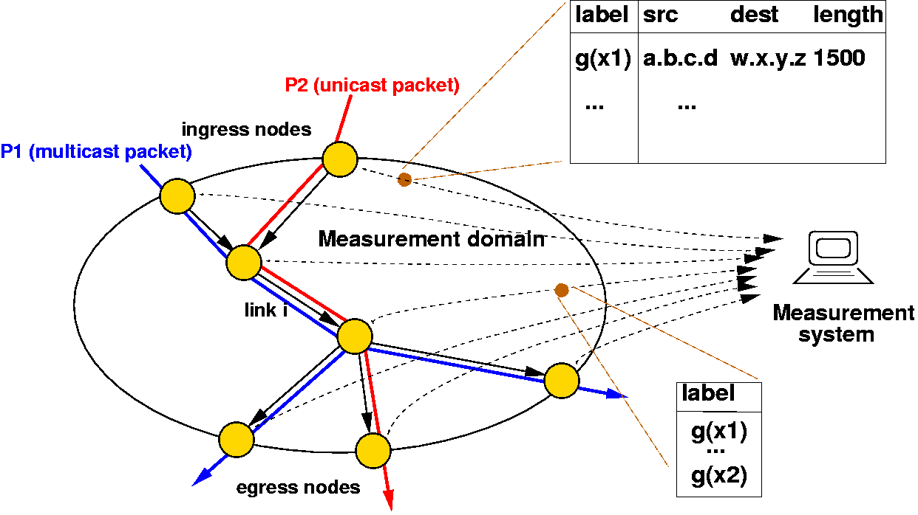
Sampling for Big Data
x₁₀
x’₁₀
x₉
x’₉
∅
x₈
x’₈
x₇
x’₆
0
1
x₆
x’₅
x₅
x’₄
x₄
x’₃
00
01
10
11
x₃
x’₂
x₂
000
001
010
011
100
101
110
111
x₁
x’₁
Graham Cormode, University of Warwick
G.Cormode@warwick.ac.uk
Nick Duffield, Texas A&M University
Nick.Duffield@gmail.com

Slide 2

Big Data
“Big” data arises in many forms:
  Physical Measurements: from science (physics, astronomy)
  Medical data: genetic sequences, detailed time series
  Activity data: GPS location, social network activity
  Business data: customer behavior tracking at fine detail
Common themes:
  Data is large, and growing
  There are important patterns
  and trends in the data
  We don’t fully know where to look
  or how to find them

Slide 3

Why Reduce?
Although “big” data is about more than just the volume…
…most big data is big!
It is not always possible to store the data in full
  Many applications (telecoms, ISPs, search engines) can’t keep everything
It is inconvenient to work with data in full
  Just because we can, doesn’t mean we should
It is faster to work with a compact summary
  Better to explore data on a laptop than a cluster

Slide 4
Why Sample?
Sampling has an intuitive semantics
  We obtain a smaller data set with the same structure
Estimating on a sample is often straightforward
  Run the analysis on the sample that you would on the full data
  Some rescaling/reweighting may be necessary
Sampling is general and agnostic to the analysis to be done
  Other summary methods only work for certain computations
  Though sampling can be tuned to optimize some criteria
Sampling is (usually) easy to understand
  So prevalent that we have an intuition about sampling

Slide 5
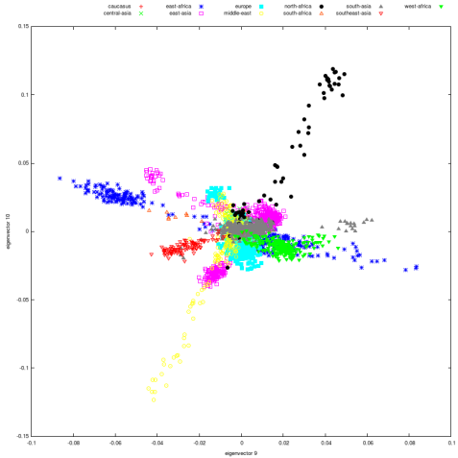
Alternatives to Sampling
Sampling is not the only game in town
  Many other data reduction techniques by many names
Dimensionality reduction methods
  PCA, SVD, eigenvalue/eigenvector decompositions
  Costly and slow to perform on big data
“Sketching” techniques for streams of data
  Hash based summaries via random projections
  Complex to understand and limited in function
Other transform/dictionary based summarization methods
  Wavelets, Fourier Transform, DCT, Histograms
  Not incrementally updatable, high overhead
All worthy of study – in other tutorials

Slide 6
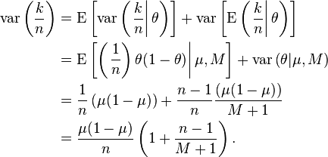
Health Warning: contains probabilities
Will avoid detailed probability calculations, aim to give high level descriptions and intuition
But some probability basics are assumed
  Concepts of probability, expectation, variance of random variables
  Allude to concentration of measure (Exponential/Chernoff bounds)
Feel free to ask questions about technical details along the way

Slide 7
Outline
Motivating application: sampling in large ISP networks
Basics of sampling: concepts and estimation
Stream sampling: uniform and weighted case
  Variations: Concise sampling, sample and hold, sketch guided
  BREAK
Advanced stream sampling: sampling as cost optimization
  VarOpt, priority, structure aware, and stable sampling
Hashing and coordination
  Bottom-k, consistent sampling and sketch-based sampling
Graph sampling
  Node, edge and subgraph sampling
Conclusion and future directions

Slide 8
Sampling as a Mediator of Constraints
Data Characteristics
(Heavy Tails, Correlations)
Sampling
Resource Constraints
(Bandwidth, Storage, CPU)
Query Requirements
(Ad Hoc, Accuracy, Aggregates, Speed)

Slide 9

Motivating Application: ISP Data
Will motivate many results with application to ISPs
Many reasons to use such examples:
  Expertise: tutors from telecoms world
  Demand: many sampling methods developed in response to ISP needs
  Practice: sampling widely used in ISP monitoring, built into routers
  Prescience: ISPs were first to hit many “big data” problems
  Variety: many different places where sampling is needed
First, a crash-course on ISP networks…

Slide 10
Structure of Large ISP Networks
Peering with other ISPs
City-level
Router Centers
Access Networks:
Wireless, DSL, IPTV
Backbone Links
Downstream ISP and
business customers
Network Management & Administration
Service and Datacenters

Slide 11
Measuring the ISP Network: Data Sources
Status Reports:
Device failures and transitions
Peering
Protocol Monitoring:
Routers, Wireless
Router Centers
Access
Backbone
Loss & Latency
Roundtrip to edge
Loss & Latency
Active probing
Link Traffic Rates
Aggregated per router interface
Business
Traffic Matrices
Flow records from routers
Customer Care Logs
Reactive indicators of
network performance
Management
Datacenters

Slide 12
Why Summarize (ISP) Big Data?
When transmission bandwidth for measurements is limited
  Not such a big issue in ISPs with in-band collection
Typically raw accumulation is not feasible (even for nation states)
  High rate streaming data
  Maintain historical summaries for baselining, time series analysis
To facilitate fast queries
  When infeasible to run exploratory queries over full data
As part of hierarchical query infrastructure:
  Maintain full data over limited duration window
  Drill down into full data through one or more layers of summarization
Sampling has been proved to be a flexible method to accomplish this

Slide 13
Data Scale:
Summarization and Sampling

Slide 14
Traffic Measurement in the ISP Network
Router Centers
Access
Backbone
Business
Traffic Matrices
Flow records from routers
Management
Datacenters

Slide 15
Massive Dataset: Flow Records
time
flow 1
flow 2
flow 3
flow 4
IP Flow: set of packets with common key observed close in time
Flow Key: IP src/dst address, TCP/UDP ports, ToS,… [64 to 104+ bits]
Flow Records:
  Protocol level summaries of flows, compiled and exported by routers
  Flow key, packet and byte counts, first/last packet time, some router state
  Realizations: Cisco Netflow, IETF Standards
Scale: 100’s TeraBytes of flow records daily are generated in a large ISP
Used to manage network over range of timescales:
  Capacity planning (months),…., detecting network attacks (seconds)
Analysis tasks
  Easy: timeseries of predetermined aggregates (e.g. address prefixes)
  Hard: fast queries over exploratory selectors, history, communications subgraphs

Slide 16
Flows, Flow Records and Sampling
Two types of sampling used in practice for internet traffic:
  Sampling packet stream in router prior to forming flow records
    Limits the rate of lookups of packet key in flow cache
    Realized as Packet Sampled NetFlow (more later…)
  Downstream sampling of flow records in collection infrastructure
    Limits transmission bandwidth, storage requirements
    Realized in ISP measurement collection infrastructure (more later…)
Two cases illustrative of general property
  Different underlying distributions require different sample designs
  Statistical optimality sometimes limited by implementation constraints
    Availability of router storage, processing cycles

Slide 17
Abstraction: Keyed Data Streams
Data Model: objects are keyed weights
  Objects (x,k): Weight x; key k
    Example 1: objects = packets, x = bytes, k = key (source/destination)
    Example 2: objects = flows, x = packets or bytes, k = key
    Example 3: objects = account updates, x = credit/debit, k = account ID
Stream of keyed weights, {(x_{i} , k_{i}): i = 1,2,…,n}
Generic query: subset sums
  X(S) = Σ_{i∈S} x_{i} for S ⊂ {1,2,…,n} i.e. total weight of index subset S
  Typically S = S(K) = {i: k_{i} ∈ K} : objects with keys in K
    Example 1, 2: X(S(K)) = total bytes to given IP dest address / UDP port
    Example 3: X(S(K)) = total balance change over set of accounts
Aim: Compute fixed size summary of stream that can be used to
estimate arbitrary subset sums with known error bounds

Slide 18
Inclusion Sampling and Estimation
Horvitz-Thompson Estimation:
  Object of size x_{i} sampled with probability p_{i}
  Unbiased estimate x’_{i} = x_{i} / p_{i} (if sampled), 0 if not sampled: E[x’_{i}] = x_{i}
Linearity:
  Estimate of subset sum = sum of matching estimates
  Subset sum X(S)= Σ_{i∈S} x_{i} is estimated by X’(S) = Σ_{i∈S} x’_{i}
Accuracy:
  Exponential Bounds: Pr[ |X’(S) - X(S)| > δX(S)] ≤ exp[-g(δ)X(S)]
  Confidence intervals: X(S) ∈ [X⁻(ε) , X⁺(ε)] with probability 1 - ε
Futureproof:
  Don’t need to know queries at time of sampling
    “Where/where did that suspicious UDP port first become so active?”
    “Which is the most active IP address within than anomalous subnet?”
  Retrospective estimate: subset sum over relevant keyset

Slide 19
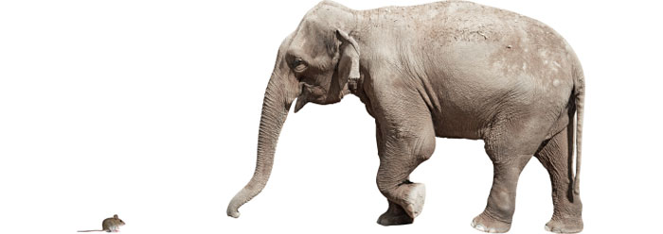
Independent Stream Sampling
Bernoulli Sampling
  IID sampling of objects with some probability p
  Sampled weight x has HT estimate x/p
Poisson Sampling
  Weight x_{i} sampled with probability p_{i} ; HT estimate x_{i} / p_{i}
When to use Poisson vs. Bernoulli sampling?
  Elephants and mice: Poisson allows probability to depend on weight…
What is best choice of probabilities for given stream {x_{i}} ?

Slide 20
Bernoulli Sampling
The easiest possible case of sampling: all weights are 1
  N objects, and want to sample k from them uniformly
  Each possible subset of k should be equally likely
Uniformly sample an index from N (without replacement) k times
  Some subtleties: truly random numbers from [1…N] on a computer?
  Assume that random number generators are good enough
Common trick in DB: assign a random number to each item and sort
  Costly if N is very big, but so is random access
Interesting problem: take a single linear scan of data to draw sample
  Streaming model of computation: see each element once
  Application: IP flow sampling, too many (for us) to store
  (For a while) common tech interview question

Slide 21
Reservoir Sampling
“Reservoir sampling” described by [Knuth 69, 81]; enhancements [Vitter 85]
Fixed size k uniform sample from arbitrary size N stream in one pass
  No need to know stream size in advance
  Include first k items w.p. 1
  Include item n > k with probability p(n) = k/n, n > k
    Pick j uniformly from {1,2,…,n}
    If j ≤ k, swap item n into location j in reservoir, discard replaced item
Neat proof shows the uniformity of the sampling method:
  Let S_{n} = sample set after n arrivals
m (< n)
  New item: selection probability
  Prob[n ∈ S_{n} ] = p_{n} := k/n
k=7
n
  Previously sampled item: induction
  m ∈ S_{n-1} w.p. p_{n-1} ⇒ m ∈ S_{n} w.p. p_{n-1} * (1 – p_{n} / k) = p_{n}

Slide 22

Reservoir Sampling: Skip Counting
Simple approach: check each item in turn
  O(1) per item:
  Fine if computation time < interarrival time
  Otherwise build up computation backlog O(N)
Better: “skip counting”
  Find random index m(n) of next selection > n
  Distribution: Prob[m(n) ≤ m] = 1 - (1-p_{n+1})*(1-p_{n+2})*…*(1-p_{m})
Expected number of selections from stream is
  k + Σ_{k<m≤N} p_{m} = k + Σ_{k<m≤N} k/m = O(k ( 1 + ln (N/k) ))
Vitter’85 provided algorithm with this average running time

Slide 23
Reservoir Sampling via Order Sampling
Order sampling a.k.a. bottom-k sample, min-hashing
Uniform sampling of stream into reservoir of size k
Each arrival n: generate one-time random value r_{n} ∈ U[0,1]
  r_{n} also known as hash, rank, tag…
Store k items with the smallest random tags
0.391
0.908
0.291
0.555
0.619
0.273
Each item has same chance of least tag, so uniform
Fast to implement via priority queue
Can run on multiple input streams separately, then merge

Slide 24
Handling Weights
So far: uniform sampling from a stream using a reservoir
Extend to non-uniform sampling from weighted streams
  Easy case: k=1
  Sampling probability p(n) = x_{n}/W_{n} where W_{n} = Σ_{i=1}^{n} x_{i}
k>1 is harder
  Can have elements with large weight: would be sampled with prob 1?
Number of different weighted order-sampling schemes proposed to realize desired distributional objectives
  Rank r_{n} = f(u_{n}, x_{n} ) for some function f and u_{n} ∈ U[0,1]
  k-mins sketches [Cohen 1997], Bottom-k sketches [Cohen Kaplan 2007]
  [Rosen 1972], Weighted random sampling [Efraimidis Spirakis 2006]
  Order PPS Sampling [Ohlsson 1990, Rosen 1997]
  Priority Sampling [Duffield Lund Thorup 2004], [Alon+DLT 2005]

Slide 25
Weighted random sampling
Weighted random sampling [Efraimidis Spirakis 06] generalizes min-wise
  For each item draw r_{n} uniformly at random in range [0,1]
  Compute the ‘tag’ of an item as r_{n} ^{(1/x}n⁾
  Keep the items with the k smallest tags
  Can prove the correctness of the exponential sampling distribution
Can also make efficient via skip counting ideas

Slide 26
Priority Sampling
Each item x_{i} given priority z_{i} = x_{i} / r_{i} with r_{n} uniform random in (0,1]
Maintain reservoir of k+1 items (x_{i} , z_{i} ) of highest priority
Estimation
  Let z* = (k+1)^{st} highest priority
  Top-k priority items: weight estimate x’_{I} = max{ x_{i} , z* }
  All other items: weight estimate zero
Statistics and bounds
  x’_{I} unbiased; zero covariance: Cov[x’_{i ,} x’_{j} ] = 0 for i≠j
  Relative variance for any subset sum ≤ 1/(k-1) [Szegedy, 2006]

Slide 27
Priority Sampling in Databases
One Time Sample Preparation
  Compute priorities of all items, sort in decreasing priority order
    No discard
Sample and Estimate
  Estimate any subset sum X(S) = Σ_{i∈S} x_{i} by X’(S) = Σ_{i∈S} x’_{I} for some S’ ⊂ S
  Method: select items in decreasing priority order
Two variants: bounded variance or complexity
  S’ = first k items from S: relative variance bounded ≤ 1/(k-1)
    x’_{I} = max{ x_{i} , z* } where z* = (k+1)^{st} highest priority in S
  S’ = items from S in first k: execution time O(k)
    x’_{I} = max{ x_{i} , z* } where z* = (k+1)^{st} highest priority
[Alon et. al., 2005]

Slide 28
Making Stream Samples Smarter
Observation: we see the whole stream, even if we can’t store it
  Can keep more information about sampled items if repeated
  Simple information: if item sampled, count all repeats
Counting Samples [Gibbons & Mattias 98]
  Sample new items with fixed probability p, count repeats as c_{i}
  Unbiased estimate of total count: 1/p + (c_{i} – 1)
Sample and Hold [Estan & Varghese 02]: generalize to weighted keys
  New key with weight b sampled with probability 1 - (1-p)^{b}
Lower variance compared with independent sampling
  But sample size will grow as pn
Adaptive sample and hold: reduce p when needed
  “Sticky sampling”: geometric decreases in p [Manku, Motwani 02]
  Much subsequent work tuning decrease in p to maintain sample size

Slide 29
Sketch Guided Sampling
Go further: avoid sampling the heavy keys as much
  Uniform sampling will pick from the heavy keys again and again
Idea: use an oracle to tell when a key is heavy [Kumar Xu 06]
  Adjust sampling probability accordingly
Can use a “sketch” data structure to play the role of oracle
  Like a hash table with collisions, tracks approximate frequencies
  E.g. (Counting) Bloom Filters, Count-Min Sketch
Track probability with which key is sampled, use HT estimators
  Set probability of sampling key with (estimated) weight w as
  1/(1 + εw) for parameter ε : decreases as w increases
  Decreasing ε improves accuracy, increases sample size

Slide 30
Challenges for Smart Stream Sampling
Current router constraints
  Flow tables maintained in fast expensive SRAM
    To support per packet key lookup at line rate
Implementation requirements
  Sample and Hold: still need per packet lookup
  Sampled NetFlow: (uniform) sampling reduces lookup rate
    Easier to implement despite inferior statistical properties
Long development times to realize new sampling algorithms
Similar concerns affect sampling in other applications
  Processing large amounts of data needs awareness of hardware
  Uniform sampling means no coordination needed in distributed setting

Slide 31
Future for Smarter Stream Sampling
Software Defined Networking
  Current: proprietary software running on special vendor equipment
  Future: open software and protocols on commodity hardware
Potentially offers flexibility in traffic measurement
  Allocate system resources to measurement tasks as needed
  Dynamic reconfiguration, fine grained tuning of sampling
  Stateful packet inspection and sampling for network security
Technical challenges:
  High rate packet processing in software
  Transparent support from commodity hardware
  OpenSketch: [Yu, Jose, Miao, 2013]
Same issues in other applications: use of commodity programmable HW

Slide 32
Stream Sampling:
Sampling as Cost Optimization

Slide 33
Matching Data to Sampling Analysis
Generic problem 1: Counting objects: weight x_{i} = 1
  Bernoulli (uniform) sampling with probability p works fine
  Estimated subset count X’(S) = #{samples in S} / p
  Relative Variance (X’(S)) = (1/p -1)/X(S)
    given p, get any desired accuracy for large enough S
Generic problem 2: x_{i} in Pareto distribution, a.k.a. 80-20 law
  Small proportion of objects possess a large proportion of total weight
    How to best to sample objects to accurately estimate weight?
  Uniform sampling?
    likely to omit heavy objects ⇒ big hit on accuracy
    making selection set S large doesn’t help
  Select m largest objects ?
    biased & smaller objects systematically ignored

Slide 34
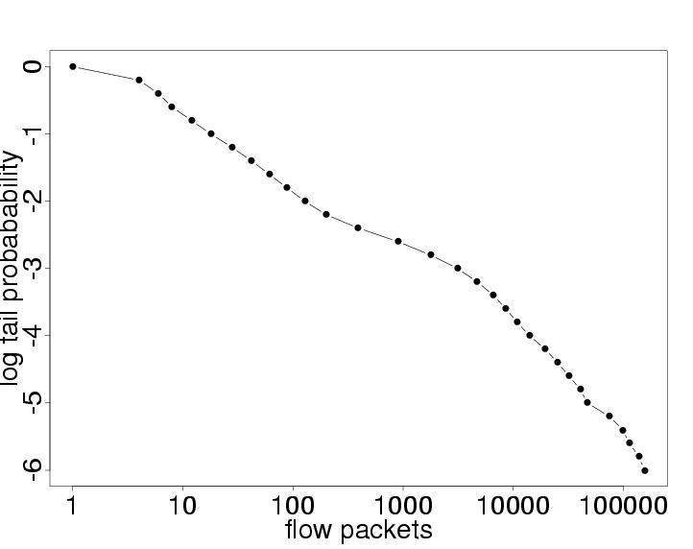
Heavy Tails in the Internet and Beyond
Files sizes in storage
Bytes and packets per network flow
Degree distributions in web graph, social networks

Slide 35
Non-Uniform Sampling
Extensive literature: see book by [Tille, “Sampling Algorithms”, 2006]
Predates “Big Data”
  Focus on statistical properties, not so much computational
IPPS: Inclusion Probability Proportional to Size
  Variance Optimal for HT Estimation
  Sampling probabilities for multivariate version: [Chao 1982, Tille 1996]
  Efficient stream sampling algorithm: [Cohen et. al. 2009]

Slide 36
Costs of Non-Uniform Sampling
Independent sampling from n objects with weights {x₁,… ,x_{n}}
Goal: find the “best” sampling probabilities {p₁, … ,p_{n}}
Horvitz-Thompson: unbiased estimation of each x_{i} by
Two costs to balance:
  Estimation Variance: Var(x’_{i}) = x²_{i} (1/p_{i} – 1)
  Expected Sample Size: Σ_{i}p_{i}
Minimize Linear Combination Cost: Σ_{i} (x_{i}²(1/p_{i} –1) + z² p_{i})
  z expresses relative importance of small sample vs. small variance

Slide 37
Minimal Cost Sampling: IPPS
IPPS: Inclusion Probability Proportional to Size
Minimize Cost Σ_{i} (x_{i}² (1/p_{i} – 1) + z² p_{i}) subject to 1 ≥ p_{i} ≥ 0
Solution: p_{i} = p_{z}(x_{i}) = min{1, x_{i} /z}
  small objects (x_{i} < z) selected with probability proportional to size
  large objects (x_{i} ≥ z) selected with probability 1
  Call z the “sampling threshold”
  Unbiased estimator x_{i}/p_{i} =max{x_{i} , z}
Perhaps reminiscent of importance
sampling, but not the same:
  make no assumptions concerning
  distribution of the x
p_{z}(x)
1
x
z

Slide 38
Error Estimates and Bounds
Variance Based:
  HT sampling variance for single object of weight x_{i}
    Var(x’_{i}) = x²_{i} (1/p_{i} – 1) = x²_{i} (1/min{1,x_{i}/z} – 1) ≤ z x_{i}
  Subset sum X(S)= Σ_{i∈S} x_{i} is estimated by X’(S) = Σ_{i∈S} x’_{i}
    Var(X’(S)) ≤ z X(S)
Exponential Bounds
  E.g. Prob[X’(S) = 0] ≤ exp(- X(S) / z )
Bounds are simple and powerful
  depend only on subset sum X(S), not individual constituents

Slide 39
Sampled IP Traffic Measurements
Packet Sampled NetFlow
  Sample packet stream in router to limit rate of key lookup: uniform 1/N
  Aggregate sampled packets into flow records by key
Model: packet stream of (key, bytesize) pairs { (b_{i}, k_{i}) }
Packet sampled flow record (b,k) where b = Σ {b_{i} : i sampled ∧ k_{i} = k}
  HT estimate b/N of total bytes in flow
Downstream sampling of flow records in measurement infrastructure
  IPPS sampling, probability min{1, b/(Nz)}
Chained variance bound for any subset sum X of flows
  Var(X’) ≤ (z + Nb_{max}) X where b_{max} = maximum packet byte size
  Regardless of how packets are distributed amongst flows
  [Duffield, Lund, Thorup, IEEE ToIT, 2004]

Slide 40
Estimation Accuracy in Practice
Estimate any subset sum comprising at least some fraction f of weight
Suppose: sample size m
Analysis: typical estimation error ε (relative standard deviation) obeys
2*16 = same storage needed for aggregates over 16 bit address prefixes
    But sampling gives more flexibility to estimate traffic within aggregates
m
Estimate fraction f = 0.1% with typical relative error 12%:

Slide 41
Heavy Hitters:
Exact vs. Aggregate vs. Sampled
Sampling does not tell you where the interesting features are
  But does speed up the ability to find them with existing tools
Example: Heavy Hitter Detection
  Setting: Flow records reporting 10GB/s traffic stream
  Aim: find Heavy Hitters = IP prefixes comprising ≥ 0.1% of traffic
  Response time needed: 5 minute
Compare:
  Exact: 10GB/s x 5 minutes yields upwards of 300M flow records
  64k aggregates over 16 bit prefixes: no deeper drill-down possible
  Sampled: 64k flow records: any aggregate ≥ 0.1% accurate to 10%
Exact
Aggregate
Sampled

Slide 42
Cost Optimization for Sampling
Several different approaches optimize for different objectives:
Fixed Sample Size IPPS Sample
  Variance Optimal sampling: minimal variance unbiased estimation
Structure Aware Sampling
  Improve estimation accuracy for subnet queries using topological cost
Fair Sampling
  Adaptively balance sampling budget over subpopulations of flows
  Uniform estimation accuracy regardless of subpopulation size
Stable Sampling
  Increase stability of sample set by imposing cost on changes

Slide 43
IPPS Stream Reservoir Sampling
Each arriving item:
  Provisionally include item in reservoir
  If m+1 items, discard 1 item randomly
    Calculate threshold z to sample m items on average: z solves Σ_{i} p_{z}(x_{i}) = m
    Discard item i with probability q_{i} =1 – p_{z}(x_{i})
    Adjust m surviving x_{i} with Horvitz-Thompson x’_{i} = x_{i} / p_{i} = max{x_{i},z}
Efficient Implementation:
  Computational cost O(log m ) per item, amortized cost O(log log m)
    [Cohen, Duffield, Lund, Kaplan, Thorup; SODA 2009, SIAM J. Comput. 2011]
1
x₁₀
x₁₀
x₉
Recalculate
threshold z:
x’₁₀
x₉
x₈
x’₉
x₈
Recalculate
Discard probs:
x₇
x’₈
x₇
Example:
m=9
x₆
x’₆
x₆
Adjust weights:
x₅
x’₅
x₅
x₄
x’₄
x₄
x₃
z
x’₃
x₃
x₂
x’₂
x₂
x₁
x’₁
x₁
0

Slide 44
Structure (Un)Aware Sampling
Sampling is oblivious to structure in keys (IP address hierarchy)
  Estimation disperses the weight of discarded items to surviving samples
Queries structure aware: subset sums over related keys (IP subnets)
  Accuracy on LHS is decreased by discarding weight on RHS
∅
0
1
00
01
10
11
000
001
010
011
100
101
110
111

Slide 45
Localizing Weight Redistribution
Initial weight set {x_{i} : i∈S} for some S ⊂ Ω
  E.g. Ω = possible IP addresses, S =observed IP addresses
Attribute “range cost” C({x_{i} : i∈R}) for each weight subset R⊆S
  Possible factors for Range Cost:
    Sampling variance
    Topology e.g. height of lowest common ancestor
  Heuristics: R* = Nearest Neighbor {x_{i} , x_{j}} of minimal x_{i}x_{j}
Sample k items from S:
  Progressively remove one item from
  subset with minimal range cost:
  While(|S| > k)
    Find R*⊆S of minimal range cost.
    Remove a weight from R* w/ VarOpt
[Cohen, Cormode, Duffield; PVLDB 2011]
∅
No change outside
subtree below
closest ancestor
0
1
00
01
10
11
000
001
010
011
100
101
110
111
Order of magnitude reduction in average subnet error vs. VarOpt

Slide 46
Fair Sampling Across Subpopulations
Analysis queries often focus on specific subpopulations
  E.g. networking: different customers, user applications, network paths
Wide variation in subpopulation size
  5 orders of magnitude variation in traffic on interfaces of access router
If uniform sampling across subpopulations:
  Poor estimation accuracy on subset sums within small subpopulations
Color = subpopulation
, = interesting items
  occurrence proportional to subpopulation size
Uniform Sampling across subpopulations:
  Difficult to track proportion of interesting items within small subpopulations:
Sample

Slide 47
Fair Sampling Across Subpopulations
Minimize relative variance by sharing budget m over subpopulations
  Total n objects in subpopulations n₁,…,n_{d} with Σ_{i}n_{i}=n
  Allocate budget m_{i} to each subpopulation n_{i} with Σ_{i}m_{i}=m
Minimize average population relative variance R = const. Σ_{i}1/m_{i}
Theorem:
  R minimized when {m_{i}} are Max-Min Fair share of m under demands {n_{i}}
Streaming
  Problem: don’t know subpopulation sizes {n_{i}} in advance
Solution: progressive fair sharing as reservoir sample
  Provisionally include each arrival
  Discard 1 item as VarOpt sample from any maximal subpopulation
Theorem [Duffield; Sigmetrics 2012]:
  Max-Min Fair at all times; equality in distribution with VarOpt samples {m_{i} from n_{i}}

Slide 48
Stable Sampling
Setting: Sampling a population over successive periods
Sample independently at each time period?
  Cost associated with sample churn
  Time series analysis of set of relatively stable keys
Find sampling probabilities through cost minimization
  Minimize Cost = Estimation Variance + z * E[#Churn]
Size m sample with maximal expected churn D
  weights {x_{i}}, previous sampling probabilities {p_{i}}
  find new sampling probabilities {q_{i}} to minimize cost of taking m samples
  Minimize Σ_{i}x²_{i} / q_{i} subject to 1 ≥ q_{i} ≥ 0, Σ_{I} q_{i} = m and Σ_{I} | p_{i} – q_{i} | ≤ D
[Cohen, Cormode, Duffield, Lund 13]

Slide 49
Summary of Part 1
Sampling as a powerful, general summarization technique
Unbiased estimation via Horvitz-Thompson estimators
Sampling from streams of data
  Uniform sampling: reservoir sampling
  Weighted generalizations: sample and hold, counting samples
Advances in stream sampling
  The cost principle for sample design, and IPPS methods
  Threshold, priority and VarOpt sampling
  Extending the cost principle:
    structure aware, fair sampling, stable sampling, sketch guided

Slide 50
Sampling for Big Data
x₁₀
x’₁₀
x₉
x’₉
∅
x₈
x’₈
x₇
x’₆
0
1
x₆
x’₅
x₅
x’₄
x₄
x’₃
00
01
10
11
x₃
x’₂
x₂
000
001
010
011
100
101
110
111
x₁
x’₁
Graham Cormode, University of Warwick
G.Cormode@warwick.ac.uk
Nick Duffield, Texas A&M University
Nick.Duffield@gmail.com

Slide 51
Outline
Motivating application: sampling in large ISP networks
Basics of sampling: concepts and estimation
Stream sampling: uniform and weighted case
  Variations: Concise sampling, sample and hold, sketch guided
  BREAK
Advanced stream sampling: sampling as cost optimization
  VarOpt, priority, structure aware, and stable sampling
Hashing and coordination
  Bottom-k, consistent sampling and sketch-based sampling
Graph sampling
  Node, edge and subgraph sampling
Conclusion and future directions

Slide 52
Data Scale:
Hashing and Coordination

Slide 53
Sampling from the set of items
Sometimes need to sample from the distinct set of objects
  Not influenced by the weight or number of occurrences
  E.g. sample from the distinct set of flows, regardless of weight
Need sampling method that is invariant to duplicates
Basic idea: build a function to determine what to sample
  A “random” function f(k) → R
  Use f(k) to make a sampling decision: consistent decision for same key

Slide 54
Permanent Random Numbers
Often convenient to think of f as giving “permanent random numbers”
  Permanent: assigned once and for all
  Random: treat as if fully randomly chosen
The permanent random number is used in multiple sampling steps
  Same “random” number each time, so consistent (correlated) decisions
Example: use PRNs to draw a sample of s from N via order sampling
  If s << N, small chance of seeing same element in different samples
  Via PRN, stronger chance of seeing same element
    Can track properties over time, gives a form of stability
Easiest way to generate PRNs: apply a hash function to the element id
  Ensures PRN can be generated with minimal coordination
  Explicitly storing a random number for all observed keys does not scale

Slide 55
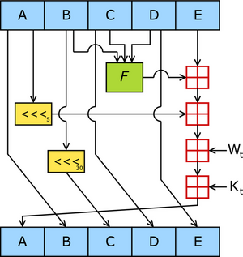
Hash Functions
Many possible choices of hashing functions:
Cryptographic hash functions: SHA-1, MD5, etc.
  Results appear “random” for most tests (using seed/salt)
  Can be slow for high speed/high volume applications
  Full power of cryptographic security not needed for most statistical purposes
    Although possible some trade-offs in robustness to subversion if not used
Heuristic hash functions: srand(), mod
  Usually pretty fast
  May not be random enough: structure in keys may cause collisions
Mathematical hash functions: universal hashing, k-wise hashing
  Have precise mathematical properties on probabilities
  Can be implemented to be very fast

Slide 56
Mathematical Hashing
K-wise independence: Pr[h(x₁) = y₁ ∧ h(x₂) = y₂ ∧ … ∧ h(x_{t}) = y_{t}] = 1/R^{t}
  Simple function: c_{t}x^{t} + c_{t-1}x^{t-1} + … c₁x + c₀ mod P
  For fixed prime P, randomly chosen c₀ … c_{t}
  Can be made very fast (choose P to be Mersenne prime to simplify mods)
(Twisted) tabulation hashing [Thorup Patrascu 13]
  Interpret each key as a sequence of short characters, e.g. 8 * 8bits
  Use a “truly random” look-up table for each character (so 8 * 256 entries)
  Take the exclusive-OR of the relevant table values
  Fast, and fairly compact
  Strong enough for many applications of hashing (hash tables etc.)

Slide 57
Bottom-k sampling
0.391
0.908
0.291
0.391
0.391
0.273
Sample from the set of distinct keys
  Hash each key using appropriate hash function
  Keep information on the keys with the s smallest hash values
  Think of as order sampling with PRNs…
Useful for estimating properties of the support set of keys
  Evaluate any predicate on the sampled set of keys
Same concept, several different names:
  Bottom-k sampling, Min-wise hashing, K-minimum values

Slide 58
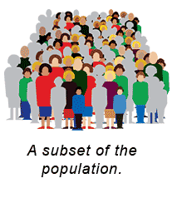
Subset Size Estimation from Bottom-k
Want to estimate the fraction t = |A|/|D|
  D is the observed set of data
  A is an arbitrary subset given later
  E.g. fraction of customers who are sports fans from midwest aged 18-35
Simple algorithm:
  Run bottom-k to get sample set S, estimate t’ = |A ∩ S|/s
  Error decreases as 1/√s
  Analysis due to [Thorup 13]: simple hash functions suffice for big enough s

Slide 59
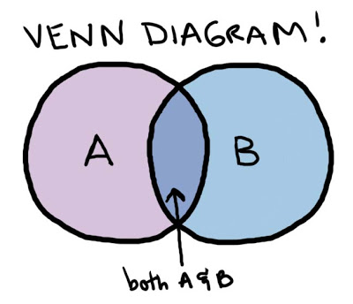
Similarity Estimation
How similar are two sets, A and B?
Jaccard coefficient: |A ∩ B|/|A ∪ B|
  1 if A, B identical, 0 if they are disjoint
  Widely used, e.g. to measure document similarity
Simple approach: sample an item uniformly from A and B
  Probability of seeing same item from both: |A ∩ B|/(|A| × |B|)
  Chance of seeing same item too low to be informative
Coordinated sampling: use same hash function to sample from A, B
  Probability that same item sampled: |A ∩ B|/|A ∪ B|
  Repeat: the average number of agreements gives Jaccard coefficient
  Concentration: (additive) error scales as 1/√s

Slide 60
Technical Issue: Min-wise hashing
For analysis to work, the hash function must be fully random
  All possibly permutations of the input are equally likely
  Unrealistic in practice: description of such a function is huge
“Simple” hash functions don’t work well
  Universal hash functions are too skewed
Need hash functions that are “approximately min-wise”
  Probability of sampling a subset is almost uniform
  Tabulation hashing a simple way to achieve this

Slide 61
Bottom-k hashing for F₀ Estimation
F₀ is the number of distinct items in the stream
  a fundamental quantity with many applications
  E.g. number of distinct flows seen on a backbone link
Let m be the domain of stream elements: each data item is [1…m]
Pick a random (pairwise) hash function h: [m] → [R]
Apply bottom-k sampling under hash function h
  Let v_{s} = s’th smallest (distinct) value of h(i) seen
If n = F₀ < s, give exact answer, else estimate F’₀ = sR/v_{s}
  v_{s}/R ≈ fraction of hash domain occupied by s smallest
0R
v_{s}
R

Slide 62
Analysis of F₀ algorithm
Can show that it is unlikely to have an overestimate
  Too many items hashed below a fixed value
  Can treat each event of an item hashing too low as independent
Similar outline to show unlikely to have an overestimate
(Relative) error scales as 1/√s
Space cost:
  Store s hash values, so O(s log m) bits
  Can improve to O(s + log m) with additional hashing tricks
  See also “Streamed Approximate Counting of Distinct Elements”, KDD’14
0R
v_{s}
sR/(1+ε)n
R

Slide 63
Consistent Weighted Sampling
Want to extend bottom-k results when data has weights
Specifically, two data sets A and B where each element has weight
  Weights are aggregated: we see whole weight of element together
Weighted Jaccard: want probability that same key is chosen by both to be ∑_{i} min(A(i), B(i))/∑_{i} max(A(i), B(i))
Sampling method should obey uniformity and consistency
  Uniformity: element i picked from A with probability proportional to A(i)
  Consistency: if i is picked from A, and B(i) > A(i), then i also picked for B
Simple solution: assuming integer weights, treat weight A(i)
as A(i) unique (different) copies of element i, apply bottom-k
  Limitations: slow, unscalable when weights can be large
  Need to rescale fractional weights to integral multiples

Slide 64
Consistent Weighted Sampling
Efficient sampling distributions exist achieving uniformity and consistency
Basic idea: consider a weight w as w/Δ different elements
  Compute the probability that any of these achieves the minimum value
  Study the limiting distribution as Δ → 0
Consistent Weighted Sampling [Manasse, McSherry, Talway 07], [Ioffe 10]
  Use hash of item to determine which points sampled via careful transform
  Many details needed to contain bit-precision, allow fast computation
Other combinations of key weights are possible [Cohen Kaplan Sen 09]
  Min of weights, max of weights, sum of (absolute) differences

Slide 65
Trajectory Sampling
Aims [Duffield Grossglauser 01]:
  Probe packets at each router they traverse
  Collate reports to infer link loss and latency
  Need to sample; independent sampling no use
Hash-based sampling:
  All routers/packets: compute hash h of invariant packet fields
  Sample if h ∈ some H and report to collector; tune sample rate with |H|
  Use high entropy packet fields as hash input, e.g. IP addresses, ID field
  Hash function choice trade-off between speed, uniformity & security
Standardized in Internet Engineering Task Force (IETF)
  Service providers need consistency across different vendors
  Several hash functions standardized, extensible
  Same issues arise in other big data ecosystems (apps and APIs)

Slide 66
Hash Sampling in Network Management
Many different network subsystems used to provide service
  Monitored through event logs, passive measurement of traffic & protocols
  Need cross-system sample that captures full interaction between network and a representative set of users
Ideal: hash-based selection based on common identifier
Administrative challenges! Organizational diversity
Timeliness challenge:
  Selection identifier may not be present at a measurement location
  Example: common identifier = anonymized customer id
    Passive traffic measurement based on IP address
    Mapping of IP address to customer ID not available remotely
    Attribution of traffic IP address to a user difficult to compute at line speed

Slide 67
Advanced Sampling from Sketches
Difficult case: inputs with positive and negative weights
Want to sample based on the overall frequency distribution
  Sample from support set of n possible items
  Sample proportional to (absolute) total weights
  Sample proportional to some function of weights
How to do this sampling effectively?
  Challenge: may be many elements with positive and negative weights
  Aggregate weights may end up zero: how to find the non-zero weights?
Recent approach: L₀ sampling
  L₀ sampling enables novel “graph sketching” techniques
  Sketches for connectivity, sparsifiers [Ahn, Guha, McGregor 12]

Slide 68
L₀ Sampling
L₀ sampling: sample with prob ≈ f_{i}⁰/F₀
  i.e., sample (near) uniformly from items with non-zero frequency
General approach: [Frahling, Indyk, Sohler 05, C., Muthu, Rozenbaum 05]
  Sub-sample all items (present or not) with probability p
  Generate a sub-sampled vector of frequencies f_{p}
  Feed f_{p} to a k-sparse recovery data structure
    Allows reconstruction of f_{p} if F₀ < k
  If f_{p} is k-sparse, sample from reconstructed vector
  Repeat in parallel for exponentially shrinking values of p

Slide 69
Sampling Process
p=1/U
k-sparse recovery
p=1
Exponential set of probabilities, p=1, ½, ¼, 1/8, 1/16… 1/U
  Let N = F₀ = |{ i : f_{i} ≠ 0}|
  Want there to be a level where k-sparse recovery will succeed
  At level p, expected number of items selected S is Np
  Pick level p so that k/3 < Np ≤ 2k/3
Chernoff bound: with probability exponential in k, 1 ≤ S ≤ k
  Pick k = O(log 1/δ) to get 1-δ probability

Slide 70
Hash-based sampling summary
Use hash functions for sampling where some consistency is needed
  Consistency over repeated keys
  Consistency over distributed observations
Hash functions have duality of random and fixed
  Treat as random for statistical analysis
  Treat as fixed for giving consistency properties
Can become quite complex and subtle
  Complex sampling distributions for consistent weighted sampling
  Tricky combination of algorithms for L₀ sampling
Plenty of scope for new hashing-based sampling methods

Slide 71
Data Scale:
Massive Graph Sampling

Slide 72





Massive Graph Sampling
“Graph Service Providers”
  Search providers: web graphs (billions of pages indexed)
  Online social networks
    Facebook: ~10⁹ users (nodes), ~10¹² links
  ISPs: communications graphs
    From flow records: node = src or dst IP, edge if traffic flows between them
Graph service provider perspective
  Already have all the data, but how to use it?
  Want a general purpose sample that can:
    Quickly provide answers to exploratory queries
    Compactly archive snapshots for retrospective queries & baselining
Graph consumer perspective
  Want to obtain a realistic subgraph directly or via crawling/API

Slide 73
Retrospective analysis of ISP graphs
Node = IP address
Directed edge = flow from source node to destination node
compromise
control
flooding
Hard to detect against background
Known attacks can be detected:
  Signature matching based on partial graphs, flow features, timing
Unknown attacks are harder to spot:
  exploratory & retrospective analysis
  preserve accuracy if sampling?
BOTNET

Slide 74
Goals for Graph Sampling
Crudely divide into three classes of goal:
Study local (node or edge) properties
  Average age of users (nodes), average length of conversation (edges)
Estimate global properties or parameters of the network
  Average degree, shortest path distribution
Sample a “representative” subgraph
  Test new algorithms and learning more quickly than on full graph
Challenges: what properties should the sample preserve?
  The notion of “representative” is very subjective
  Can list properties that should be preserved
  (e.g. degree dbn, path length dbn), but there are always more…

Slide 75
Models for Graph Sampling
Many possible models, but reduce to two for simplicity
(see tutorial by Hasan, Ahmed, Neville, Kompella in KDD 13)
Static model: full access to the graph to draw the sample
  The (massive) graph is accessible in full to make the small sample
Streaming model: edges arrive in some arbitrary order
  Must make sampling decisions on the fly
Other graph models capture different access scenarios
  Crawling model: e.g. exploring the (deep) web, API gives node neighbours
  Adjacency list streaming: see all neighbours of a node together

Slide 76
Node and Edge Properties
Gross over-generalization:
node and edge properties can be solved using previous techniques
  Sample nodes/edge (in a stream)
  Handle duplicates (same edge many times) via hash-based sampling
  Track properties of sampled elements
    E.g. count the degree of sampled nodes
Some challenges. E.g. how to sample a node proportional to its degree?
  If degree is known (precomputed), then use these as weights
  Else, sample edges uniformly, then sample each end with probability ½

Slide 77
Induced subgraph sampling
Node-induced subgraph
  Pass 1: Sample a set of nodes (e.g. uniformly)
  Pass 2: collect all edges incident on sampled nodes
  Can collapse into a single streaming pass
  Can’t know in advance how many edges will be sampled
Edge-induced subgraph
  Sample a set of edges (e.g. uniformly in one pass)
  Resulting graph tends to be sparse, disconnected
Edge-induced variant [Ahmed Neville Kompella 13]:
  Take second pass to fill in edges on sampled nodes
  Hack: combine passes to fill in edges on current sample

Slide 78
HT Estimators for Graphs
Can construct HT estimators from uniform vertex samples [Frank 78]
  Evaluate the desired function on the sampled graph (e.g. average degree)
For functions of edges (e.g. number of edges satisfying a property):
  Scale up accordingly, by N(N-1)/(k(k-1)) for sample size k on graph size N
  Variance of estimates can also be bounded in terms of N and k
Similar for functions of three edges (triangles) and higher:
  Scale up by NC3/kC3 ≈ 1/p³ to get unbiased estimator
  High variance, so other sampling schemes have been developed

Slide 79
Graph Sampling Heuristics
“Heuristics”, since few formal statistical properties are known
Breadth first sampling: sample a node, then its neighbours…
  Biased towards high-degree nodes (more chances to reach them)
Snowball sampling: generalize BF by picking many initial nodes
  Respondent-driven sampling: weight the snowball sample to give
  statistically sound estimates [Salganik Heckathorn 04]
Forest-fire sampling: generalize BF by picking only a fraction of neighbours to explore [Leskovec Kleinberg Faloutsos 05]
  With probability p, move to a new node and “kill” current node
No “one true graph sampling method”
  Experiments show different preferences, depending on graph and metric
  [Leskovec, Faloutsos 06; Hasan, Ahmed, Neville, Kompella 13]
  None of these methods are “streaming friendly”: require static graph
    Hack: apply them to the stream of edges as-is

Slide 80
Random Walks Sampling
Random walks have proven very effective for many graph computations
  PageRank for node importance, and many variations
Random walk a natural model for sampling a node
  Perform “long enough” random walk to pick a node
  How long is “long enough” (for mixing of RW)?
  Can get “stuck” in a subgraph if graph not well-connected
  Costly to perform multiple random walks
  Highly non-streaming friendly, but suits graph crawling
Multidimensional Random Walks [Ribeiro, Towsley 10]
  Pick k random nodes to initialize the sample
  Pick a random edge from the union of edges incident on the sample
  Can be viewed as a walk on a high-dimensional extension of the graph
  Outperforms running k independent random walks

Slide 81
Subgraph estimation: counting triangles
Hot topic: sample-based triangle counting
  Triangles: simplest non-trivial representation of node clustering
    Regard as prototype for more complex subgraphs of interest
  Measure of “clustering coefficient” in graph, parameter in graph models…
Uniform sampling performs poorly:
  Chance that randomly sampled edges happen to form subgraph is ≈ 0
Bias the sampling so that desired subgraph is preferentially sampled

Slide 82
Subgraph Sampling in Streams
Want to sample one of the T triangles in a graph
[Buriol et al 06]: sample an edge uniformly, then pick a node
  Scan for the edges that complete the triangle
  Probability of sampling a triangle is T/(|E| (|V|-2))
[Pavan et al 13]: sample an edge, then sample an incident edge
  Scan for the edge that completes the triangle
  (After bias correction) probability of sampling a triangle is T/(|E| Δ)
    Δ = max degree, considerably smaller than |V| in most graphs
[Jha et.al. KDD 2013]: sample edges, the sample pairs of incident edges
  Scan for edges that complete “wedges” (edge pairs incident on a vertex)
Advert: Graph Sample and Hold [Ahmed, Duffield, Neville, Kompella, KDD 2014]
  General framework for subgraph counting; e.g. triangle counting
  Similar accuracy to previous state of art, but using smaller storage

Slide 83
Graph Sampling Summary
Sampling a representative graph from a massive graph is difficult!
Current state of the art:
  Sample nodes/edges uniformly from a stream
  Heuristic sampling from static/streaming graph
Sampling enables subgraph sampling/counting
  Much effort devoted to triangles (smallest non-trivial subgraph)
“Real” graphs are richer
  Different node and edge types, attributes on both
  Just scratching surface of sampling realistic graphs

Slide 84
Current Directions in Sampling

Slide 85
Outline
Motivating application: sampling in large ISP networks
Basics of sampling: concepts and estimation
Stream sampling: uniform and weighted case
  Variations: Concise sampling, sample and hold, sketch guided
  BREAK
Advanced stream sampling: sampling as cost optimization
  VarOpt, priority, structure aware, and stable sampling
Hashing and coordination
  Bottom-k, consistent sampling and sketch-based sampling
Graph sampling
  Node, edge and subgraph sampling
Conclusion and future directions

Slide 86
Role and Challenges for Sampling
Matching
  Sampling mediates between data characteristics and analysis needs
  Example: sample from power-law distribution of bytes per flow…
    but also make accurate estimates from samples
    simple uniform sampling misses the large flows
Balance
  Weighted sampling across key-functions: e.g. customers, network paths, geolocations
    cover small customers, not just large
    cover all network elements, not just highly utilized
Consistency
  Sample all views of same event, flow, customer, network element
    across different datasets, at different times
    independent sampling ⇒ small intersection of views

Slide 87


Sampling and Big Data Systems
Sampling is still a useful tool in cluster computing
  Reduce the latency of experimental analysis and algorithm design
Sampling as an operator is easy to implement in MapReduce
  For uniform or weighted sampling of tuples
Graph computations are a core motivator of big data
  PageRank as a canonical big computation
  Graph-specific systems emerging (Pregel, LFgraph, Graphlab, Giraph…)
  But… sampling primitives not yet prevalent in evolving graph systems
When to do the sampling?
  Option 1: Sample as an initial step in the computation
    Fold sample into the initial “Map” step
  Option 2: Sample to create a stored sample graph before computation
    Allows more complex sampling, e.g. random walk sampling

Slide 88
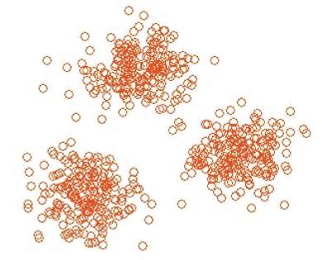
Sampling + KDD
The interplay between sampling and data mining is not well understood
  Need an understanding of how ML/DM algorithms are affected by sampling
  E.g. how big a sample is needed to build an accurate classifier?
  E.g. what sampling strategy optimizes cluster quality
Expect results to be method specific
  I.e. “IPPS + k-means” rather than “sample + cluster”

Slide 89

Sampling and Privacy
Current focus on privacy-preserving data mining
  Deliver promise of big data without sacrificing privacy?
  Opportunity for sampling to be part of the solution
Naïve sampling provides “privacy in expectation”
  Your data remains private if you aren’t included in the sample…
Intuition: uncertainty introduced by sampling contributes to privacy
  This intuition can be formalized with different privacy models
Sampling can be analyzed in the context of differential privacy
  Sampling alone does not provide differential privacy
  But applying a DP method to sampled data does guarantee privacy
  A tradeoff between sampling rate and privacy parameters
    Sometimes, lower sampling rate improves overall accuracy

Slide 90




Advert: Now Hiring…
Nick Duffield, Texas A&M
  Phds in big data, graph sampling
Graham Cormode, University of Warwick UK
  Phds in big data summarization
  (graphs and matrices, funded by MSR)
  Postdocs in privacy and data modeling
  (funded by EC, AT&T)

Slide 91
Sampling for Big Data
x₁₀
x’₁₀
x₉
x’₉
∅
x₈
x’₈
x₇
x’₆
0
1
x₆
x’₅
x₅
x’₄
x₄
x’₃
00
01
10
11
x₃
x’₂
x₂
000
001
010
011
100
101
110
111
x₁
x’₁
Graham Cormode, University of Warwick
G.Cormode@warwick.ac.uk
Nick Duffield, Texas A&M University
Nick.Duffield@gmail.com

