Slide 1
Privacy at Scale: Local Differential Privacy in Practice
Graham Cormode
Based on a tutorial with Somesh Jha, Tejas Kulkarni, Ninghui Li, Divesh Srivastava, and Tianhao Wang

Slide 2
Schedule
Part 1 (yesterday): Centralized privacy models
  The Privacy Problem
  Syntactic Approaches to Privacy (1998 onwards)
  (Centralized) Differential Privacy (2006 onwards)
Part 2 (today): Local privacy models (2014 onwards)
  Local Differential Privacy technical foundations
  Current directions and open problems
Note: This material can be quite technical and mathematical!
Slides available from http://cormode.org/ghent

Slide 3
Aims of today’s material
To introduce the privacy model of local differential privacy (LDP)
  Provide technical understanding, scaling of basic LDP algorithms
  Show how these have been used in practice
To connect with the privacy research literature
  Give a deep understanding of the frequency estimation problem
  Describe new work on LDP data mining and data modeling
To suggest directions for future research
  Identify topics that have just recently been considered
  Suggest open problems and grand challenges for the area

Slide 4
Outline
Module 1
  Introduction and Preliminaries (20 min)
  State of the Art Deployments (25 min)
  Theoretical Foundations (20 min)
  Frequency Oracles and Mean Oracles (30 min)
Module 2
  Heavy Hitters (20 min)
  Current Research Directions part 2 (20 min)
    Marginals, graphs, location data, language modeling
  Open Problems (20 min)
Notes:
5 min q&a at the end of each module

Slide 5
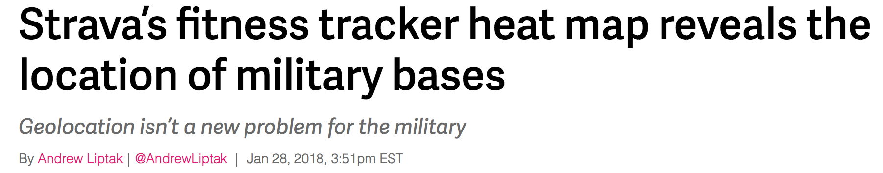
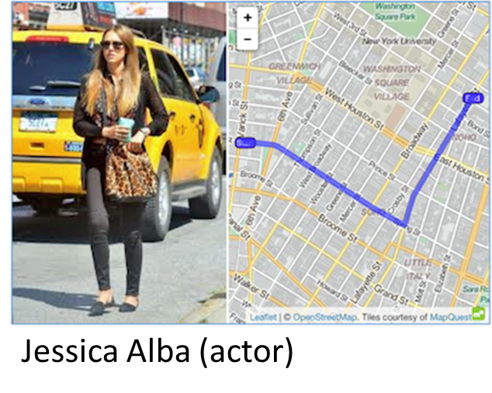
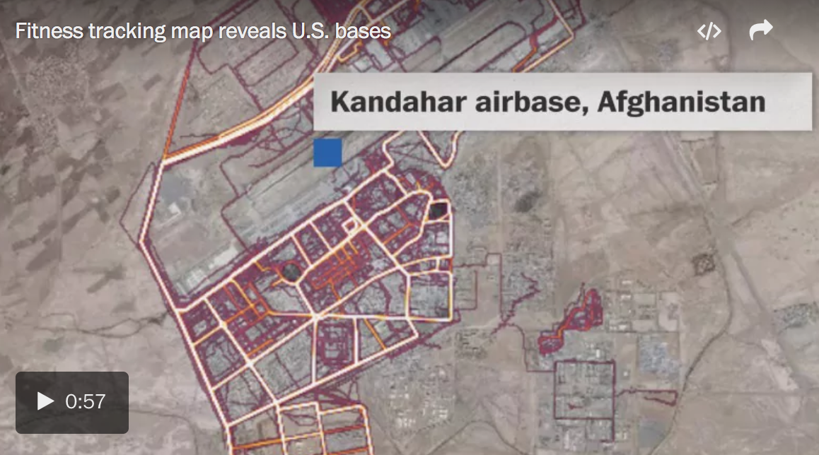



Data Release Horror Stories
We need to solve this data release problem ...
Notes:
5 min q&a at the end of each module

Slide 6
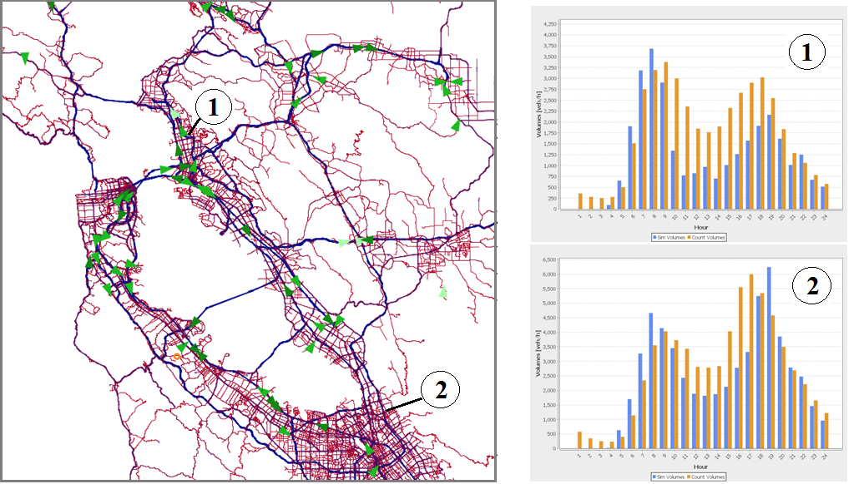
But Why Release Data?
Urban mobility modeling at scale
  Smart traffic design is critical, congestion is getting worse
Notes:
5 min q&a at the end of each module

Slide 7

Record Level Anonymization: A Brief Recap
Pre-1997: hash identifiers
1998: k-anonymity [SS98]
  Alphabet soup followed
2006: differential privacy [DM+06]
  Semantic notion of privacy
1997: linking attack [S07]
  Multiple QIs ≈ identifier
2006+: syntactic attacks
2009: deFinetti's thm [K09]
  Machine learning attack
Notes:
5 min q&a at the end of each module

Slide 8
Differential Privacy Definition
A randomized algorithm K satisfies ε-differential privacy if:
  Given two data sets that differ by one individual,
  D and D’, any property S, and ε > 0:
  Pr[ K(D) ∈ S] ≤ e^{ε} Pr[ K(D’) ∈ S]
Can achieve ε-DP for counts by adding a random noise value
Uncertainty due to noise → plausible deniability
  Hides whether someone is present in the data
Notes:
5 min q&a at the end of each module

Slide 9
Achieving ε-DP in the Centralized Model
(Global) Sensitivity of publishing:
s = max_{D,D’} |F(D) – F(D’)|, D, D’ differ by 1 individual
E.g., count individuals satisfying property P: s = 1
For every value that is output:
  Add Laplacian noise Lap(ε/s):
  Or Geometric noise for discrete case:
Simple rules for composition of differentially private outputs:
Given output O₁ that is ε₁-DP and O₂ that is ε₂-DP
(Sequential composition) If inputs overlap, result is (ε₁ + ε₂)-DP
(Parallel composition) If inputs disjoint, result is max(ε₁, ε₂)-DP
Notes:
5 min q&a at the end of each module

Slide 10
Trying to Reduce Trust
Most work on differential privacy assumes a trusted party
  Centralized data aggregator that sees the true, raw data
  Can compute exact query answers, then perturb for privacy
A reasonable question: can we reduce the amount of trust?
  Can we remove the trusted party from the equation?
  Users produce locally private output, aggregate to answer queries
One approach is to use SMC or homomorphic encryption
  Merge encrypted data, and add noise for privacy inside encryption
  Complex to get right, and very high computational overhead

Slide 11
Local Differential Privacy
What about having each user run a DP algorithm on their data?
  Then combine all the results to get a final answer
On first glance, this idea seems crazy!
  Each user adds noise to mask their own input
  So surely the noise will always overwhelm the signal?
But … noise can cancel out or be subtracted out
  We end up with the true answer, plus noise which can be smaller
  However, noise is still larger than in the centralized case

Slide 12
Local Differential Privacy: Example
Each of N users has 0/1 value, estimate total population sum
  Each user adds independent Laplace noise: mean 0, variance 2/ε²
Adding user results: true answer + sum of N Laplace distributions
  Error is random variable, with mean 0, variance 2N/ε²
  Confidence bounds: ~95% chance of being within 2σ of the mean
  So error looks like √N/ε, but true value may be proportional to N
Numeric example: suppose true answer is N/2, ε = 1, N = 1M
  We see 500K ± 2800 : about 1% uncertainty
  Error in centralized case would be close to 1 (0.001%)

Slide 13
Local Differential Privacy
We can achieve LDP, and obtain reasonable accuracy (for large N)
  The error typically scales with √N
Generic approach: apply centralized DP algorithm to local data
  But error might still be quite large
  Unclear how to merge private outputs (e.g. private clustering)
So we seek to design new LDP algorithms
  Maximize the accuracy of the results
  Minimize the costs to the users (space, time, communication)
  Ensure that there is an accurate algorithm for aggregation

Slide 14
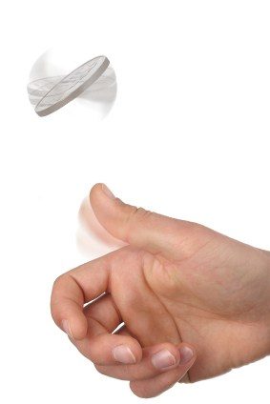
Privacy with a coin toss: Randomized Response
Each user has a single bit of private information
  Encoding e.g. political/sexual/religious preference, illness, etc.
Randomize Response (RR): toss an unbiased coin [Warner 65]
  If Heads (probability p = ½), report the true answer
  Else, toss unbiased coin again: if Heads, report true answer, else lie
Collect responses from N users, subtract noise
  Error in the estimate is proportional to 1/√N
  Simple LDP algorithm with parameter ε=ln((¾)/(¼)) = ln(3)
  Generalization: allow biased coins (p ≠ ½)

Slide 15



Privacy in practice
Differential privacy based on coin tossing is widely deployed!
  In Google Chrome browser, to collect browsing statistics
  In Apple iOS and MacOS, to collect typing statistics
  In Microsoft Windows to collect telemetry data over time
  From Snap to perform modeling of user preference
  This yields deployments of over 100 million users each
All deployments are based on RR, but extend it substantially
  To handle the large space of possible values a user might have
Local Differential Privacy is state of the art today
  Randomized response invented in 1965: over five decades ago!

Slide 16
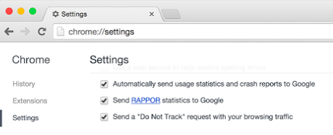
Google’s RAPPOR
Each user has one value out of a very large set of possibilities
  E.g. their favourite URL, www.nytimes.com
Attempt 1: run RR for all values: google.com? Bing.com? …
  User has sparse binary vector with one 1: run RR on every bit
  Satisfies 2ε-LDP: change user’s choice, 2 bits change: 1 → 0, 0 → 1
  Slow: sends 1 bit for every possible index in the vector
  Limited: can’t handle new possibilities being added
Try to do better by reducing domain size through hashing

Slide 17
Bloom Filters
item
Bloom filters [Bloom 70] compactly encode set membership
  k hash functions map items to m-bit vector k times
  Update: Set all k entries to 1 to indicate item is present
  Query: Can lookup items, store set of size n in O(n) bits
  Analysis: choose k and m to obtain small false positive probability
Can be merged by OR-ing vectors (of same size)
  Duplicate insertions do not change Bloom filters
0
1
0
0
0
1
0
0
1
0

Slide 18
Counting Bloom Filters & Randomized Response
item
Idea: apply Randomized Response to the bits in a Bloom filter
  Not too many bits in the filter compared to all possibilities
Each user maps their input to at most k bits in the filter
  Privacy guarantee with parameter 2kε
Combine all user reports and observe how often each bit is set
0/1
1/0
0/1
0/1
0/1
1/0
0/1
0/1
1/0
0/1

Slide 19
Decoding Noisy Counting Bloom Filters
We have a noisy Bloom filter, where each bit has a probability
To estimate the frequency of a particular value:
  Look up its bit locations in the Bloom filter
  Compute the unbiased estimate of the probability each is 1
  Take the minimum of these estimates as the frequency
  More advanced decoding heuristics to decode all at once
How to find frequent strings without knowing them in advance?
  Subsequent work: build up frequent strings character by character

Slide 20

RAPPOR in practice
The RAPPOR approach is implemented in the Chrome browser
  Collects data from opt-in users, tens of millions per day
  Open source implementation available
Tracks settings in the browser, e.g. home page, search engine
  Many users unexpectedly change home page → possible malware
Typical configuration:
  128 bit Bloom filter, 2 hash functions, privacy parameter ~0.5
  Needs about 10K reports to identify a value with confidence

Slide 21
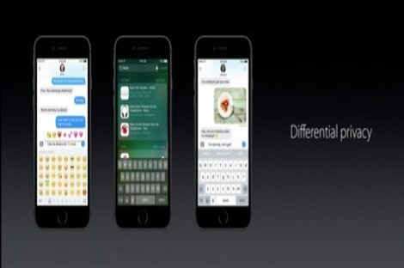
Apple: Sketches and Transforms
Similar problem to RAPPOR: count frequencies of many items
  For simplicity, assume that each user holds a single item
  To reduce burden of collection, can size of summary be reduced?
Instead of Bloom Filter, make use of sketches
  Similar idea, but better suited to capturing frequencies

Slide 22
Count-Min Sketch [CM04]
W
Count-Min sketch encodes item counts
  Allows estimation of frequencies (e.g. for selectivity estimation)
  Some similarities in appearance to Bloom filters
Model input data as a sparse frequency vector x of dimension U
  Create a small summary as an array of w × d in size
  Use d hash function to map vector entries to [1..w]
Array: CM[i,j]
d

Slide 23
Count-Min Sketch
h₁(j)
+c
Update: each entry in vector x is mapped to one bucket per row
Query: estimate x[j] by taking min_{k} CM[k,h_{k}(j)]
  Guarantees error less than eps*‖x‖₁ in size O(1/eps)
Merge two sketches by entry-wise summation
j,+c
+c
+c
d rows
h_{d}(j)
+c
w = 2/eps

Slide 24
Count-Min Sketch + Randomized Response
Each user encodes their (unit) input with a Count-Min sketch
  Then applies randomized response to each (binary) entry
Aggregator adds sketches, unbiases entries, estimates using mean
  More robust than taking min when there is random noise
  Error is a random variable with variance proportional to ‖x‖₂²/(wdn)
  I.e. (absolute) error decreases proportional to 1/√n, 1/√sketch size
Bigger sketch → more accuracy
  But we want smaller communication

Slide 25
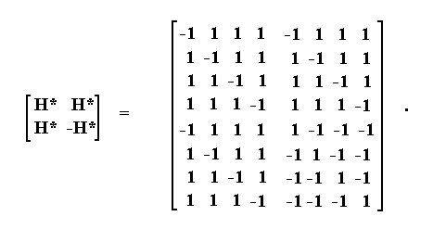
Hadamard Transform
The distribution of interest could be sparse and spiky
  This distribution is preserved under CM sketch
  But, if we don’t report the whole sketch, we might lose information
Idea: Transform sketched data to “spread out” the signal
  Use Hadamard transform (a discrete Fourier transform)

Slide 26
Low Communication with Hadamard Transform
Now the user just samples one entry in the transformed sketch
  No danger of missing the important information – it’s everywhere!
  User only has to send one bit of information → low communication
Aggregator can invert the transform to get the sketch back
  Variance is essentially unchanged from previous case

Slide 27
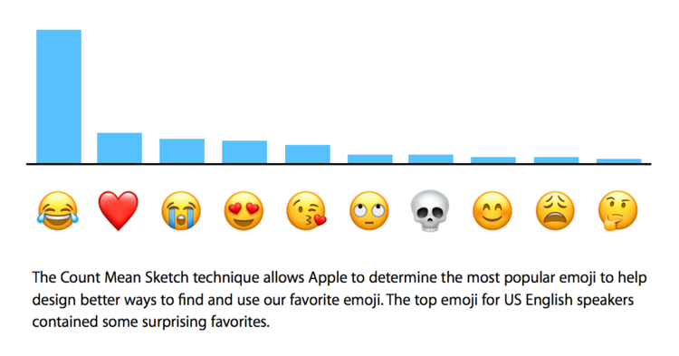
Apple’s Differential Privacy in Practice
Apple uses their system to collect data from iOS and OS X users
  Popular emojis: (heart) (laugh) (smile) (crying) (sadface)
  “New” words: bruh, hun, bae, tryna, despacito, mayweather
  Which websites to mute, which to autoplay audio on!
Deployment settings: w=1000, d=1000, ε=2-8 (some criticism)

Slide 28
Microsoft telemetry data collection
Microsoft want to collect data on app usage
  How much time was spent on a particular app today?
  Allows finding patterns over time
Makes use of multiple subroutines:
  1BitMean to collect numeric data
  dBitFlip to collect (sparse) histogram data
  Memoization and output perturbation to allow repeated probing
Has been implemented in Windows since 2017

Slide 29
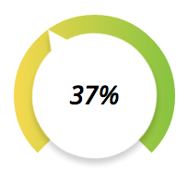
1BitMean
Problem 1: Want to estimate the mean f value of all users
  Each user has a value f between 0 and 1
Simple approach: build a histogram
  How to decide bucket boundaries? Introduces rounding error
1bitMean: modify randomized response
  User outputs 1 with probability linear in f: (1 + f·(e^{ε} – 1))/(e ^{ε} + 1)
  f=0 gives Pr[1] = 1/(e ^{ε} + 1), while f=1 gives Pr[1]= e ^{ε}/(e ^{ε} + 1)
  Taking the average of (unbiased version of) reports gives mean
  Error can be bounded proportional to 1/ε√n

Slide 30
dBitFlip
Problem 2: build a histogram over data items from a population
  Each user has a single item value out of k possibilities
  Essentially the same problem that Google and Apple tackle
Simple approach: apply RR to every bucket, costly when k is large
dBitFlip: apply Randomized Response to a sample of buckets
  User samples d buckets without replacement, applies RR to each
  Aggregator sums and unbiases the noisy reports
  Error proportional to √(k/d): trades off error for speed
  Many alternative solutions for this “frequency oracle” problem

Slide 31
Memoization
Collecting data continuously erodes the privacy guarantee
  E.g. if we know a user’s value didn’t change, we can estimate it
Memoization: a heuristic to reduce privacy loss
  Each user rounds their current value to a discrete range
  Each user precomputes their output for each range
  Choosing a fixed random shift for each user reduces error
User’s current value
Rounding
Memoized output

Slide 32
Output Perturbation
Note however “memoization violates differential privacy”!
  Can tell the difference between change and no change
  But at least this process hides what the value was
Output perturbation aims to address this problem
  For each user output bit, flip it with small probability γ, e.g. 0.2
  Increases error by a factor of 1/(1 - 2γ) (so 5/3 for γ=0.2)
Increases uncertainty about exactly when a change happened
  After long enough, can be certain that some change happened

Slide 33
MS Telemetry Collection in Practice
Deployed in Windows 10 Fall Creators Update (October 2017)
  Collects number of seconds users spend in different apps
  Parameters: ε =1 and γ = 0.2
  Collection period: every 6 hours
Collects data on all app usage, not just one at a time
  Can analyze based on the fact that total time spent is limited
  Gives overall guarantee of ε = 1.672 for a round of collection

Slide 34

Snap Private Machine Learning
Snap (parent company of Snapchat) propose LDP ML
  “Federated Machine Learning”, with privacy
  Maintain k current models
  Each step, send one user a randomly chosen model
  Receive an updated model, randomly replace one of the k
Deployment example: detecting phishing URLs
  Model: Logistic regression, circa 1000 features
  Parameters: k=20, ε = ???
  Accuracy: reached 93% accuracy, after 1 billion updates

Slide 35
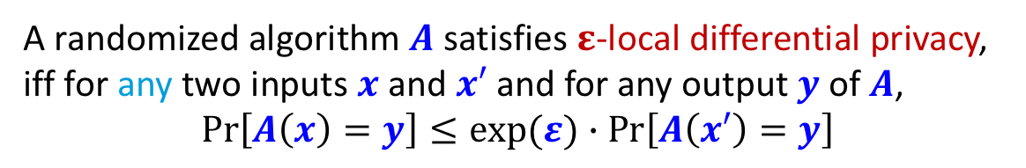
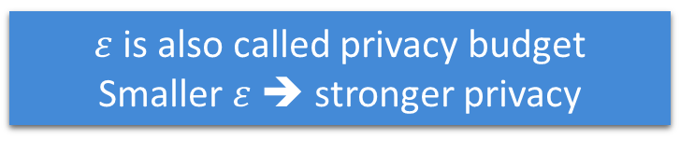
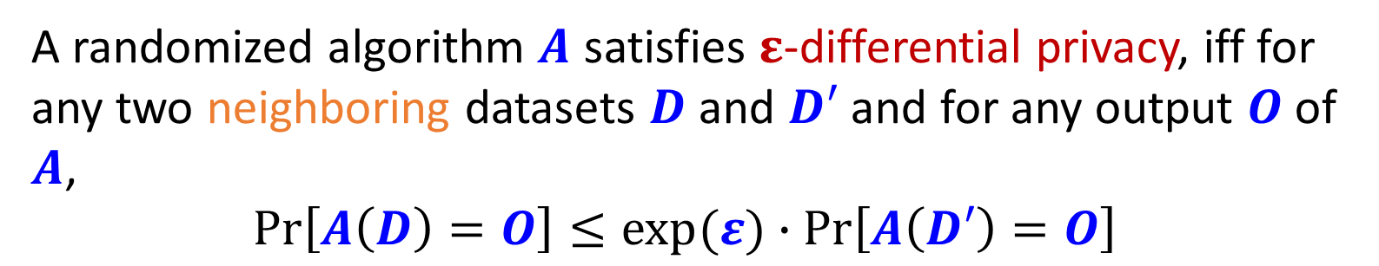
From DP to LDP: Formal Definition
Idea of DP: Any output should be about as likely regardless of whether or not I am in the dataset
A randomized algorithm $A$ satisfies $ε$-differential privacy, iff for any two neighboring datasets $D$ and $D′$ and for any output $O$of $A$,
$$\operatorname{Pr}\left[A\left(D\right)=O\right]≤exp⁡(ε)∙\operatorname{Pr}\left[A\left(D′\right)=O\right]$$
A randomized algorithm $A$ satisfies $ε$-local differential privacy, iff for any two inputs $x$ and $x′$ and for any output $y$of $A$,
$$\operatorname{Pr}\left[A\left(x\right)=y\right]≤exp⁡(ε)∙\operatorname{Pr}\left[A\left(x′\right)=y\right]$$
$ε$is also called privacy budget
Smaller $ε$➔ stronger privacy
Run by the server
Run by each single person
Idea of LDP: Any output should be about as likely regardless of my secret
Notes:
Feel free to interrupt

Slide 36
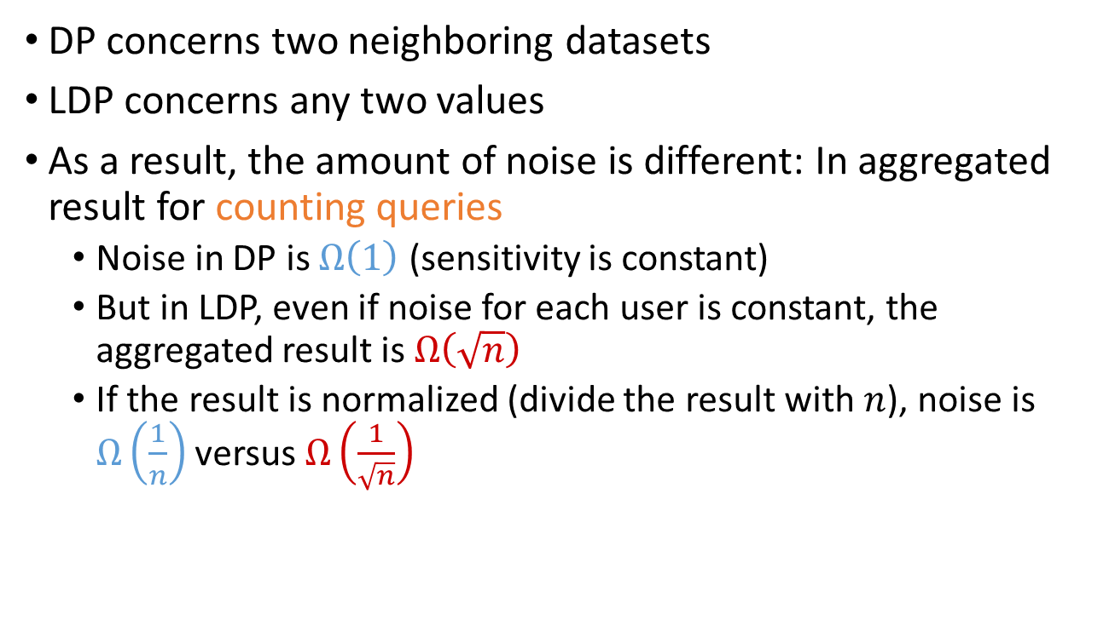
Key difference between DP and LDP
DP concerns two neighboring datasets
LDP concerns any two values
As a result, the amount of noise is different: In aggregated result for counting queries
  Noise in DP is $Ω\left(1\right)$ (sensitivity is constant)
  But in LDP, even if noise for each user is constant, the aggregated result is $Ω\left(\sqrt{n}\right)$
  If the result is normalized (divide the result with $n$), noise is $Ω\left(\frac{1}{n}\right)$ versus $Ω\left(\frac{1}{\sqrt{n}}\right)$

Slide 37

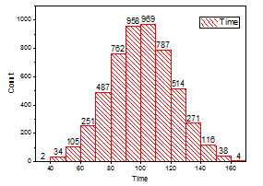






The Frequency Estimation Problem
Assumption: each user has a single value $x$ from a categorical domain $D$
Goal: Estimate the frequency of any value in $D$
Data+Noise
Data+Noise
Data+Noise
Trust boundary
Notes:
To effectively reduce the size of the set from Cartesian product

Slide 38

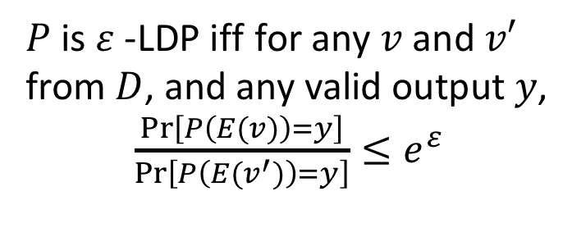
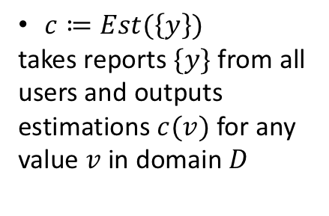

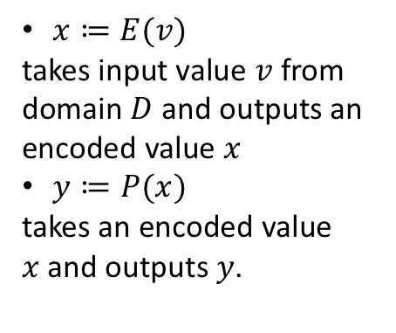
The Frequency Oracle Framework
$x≔E(v)$
takes input value $v$ from domain $D$ and outputs an encoded value $x$
$y≔P(x)$
takes an encoded value $x$and outputs $y$.
$c≔Est(\left\{y\right\})$
takes reports $\{y\}$ from all users and outputs estimations $c(v)$ for any value $v$ in domain $D$
$$y$$
$P$ is $ε$-LDP iff$′$for any $v$ and $v′$ from $D$, and any valid output $y$,
$\frac{\operatorname{Pr}\left[P\left(E(v)\right)=y\right]}{\operatorname{Pr}\left[P\left(E(v^{′})\right)=y\right]}≤e^{ε}$
Notes:
Here encode is mainly used for presenting the paper

Slide 39

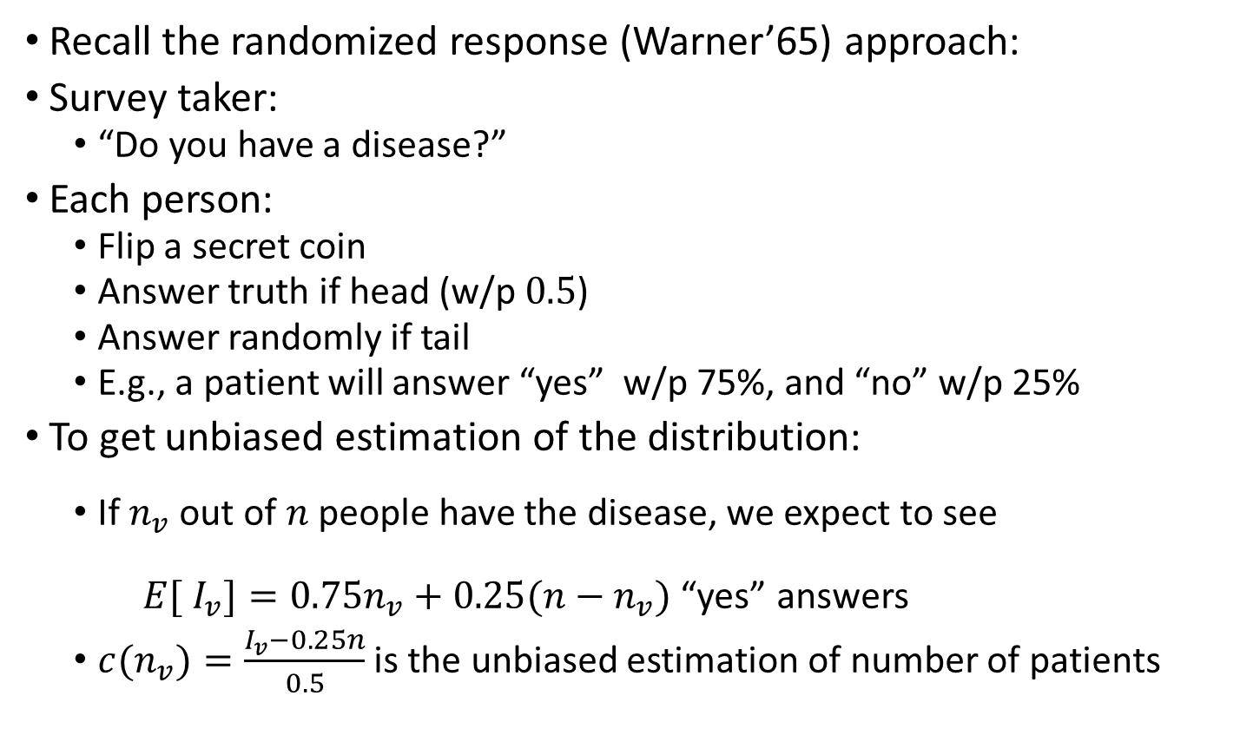
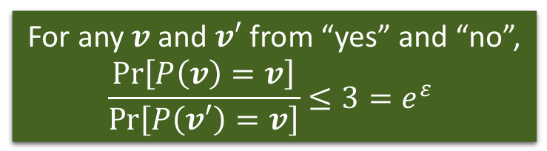
Randomized Response as a binary oracle
Recall the randomized response (Warner’65) approach:
Survey taker:
  “Do you have a disease?”
Each person:
  Flip a secret coin
  Answer truth if head (w/p $0.5$)
  Answer randomly if tail
  E.g., a patient will answer “yes” w/p 75%, and “no” w/p 25%
To get unbiased estimation of the distribution:
  If $n_{v}$ out of $n$people have the disease, we expect to see
  $E[ {I_{v}]=0.75n}_{v}+0.25(n−n_{v})$ “yes” answers
  ${c(n}_{v})=\frac{I_{v}−0.25n}{0.5}$ is the unbiased estimation of number of patients
For any $v$ and $v′$ from “yes” and “no”,
$$\frac{\operatorname{Pr}\left[P\left(v\right)=v\right]}{\operatorname{Pr}\left[P\left(v′\right)=v\right]}≤3=e^{ε}$$
Provide deniability:
Seeing answer, not certain about the secret.
This only handles binary attribute.
We will handle the more general setting.
Notes:
The definition of LDP is not new.
Comes from …

Slide 40
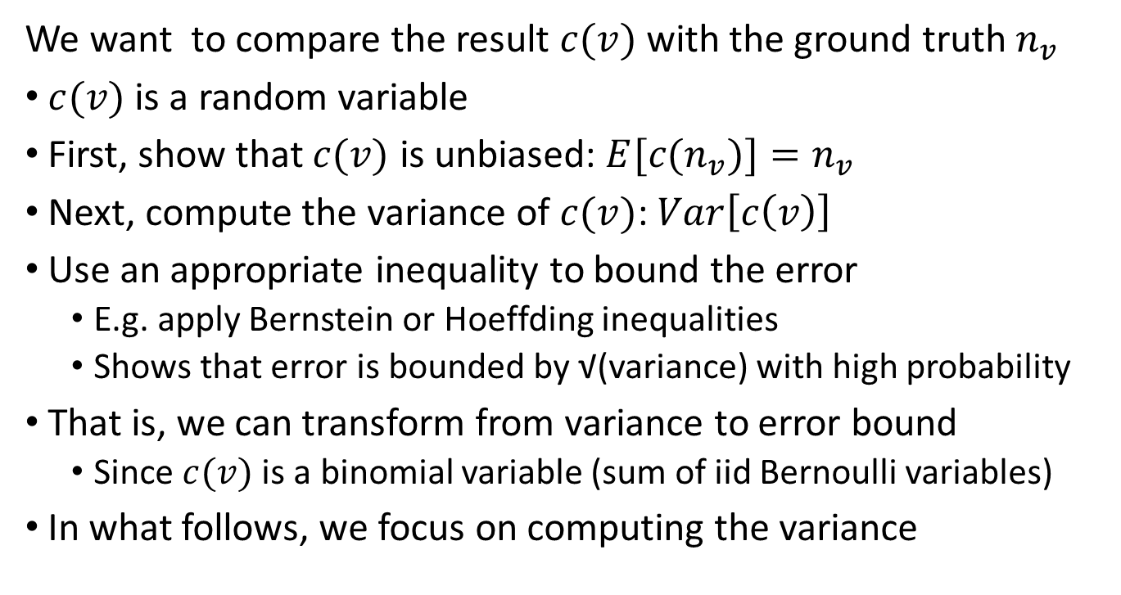
Overview of Probabilistic Analysis
We want to compare the result $c(v)$ with the ground truth $n_{v}$
$c(v)$ is a random variable
First, show that $c(v)$ is unbiased: $E[{c(n}_{v})]=n_{v}$
Next, compute the variance of $c(v)$: $Var\left[c\left(v\right)\right]$
Use an appropriate inequality to bound the error
  E.g. apply Bernstein or Hoeffding inequalities
  Shows that error is bounded by √(variance) with high probability
That is, we can transform from variance to error bound
  Since $c(v)$ is a binomial variable (sum of iid Bernoulli variables)
In what follows, we focus on computing the variance
Notes:
We use variance, but one can also use others

Slide 41

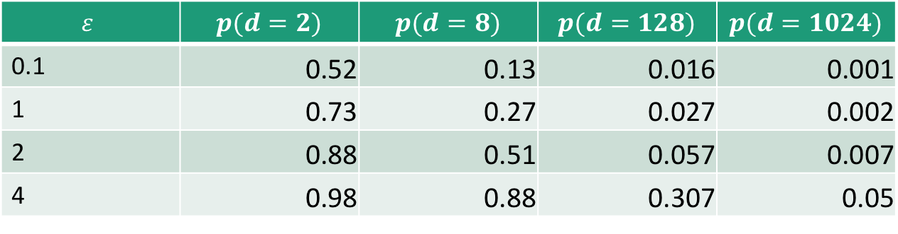
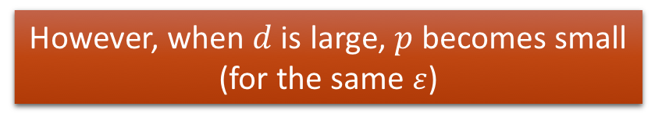
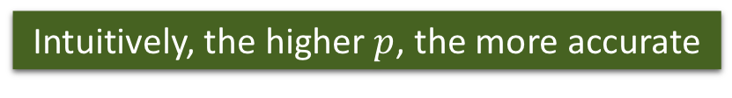
Generalized Randomized Response
(Direct Encoding) for non-binary data
User:
  Encode $x=v$ (suppose $v$ from domain $D=\{1,2,…,d\}$)
  Toss a coin with bias $p$
  If successful, report the true value $y=x$
  Otherwise, report any other value with probability $q=\frac{1−p}{d−1}$ (uniformly at random)
    $p=\frac{e^{ε}}{e^{ε}+d−1},q=\frac{1}{e^{ε}+d−1}⇒\frac{\operatorname{Pr}\left[P\left(v\right)=v\right]}{\operatorname{Pr}\left[P\left(v′\right)=v\right]}=\frac{p}{q}=e^{ε}$
Aggregator:
  Suppose $n_{v}$ users possess value $v, I_{v}$ is the number of reports on $v.$
  ${E[I}_{v}]=n_{v}⋅p+\left(n−n_{v}\right)⋅q$
  Unbiased Estimation: $c(v)=\frac{I_{v}−n⋅q}{p−q}$
Intuitively, the higher $p$, the more accurate
However, when $d$ is large, $p$ becomes small (for the same $ε$)
$$ε$$ | $$p(d=2)$$ | $$p(d=8)$$ | $$p(d=128)$$ | $$p(d=1024)$$
0.1 | 0.52 | 0.13 | 0.016 | 0.001
1 | 0.73 | 0.27 | 0.027 | 0.002
2 | 0.88 | 0.51 | 0.057 | 0.007
4 | 0.98 | 0.88 | 0.307 | 0.05
To remove dependency on domain size, we look at unary encoding protocols.
Notes:
remind

Slide 42
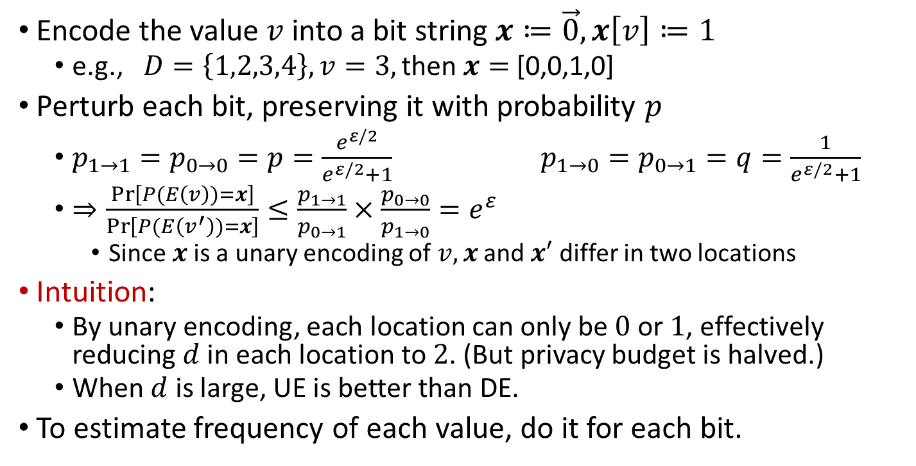
Unary Encoding (Basic RAPPOR)
Encode the value$v$ into a bit string $x≔\vec{0}, x\left[v\right]≔1$
  e.g., $D=\left\{1,2,3,4\right\}, v=3,\text{then} x=$ [0,0,1,0]
Perturb each bit, preserving it with probability $p$
  $p_{1→1}=p_{0→0}=p=\frac{e^{ε/2}}{e^{ε/2}+1} p_{1→0}=p_{0→1}=q=\frac{1}{e^{ε/2}+1}$
  $⇒\frac{\operatorname{Pr}\left[P(E\left(v\right))=x\right]}{\operatorname{Pr}\left[P(E\left(v^{′}\right))=x\right]}≤\frac{p_{1→1}}{p_{0→1}}×\frac{p_{0→0}}{p_{1→0}}=e^{ε}$
    Since $x$is a unary encoding of $v,x$ and $x′$ differ in two locations
Intuition:
  By unary encoding, each location can only be $0$ or $1$, effectively reducing $d$ in each location to $2$. (But privacy budget is halved.)
  When $d$ is large, UE is better than DE.
To estimate frequency of each value, do it for each bit.
Notes:
Suppose there are $d=2$ values, $q=\frac{1−p}{d−1}=1−p$

Slide 43




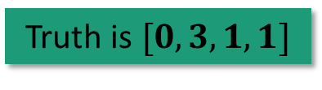






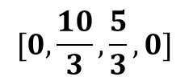


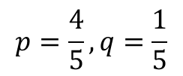





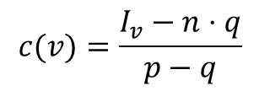





Truth is $[0,3,1,1]$
$$[0,\frac{10}{3},\frac{5}{3},0]$$
$$c$$
$$c(v)=\frac{I_{v}−n⋅q}{p−q}$$
$$Σy$$
$$[1,3,2,1]$$
Accuracy increases with the number of users
$$y$$
$$[0,1,0,0]$$
$$[0,0,0,0]$$
$$[0,1,1,0]$$
$$[0,1,1,0]$$
$$[1,0,0,1]$$
$$p=\frac{4}{5},q=\frac{1}{5}$$
$$x$$
$$[0,1,0,0]$$
$$[0,1,0,0]$$
$$[0,0,1,0]$$
$$[0,1,0,0]$$
$$[0,0,0,1]$$
$$d=4$$
$$v$$
$$2$$
$$2$$
$$3$$
$$2$$
$$4$$
Notes:
Accuracy is defined as relative error, or variance

Slide 44
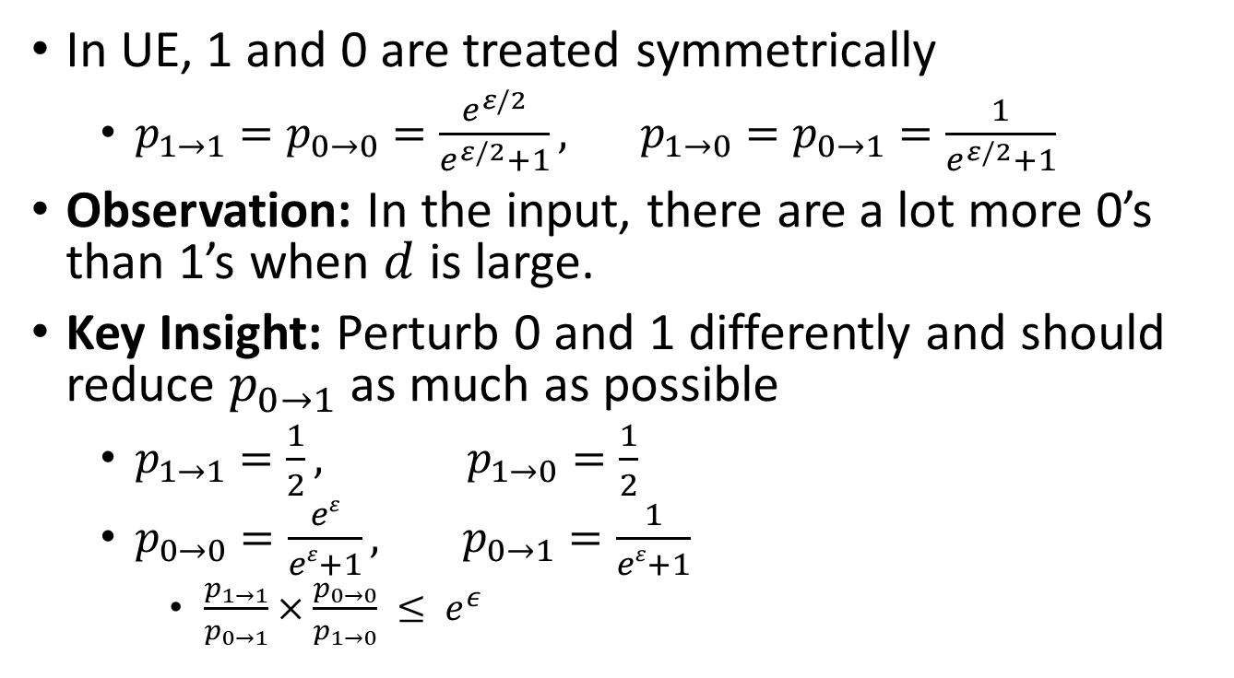
Optimized Unary Encoding (UE)
In UE, 1 and 0 are treated symmetrically
  $p_{1→1}=p_{0→0}=\frac{e^{ε/2}}{e^{ε/2}+1}, p_{1→0}=p_{0→1}=\frac{1}{e^{ε/2}+1}$
Observation: In the input, there are a lot more 0’s than 1’s when $d$ is large.
Key Insight: Perturb 0 and 1 differently and should reduce $p_{0→1}$ as much as possible
  $p_{1→1}=\frac{1}{2}, p_{1→0}=\frac{1}{2}$
  $p_{0→0}=\frac{eε}{eε+1}, p_{0→1}=\frac{1}{eε+1}$
    $\frac{p_{1→1}}{p_{0→1}}×\frac{p_{0→0}}{p_{1→0}} ≤ e^{ε}$

Slide 45
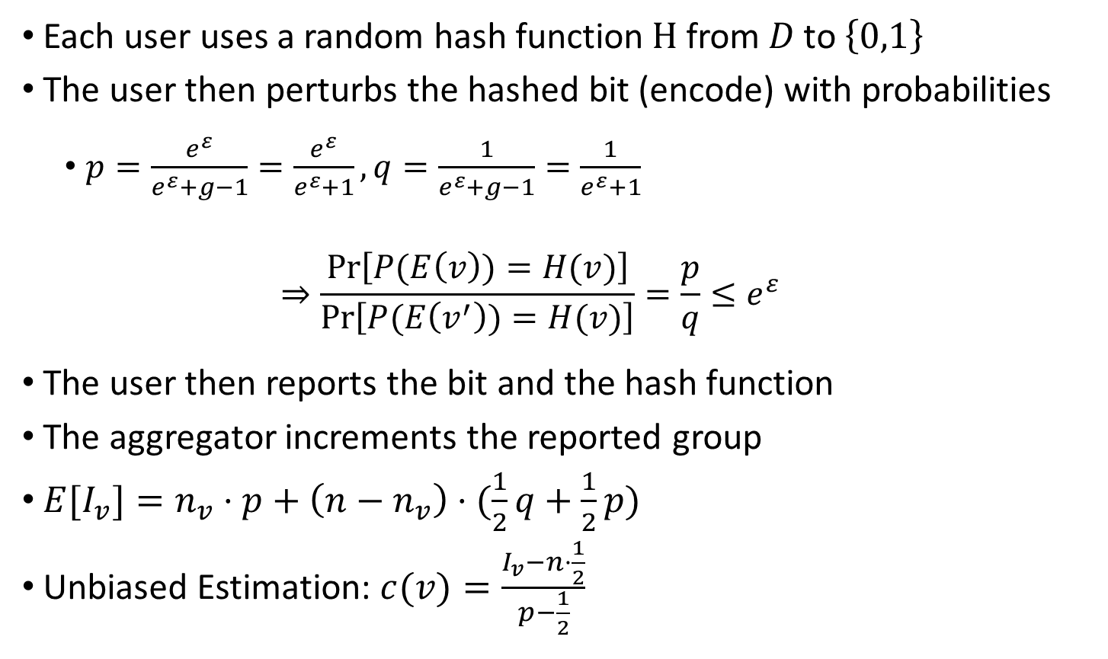
Binary Local Hash
Each user uses a random hash function$H$from$D \text{to} \left\{0,1\right\}$
The user then perturbs the hashed bit (encode) with probabilities
  $p=\frac{e^{ε}}{e^{ε}+g−1}=\frac{e^{ε}}{e^{ε}+1},q=\frac{1}{e^{ε}+g−1}=\frac{1}{e^{ε}+1}$
  $$⇒\frac{\operatorname{Pr}\left[P(E\left(v\right))=H(v)\right]}{\operatorname{Pr}\left[P(E\left(v^{′}\right))=H(v)\right]}=\frac{p}{q}≤e^{ε}$$
The user then reports the bit and the hash function
The aggregator increments the reported group
${E[I}_{v}]=n_{v}⋅p+\left(n−n_{v}\right)⋅(\frac{1}{2}q+\frac{1}{2}p)$
Unbiased Estimation: $c(v)=\frac{I_{v}−n⋅\frac{1}{2}}{p−\frac{1}{2}}$
Notes:
g is number of groups

Slide 46



Example
+ 1
+ 1
$$[0,0,0,0]$$
Group 1={2,4}
$$v=2$$
Group 1
$$D=\{1,2,3,4\}$$
Group 0

Slide 47
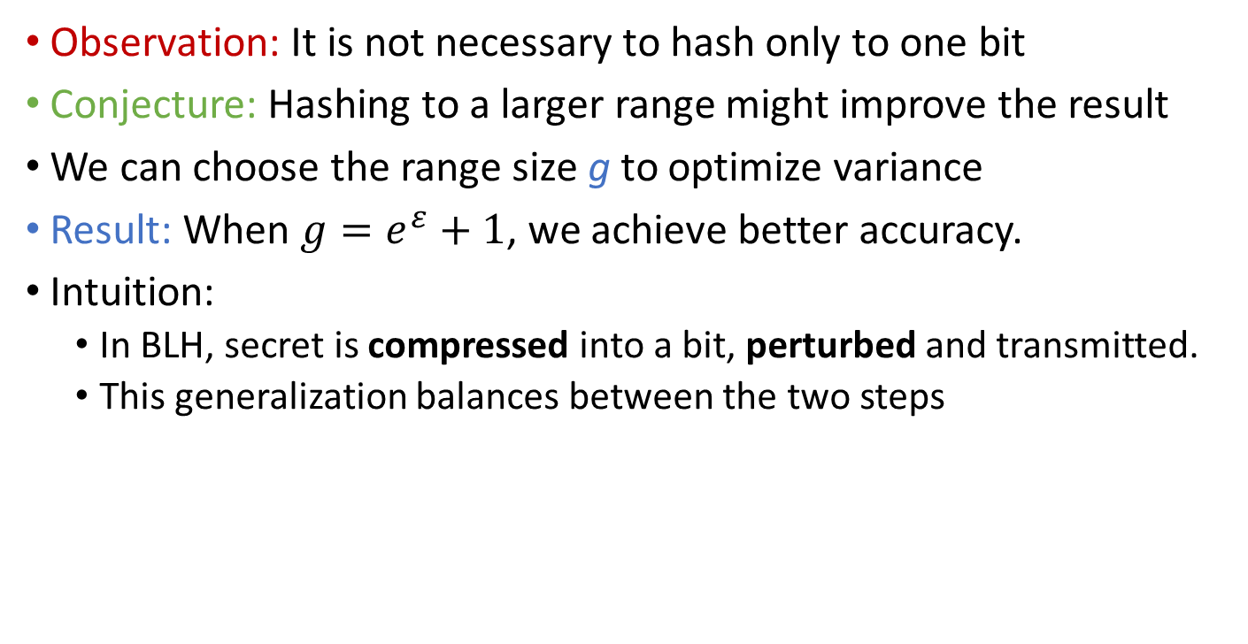
Optimized Local Hash (OLH)
Observation: It is not necessary to hash only to one bit
Conjecture: Hashing to a larger range might improve the result
We can choose the range size g to optimize variance
Result: When $g=e^{ε}+1$, we achieve better accuracy.
Intuition:
  In BLH, secret is compressed into a bit, perturbed and transmitted.
  This generalization balances between the two steps

Slide 48
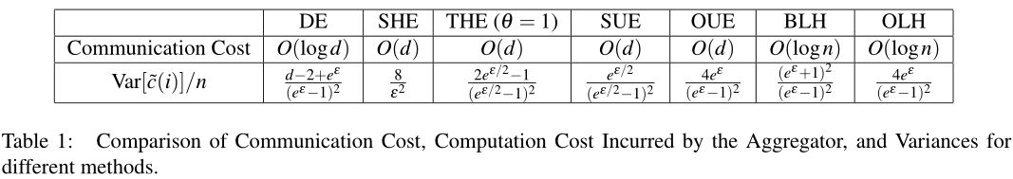
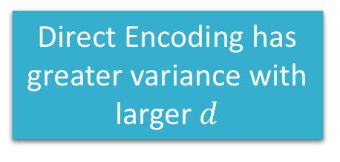
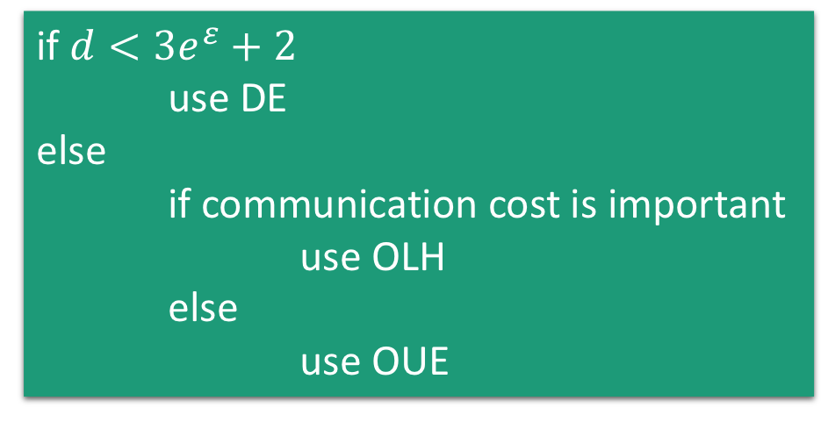
Comparison of Mechanisms
if $d<3e^{ε}+2$
use DE
else
if communication cost is important
use OLH
else
use OUE
Direct Encoding has greater variance with larger $d$
OUE and OLH have the same variance

Slide 49
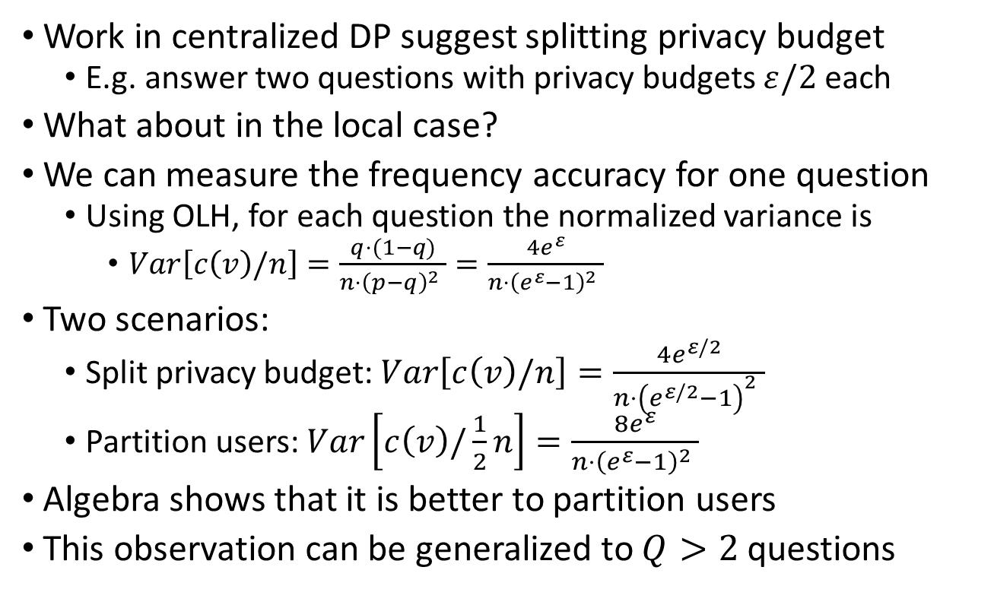
On answering multiple questions
Work in centralized DP suggest splitting privacy budget
  E.g. answer two questions with privacy budgets $ε/2$ each
What about in the local case?
We can measure the frequency accuracy for one question
  Using OLH, for each question the normalized variance is
    $Var\left[c\left(v\right)/n\right]=\frac{q⋅(1−q)}{{n⋅\left(p−q\right)}^{2} }=\frac{4e^{ε}}{{n⋅\left(e^{ε}−1\right)}^{2} }$
Two scenarios:
  Split privacy budget: $Var\left[c\left(v\right)/n\right]=\frac{4e^{ε/2}}{{n⋅\left(e^{ε/2}−1\right)}^{2} }$
  Partition users: $Var\left[c\left(v\right)/\frac{1}{2}n\right]=\frac{8e^{ε}}{{n⋅\left(e^{ε}−1\right)}^{2} }$
Algebra shows that it is better to partition users
This observation can be generalized to $Q>2$ questions

Slide 50
Interpreting the results
Amount of noise is constant for each category
If the true count is small, it may be overwhelmed by the noise, especially when domain size is big
Estimates that are close to the quantity of noise may be treated as effectively 0

Slide 51
Summary so far
Random Response
Frequency Oracles
How to use FO
 | categorical
Scalar | FO
Vector | Split Users
numerical
?
?

Slide 52
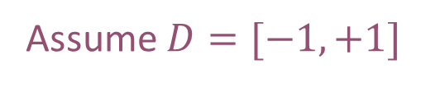
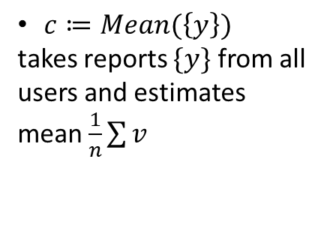

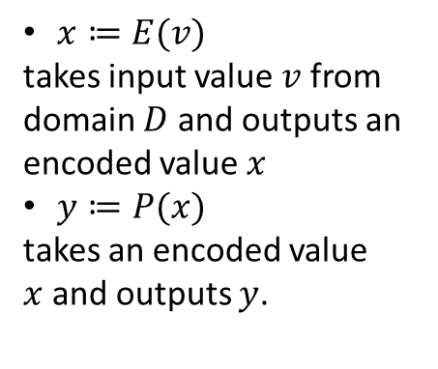
Numerical Mean Oracle
$x≔E(v)$
takes input value $v$ from domain $D$ and outputs an encoded value $x$
$y≔P(x)$
takes an encoded value $x$and outputs $y$.
$c≔Mean(\left\{y\right\})$
takes reports $\{y\}$ from all users and estimates mean $\frac{1}{n}\sum{v}$
$$y$$
Assume $D=[−1,+1]$
Mean estimation
Notes:
For now assume D=[-1,+1]. We will go to the more complex setting later.

Slide 53
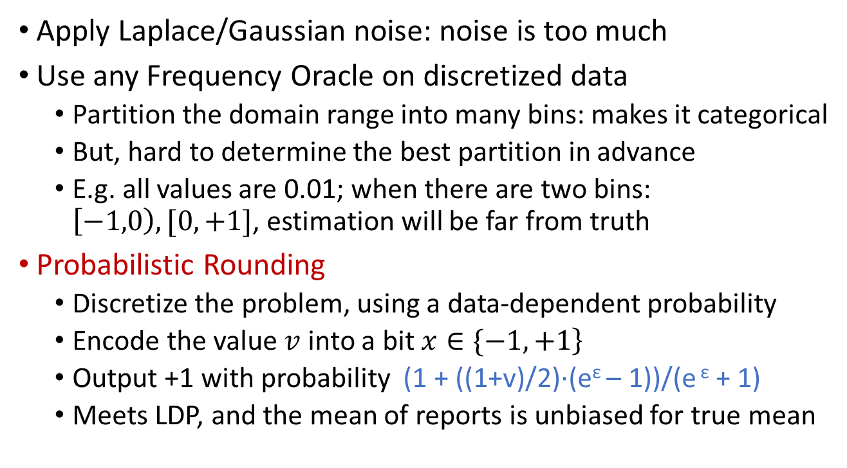
Numerical Oracles
Apply Laplace/Gaussian noise: noise is too much
Use any Frequency Oracle on discretized data
  Partition the domain range into many bins: makes it categorical
  But, hard to determine the best partition in advance
  E.g. all values are 0.01; when there are two bins: $\left[−1,0\right),[0,+1]$, estimation will be far from truth
Probabilistic Rounding
  Discretize the problem, using a data-dependent probability
  Encode the value$v$ into a bit$\left. x∈\{−1,+1\right\}$
  Output +1 with probability (1 + ((1+v)/2)·(e^{ε} – 1))/(e ^{ε} + 1)
  Meets LDP, and the mean of reports is unbiased for true mean

Slide 54
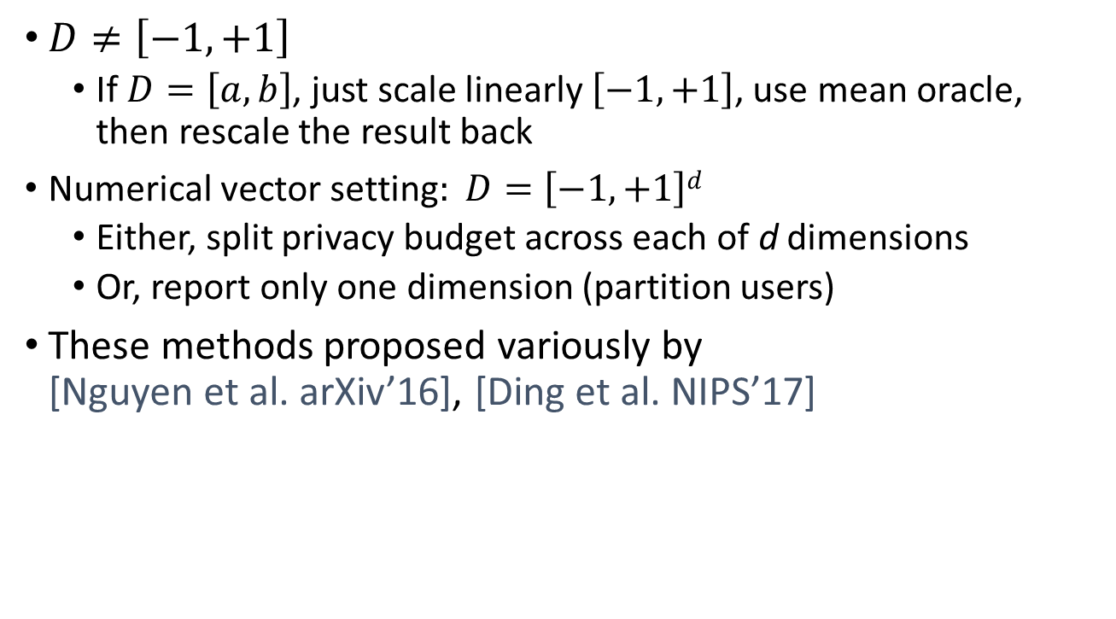
Other Numerical Settings
$D≠\left[−1,+1\right]$
  If $D=\left[a,b\right]$, just scale linearly $\left[−1,+1\right]$, use mean oracle, then rescale the result back
  $\text{Numerical} \text{vector} \text{setting}: D=\left[−1,+1\right]d$
  Either, split privacy budget across each of d dimensions
  Or, report only one dimension (partition users)
These methods proposed variously by
[Nguyen et al. arXiv’16], [Ding et al. NIPS’17]

Slide 55
Summary so far
Randomize Response
Frequency Oracles
Mean Oracle
 | categorical | numerical
Scalar | FO | Prob. Assign+RR
Vector | Split Users | Split Users

Slide 56
Heavy Hitter Estimation

Slide 57
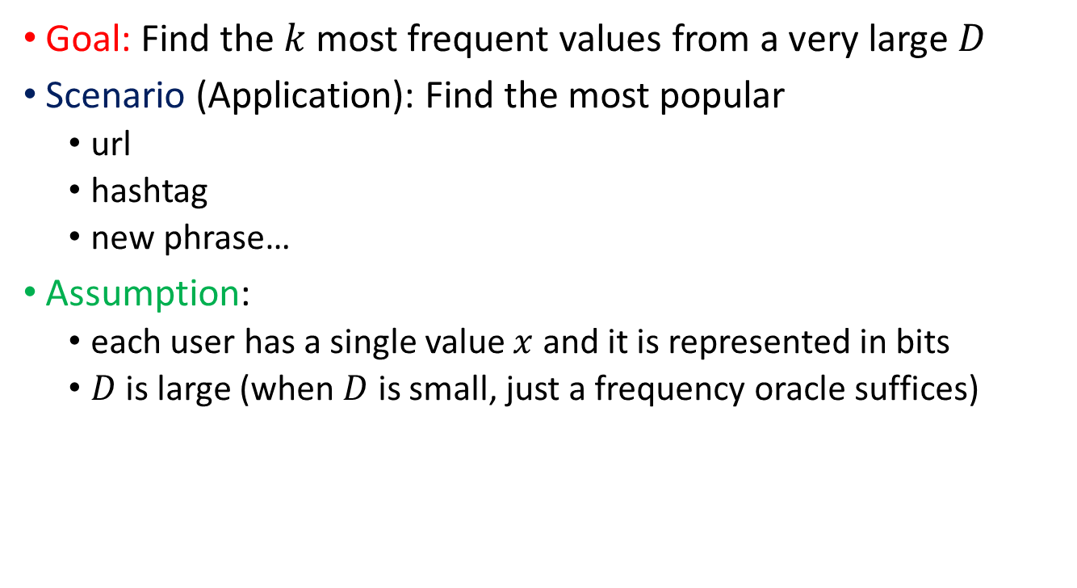
The Heavy Hitter problem
Goal: Find the $k$most frequent values from a very large $D$
Scenario (Application): Find the most popular
  url
  hashtag
  new phrase…
Assumption:
  each user has a single value $x$ and it is represented in bits
  $D$ is large (when $D$ is small, just a frequency oracle suffices)
Notes:
To effectively reduce the size of the set from Cartesian product

Slide 58
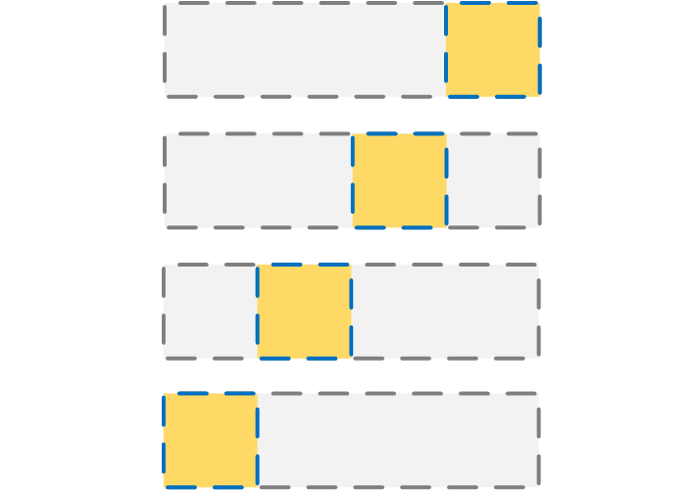

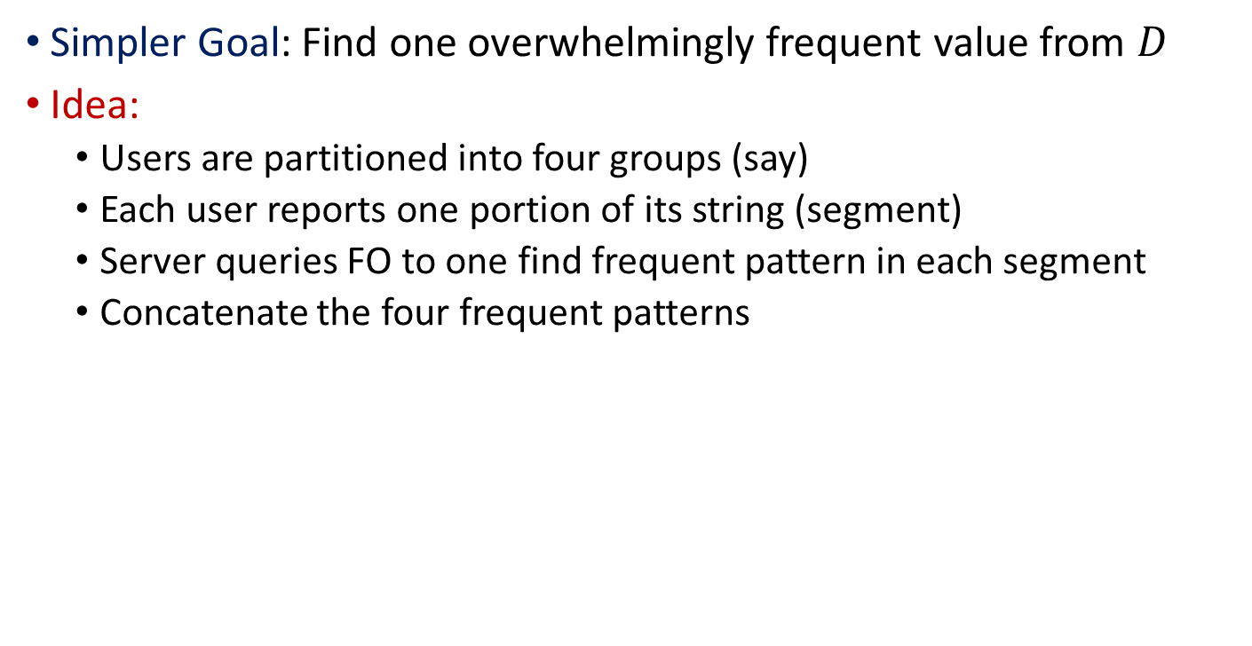
A First Solution
Simpler Goal: Find one overwhelmingly frequent value from $D$
Idea:
  Users are partitioned into four groups (say)
  Each user reports one portion of its string (segment)
  Server queries FO to one find frequent pattern in each segment
  Concatenate the four frequent patterns
+
+
+
Notes:
To effectively reduce the size of the set from Cartesian product

Slide 59

A First Solution
General Goal: Find $k$ most frequent values from $D$
Idea:
  Server use FO to find $k$frequent patterns in each segment
  Calculate the Cartesian product of the four sets of frequent patterns
Drawback:
Composing the four segment candidate sets gives a very large set of results.
x
x
x
Notes:
To effectively reduce the size of the set from Cartesian product

Slide 60
Different approaches to heavy hitters
Building a rappor with the unknown: Privacy-preserving learning of associations and data dictionaries
  G. Fanti, V. Pihur, and U. Erlingsson, PoPETS 2016.
  Segment Pair Method, from Google/Rappor
Local, Private, Efficient Protocols for Succinct Histograms
  R. Bassily, A. Smith. STOC 2015.
  Multiple Channel Method
Prefix Extending Methods (state-of-the-art)
  R. Bassily, K. Nissim, U. Stemmer, A. Thakurta, NIPS 2017
  T. Wang, N. Li, S. Jha: arXiv 2017
  N. Wang, X. Xiao, Y. Yang, T. Hoang, H. Shin, J. Shin, Y. Ge, ICDE’18
Notes:
There are mainly three styles, but there are many papers in the third style

Slide 61
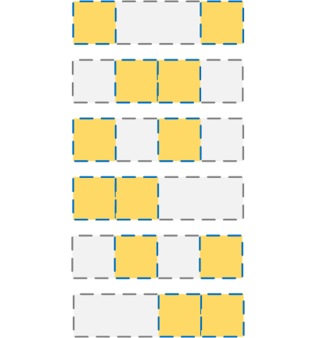
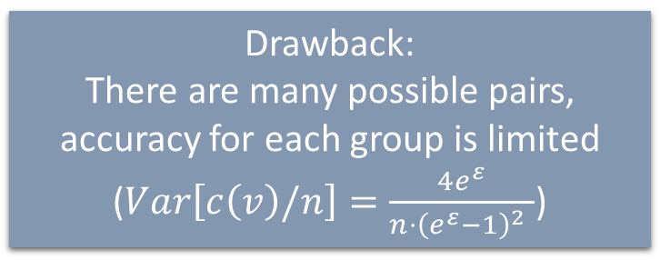
Segment Pair Method
Each user reports a pair of two randomly chosen segments.
A-priori principle:
  A pair of segments is frequent iff both segments are frequent
  A string is frequent iff any pair of segments is frequent
Step 1: For each location, test all possible segment
Step 2: For each pair, test all frequent segment pairs
Step 3: Build a k-partite graph where
  each node represents a frequent segment
  each edge represents a frequent segment pair
Step 4: Find cliques in the graph (heavy hitter candidates)
Step 5: Estimate frequencies of the heavy hitters
Drawback:
There are many possible pairs, accuracy for each group is limited ($Var\left[c\left(v\right)/n\right]=\frac{4e^{ε}}{{n⋅\left(e^{ε}−1\right)}^{2} }$)

Slide 62
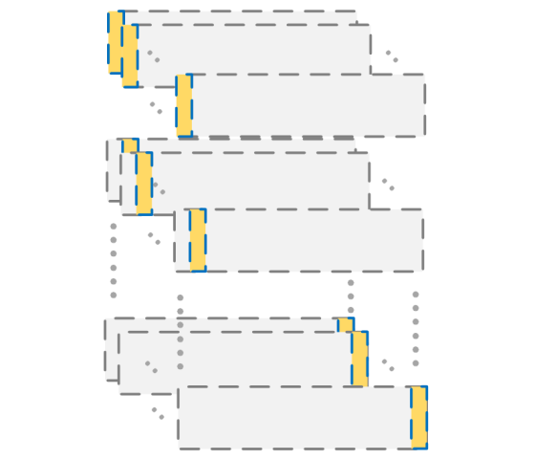


Multiple Channel Method
If there is only one heavy hitter, we can afford the Cartesian product, which contains only one element
Use multiple “channels” to isolate heavy hitters
Each user reports a bit in each channel:
  In channel $H(v)$, report $v[l]$;
  In other channels, report a uniformly random bit
Aggregator identifies the dominant bits in each channel
Estimate frequencies of the heavy hitters
Drawback:
To avoid collision, many ($n1.5$) channels are used.
Number of users in each channel is limited.
Computational cost is high.

Slide 63











Prefix Extending Method
Start from a prefix, and gradually extend this prefix.
Identify the frequent patterns for a small prefix first, and then extend to a larger prefix by b bits at a time
Result for the last group can be used for frequency estimation
OLH.P($`deadbeef′$)
OLH.Q($`deadbe∗∗′$)->`deadbeef’
OLH.P($`deadbe′$)
OLH.Q($`dead∗∗′$)->`deadbe’
OLH.Q($`de∗∗′$)->`dead’
OLH.P($`dead′$)
OLH.Q($`∗∗′$)->`de’
OLH.P($`de′$)
$$v=`deadbeef′$$

Slide 64
More Applications for LDP
Beyond heavy hitters and simple statistics, many LDP applications:
Text and language modelling
Marginal distributions and correlation
Spatial data
Graphs and social networks
Machine learning
Across all these LDP applications, some common features emerge

Slide 65

Text and language modeling
Many reasons to analyze (private) text:
  Understand evolving use of language
  Build models to help mobile users
Current deployments involve text and text-like data
  Apple building custom dictionaries and emoji popularity
Data comes from a large (hierarchical / unbounded) domain
  Google tracking popular URLs, which are long text strings
Several recent LDP papers address various problems here
  PrivTrie: Frequent Term Discovery under LDP [Wang et al. ICDE 18]
  Autocomplete in LDP [Chang & Thakurta, IEEE S&P 18]
  LDP Bayesian Inference for Count Models [Schein et al. ArXiv 18]

Slide 66


N-Grams with PrivTrie
Objective: collect popular new terms “freshly minted by users”
  E.g. to add to dictionaries/autocorrect typing features
Modeled as each user has one new term to report
  Essentially this is another heavy hitters problems!
Approach: search for heavy nodes within a trie

Slide 67
N-Grams with PrivTrie
PrivTrie combines several ideas that can be applied elsewhere:
Perform the search in multiple rounds of interaction
  New queries sent to users based on current search range
Partition users into ‘batches’, query each batch only once
  O(√k) improvement over querying all users k times
  Set batch size big enough to give reasonable accuracy
  Reuse a batch for non-overlapping nodes (parallel composition)
Refine count estimates by using consistency properties
  E.g. count of a parent node should equal sum of its children
  Modelled as least-squares minimization (Gauss-Markov theorem)

Slide 68

Private Autocomplete
Autocompletion in LDP [Chang Thakurta IEEE S&P 18]
considers how to build the full autocomplete model
A full Markov model predicts next work based on last k words
  This is hard to learn in LDP: small counts for k-word combinations
‘Tags and words model’ uses ‘parts of speech’ tags (noun, verb…)
  Predict next tag based on last two tags
  Predict next word based on (predicted) tag and last word
The model requires fewer statistics to build
  Statistics captured in LDP via a frequency oracle on word pairs
Lesson for (LDP) model design: choose simpler models whose parameters will be better supported from the data collected

Slide 69
Marginal Distributions
Heavy hitters treats data as 1D but often data is multidimensional
C., Kulkarni, Srivastava [SIGMOD 18]: marginal distributions
  Each user has d bits of data (encoding sensitive data)
  We want (all) marginals over k attributes – well-studied in cental DP
 | Gender | Obese | High BP | Smoke | Disease
Alice | 1 | 0 | 0 | 1 | 0
Bob | 0 | 1 | 0 | 1 | 1
…
Zayn | 0 | 0 | 1 | 0 | 0
Gender/Obese | 0 | 1
0 | 0.28 | 0.22
1 | 0.29 | 0.21
Disease/Smoke | 0 | 1
0 | 0.55 | 0.15
1 | 0.10 | 0.20

Slide 70
Marginal Distributions
Each marginal is a frequency distribution, so we have multiple overlapping instances of the frequency oracle problem
Could apply Randomized Reponse to each entry of each marginal
  To give an overall guarantee of privacy, need to scale ε
  The more bits released by a user, the more noise we have
Need to design algorithms that minimize information per user
First observation: apply sampling (batching) to reduce error
  If we release b bits of information per user, the error is b/√n
  If we sample 1 out of n bits, the error is √(b/n)
  Quadratically better to sample than to share!

Slide 71
Marginals: what to materialize?
Different approaches based on how information is revealed
We could reveal information about all marginals of size k
  There are (d choose k) such marginals, of size 2^{k} each
Or we could reveal information about the full distribution
  There are 2^{d} entries in the d-dimensional distribution
  Then aggregate results here (obtaining additional error)
Still using randomized response on each entry
  Approach 1 (marginal-based): cost proportional to 2^{3k/2} d^{k/2}/√n
  Approach 2 (full distribution): cost proportional to 2^{(d+k)/2}/√n
If k is small (say, 2), and d is large (say 10s), Approach 1 is better
  But there’s another idea to try…

Slide 72

Marginals via Hadamard
Instead of materializing the data, we can transform it
The Hadamard transform is the discrete
Fourier transform for the binary hypercube
  Very simple in practice
Property 1: only (d choose k) coefficients
are needed to build any k-way marginal
  Reduces amount of information to release [Barak et al. PODS 07]
Property 2: Hadamard transform is a linear transform
  Vector mean: estimate global coefficients by sample and average
Yields error proportional to 2^{k/2}d^{k/2}/√n
  Better than both previous methods (in theory, and in practice)

Slide 73

Marginals and models
How to handle attributes with higher cardinality than binary?
  Can encode attribute with |A| values into log|A| binary attributes
Also heuristic approaches for marginals on arbitrary attributes:
  Expectation-Maximization for 2-way [Fanti et al. PETS 16]
  Lasso-based regression for higher orders [Ren et al. IEEE TIFS 18]
Once marginals are recovered, synthetic data can be generated
  Via Chow-Liu tree Bayesian model [Cormode et al. SIGMOD 18]
  Or more general Bayesian network [Ren et al. IEEE TIFS 18]
  Use estimated mutual information of marginals to choose model
  Then use synthetic data for any analytics (eg classification)

Slide 74


Range Queries
Given data from an ordered domain, we study range queries:
  “How many data points fall in the range [l, r]”?
Hierarchical approaches improve over summing point queries:
  Impose a regular tree over the input domain, and sample nodes
    Need to do post-processing to obtain consistent answers
  Apply a Haar wavelet transform to input, and sample coefficients
Which method is best? Answer: both are competitive!
  Similar variance (up to leading constant) for optimal settings
  Similar empirical performance, slight preferences for different ε
  In contrast to the centralized case, where trees are preferred

Slide 75

Quantile queries [C, Kulkarni, Srivastava VLDB19]
Use range queries to find ranges that cover a given fraction
  E.g. the median is the 0.5 quantile query
Both Hierarchical Histograms (HH) and Haar wavelets obtain similar results: very accurate answers for N large enough

Slide 76

Spatial Data
People’s geographic locations can be very privacy sensitive
  Canonical example: presence at a health clinic
  But we want to capture population location distribution
First attempt: impose a hierarchical grid structure and count
  Similar ideas successful in the centralized model
  Identify heavy regions: a heavy hitter problem
  Could be solved via frequency oracle (again)!
Limitations:
  Doesn’t account for varying spatial density
  (the difference between Manhattan NY vs Manhattan KS)
  Maybe too cautious: it’s fine to know what country I’m in

Slide 77

Spatial Data
Private Spatial Data Aggregation in the Local Setting
[Chen et al ICDE 2016] use a relaxation of LDP
We impose a (semantic) hierarchy over locations
E.g. Country / State / City / Block
  Each user specifies which level they can be located within
  Restrict user’s LDP definition to locations within the same level
  We can apply a modified frequency oracle (FO):
  locations outside a user’s ‘safe zone’ are known to be empty
More details in the paper:
  Can easily allow a ‘personalized’ privacy parameter ε_{i}
  Group (cluster) users together to run fewer FO invocations

Slide 78

Social Network Data
Our ‘true’ social networks are very private
  Our Facebook friends might be (mostly) public…
  …but who we actually talk to/hang out with most is private!
We want to release social network data as graph models
  Hard enough in the central DP model, so only harder with LDP
  Aim to release parameters of a statistical graph model
As for central DP, there are alternative LDP definitions for graphs:
  Node LDP: LDP definition applied to whole adjacency list of a user
  Edge LDP: LDP restricted to adjacency lists that differ in one edge
Results so far only for the (more relaxed) edge LDP definition

Slide 79

Synthetic Social Graphs
Generating Synthetic Decentralized Social Graphs with Local Differential Privacy [Qin et al. CCS 2017] considers two baselines:
Randomized neighbour list (RNL) on user’s adjacency list
  Meets LDP, but introduces a lot of fake edges
  Need a model where parameters have more support
Degree-based graph generation (DGG)
  Compute degree of each node (accurate under edge LDP)
  Sample from a graph model that only needs degrees (eg BTER)
Neither baseline is very satisfying
  Goldilocks effect: RNL too detailed, DGG too coarse

Slide 80

Synthetic Social Graphs
Qin et al. propose a different approach with three phases:
Aggregator randomly clusters users into k groups
  Users release noisy histogram of their links to these groups
Cluster nodes with similar histograms into new groups
  Users release noisy histogram to new groups [optionally, iterate]
Sample a corresponding graph from modified BTER model

Slide 81

Machine Learning
Effective machine learning (ML) needs to learn from real data
  For tasks like classification, regression, recommender systems
Traditional machine learning assumes centralized data
  Training data to build the model, and test data to evaluate
Many ML tasks can be written as optimization problems:
  Minimize a (regularized) loss function for training data points (x, y)
  Learn parameters Θ to minimize ∑_{i} Loss(Θ, x_{i}, y_{i}) + NΩ ‖Θ‖₂²
  E.g. linear regression, Loss(Θ, x_{i}, y_{i}) = (x_{i}^{T} Θ – y_{i})²
  E.g. SVM with hinge loss, Loss(Θ, x_{i}, y_{i}) = max(0, 1 – y_{i} x_{i}^{T} Θ)
Can we find private ML models directly under LDP?

Slide 82
Machine Learning
Collecting and Analyzing Data from Smart Device Users with LDP [Nguyen et al, ArXiv 16] extend [Duchi et al FOCS 13]:
Adopt the approach of Stochastic Gradient Descent (SGD):
  Pick a random data point, and the compute gradient of Loss()
  Update the model by a (small) step in the direction of the gradient
  For LDP, “clip” the gradient to [-1,1]^{d} and apply vector release
Working one user at a time is too noisy, so use (mini)batches
  Each user participates in at most one batch
  One interaction round to compute a noisy (mean) gradient update
When the data/model dimension d is high, not enough data
  Apply dimensionality reduction to build smaller models
  Multiply all data by a (fixed) random linear projection

Slide 83
Single-round Machine Learning
Recent theoretical results aim to reduce rounds needed for ML:
Is Interaction Necessary for Distributed Private Learning?
[Smith et al, S&P 17]:
  Develops protocols with (provably) few rounds of interaction
  Shows simple protocol for regression without interaction:
  each user sends (noisy) information about their data point
Collect at Once, Use Effectively: Making Non-interactive Locally Private Learning Possible [Zheng et al, ICML 17] uses:
  Dimensionality reduction for sparse high dimensional problems
  Approximation theory techniques for ‘smooth linear loss’
Empirical Risk Minimization in Non-interactive Local Differential Privacy [Wang et al ArXiv 18] try to improve on these
  Give efficient polynomial approximations for smooth loss functions

Slide 84

Recommender Systems
Given a collection of user ratings, we want to recommend items
  Generalizing ‘people who liked that, also liked this…’
n × m matrix of ratings R, where r_{i,j} is rating of user i for item j
  Typically, R is large and sparse
  Write y_{ij}=1 when user i has rated item j, 0 otherwise
  Aim to (approximately) factorize R = UV over d-dimensional space
Loss function here is ∑_{ij} y_{ij}(r_{ij} – u_{i}^{T} v_{j})² (+ regularization terms)
  u_{i} is user’s (d-dimensional) row, v is item’s column in factor space
  Can solve (non-privately) by gradient descent over U and V
LDP version: aim for privacy at user granularity (like node LDP)
  Similar approaches have been tried in centralized case

Slide 85

Recommender Systems
Privacy-enhanced matrix factorization for recommendation
[Shin et al., TKDE 18] via vector release:
  Users maintain their own u_{i} vector without sharing it
  Collect LDP gradients on V from batches of users, clipped to [-1,1]
  Use dimensionality reduction on items to improve accuracy

Slide 86
Common Themes
Across all these varied applications, a few themes emerge:
Finding a good (statistical) model is often the main challenge
  Large models don’t work well under privacy due to the noise
  Seek models where each parameter is supported by many users
Often we can map onto one of a few basic problems
  Most methods use a frequency oracle, or vector generalizations
A few other tricks are seen multiple times:
  Sample or split users into batches instead of dividing privacy budget
  “Clip” data to ranges to reduce noise that must be added
  Use multiple rounds to adaptively ask queries
  Data transformation and dimensionality reduction often useful
  Enforce consistency constraints when possible

Slide 87
Open Problems and Closing Thoughts

Slide 88




Immediate Open Problems for LDP
Take any data type or analysis goal and ask
“Can we handle this under the LDP model?”:
  Sentiment analysis for (private) reviews: LDP-TripAdvisor?
  Trajectory analysis of GPS movements: LDP-RunKeeper?
  Social network data analysis: LDP-Facebook?
More challenging to apply to richer, unstructured data
  E.g. Free text in written medical notes
  E.g. Multimedia – images and videos
  The semantics of privacy are not yet well defined here!
Algorithm engineering: make LDP widely available
  RAPPOR is open source, but there’s no easy toolkit for LDP yet

Slide 89

Evolving Data
Often want to collect data multiple times
  Regular update of usage statistics e.g. daily
Current deployments offer only weak longitudinal guarantees
  Google & Microsoft: memoization and re-randomization heuristics
  Apple: privacy budget ‘replenished’ every day [Tang et al ArXiv 17]
LDP for Evolving Data [Joseph, Roth, Ullman, Waggoner 18]
gives a privacy guarantee for repeated release of a statistic
  Time divided into ‘epochs’ of multiple timesteps
  In each epoch, subsets of users ‘vote’ to refresh the global statistic
  Voting thresholds make cost proportional to number of changes
More work needed to implement and make practical!

Slide 90

Deep Learning and Privacy
Methods based on ‘deep learning’ (neural networks) are currently very popular for accurate machine learning
  This is challenging for privacy: they can (over)fit the data
‘Federated learning’ promises some privacy gains
  The model is learned with the help of distributed users
  Each selected user updates the current model based on their data
  Data never leaves the user – but gradients could still be revealing?
Some examples in other DP models are promising, e.g. Learning differentially private language models without losing accuracy [McMahan et al. ICLR 18]
  Multiple rounds of federated training using batches of users
  Almost (but not quite) LDP for an LSTM RNN model

Slide 91

Theoretical Underpinnings
LDP (re)emerged most recently from the theory literature
  What can we learn privately? [Kasiviswanathan et al, FOCS 08]
  Showed the model is equivalent to Kearns’ model of ‘statistical queries’ – up to polynomial blow up in population size n!
  Local Privacy and Statistical Minimax Rates [Duchi et al, FOCS 13]
  Showed asymptotic optimality of basic LDP algorithms such as Laplace mechanism and Randomized Response
Still many theoretical questions about LDP:
  Can we show more lower bounds for the accuracy tradeoff?
  What problems don’t have efficient LDP protocols?
  Can all LDP algorithms have each user output only 1 (noisy) bit?
  (Some good reasons to believe so)

Slide 92

Opening up Private Data
Deployments of LDP are still tightly controlled by aggregator
  Google/MSR/Apple/Snap controls the code on your device
  User reports typically sent over secure channel to aggregator
Could there be a more ‘open’ implementation of LDP?
  Users could publish their LDP outputs
  Multiple aggregators could perform independent analysis
  Would require a big change in architecture and adoption!
LDP data

Slide 93
Generalizing LDP
Additive error probability
  Centralized DP allows an additional parameter δ, which relaxes the requirement to Pr[X ∈ S|D] ≤ e^{ε} Pr[X ∈ S|D’] + δ
  LDP can be relaxed similarly, but makes no big difference (in theory)
  What are the practical consequences of this relaxation?
Multiple rounds of data collection
  Some LDP protocols collect data once, others interact with users
    Queries in subsequent rounds depend on prior rounds
  What is the tradeoff between rounds and accuracy/communication?
Distributed Differential Privacy e.g. for federated learning
  Users in small groups trust their raw data to an aggregator
  Aggregators release DP data to an untrusted global aggregator

Slide 94


LDP limitations
For LDP to really work with good accuracy we need to have:
  Massive number of participating users (ideally millions)
  Relaxed privacy parameters (ε = 8–16 in Apple deployment)
  “Flexible” attitude to composition results (daily “reset”)
  Relatively simple analytics target (simple statistics)
LDP is really good for:
  Large deployments by well-resourced tech companies
  Academic research generating new papers in popular model
LDP does not seem so good for:
  Everyone else?
RAPPOR has been replaced in current Chrome versions

Slide 95

Hybrid Privacy Models
We can imagine ‘hybrid’ models of privacy
  Users run LDP with different (personalized) values of ε
  Some users entrust their raw data to the aggregator
Blender [Avent et al UsenixSecurity 17] fleshes out this model
  Combines data obtained from the ‘opt-in’ group O with the ‘regular’ (LDP) clients C
  E.g. use opt-in data to generate list of possible query answers
  Use combined data from both groups to rank the list
Several natural questions about theory and applications:
  Quantify benefits of hybrid privacy as a function of |O| and |C|
  What is the ‘killer app’ for this model of privacy?
  Other hybrids: each user chooses what to reveal non-privately

Slide 96

SMC and DP
The main weakness of LDP is the magnitude of the error added
  Compared to central DP, where the noise is essentially a constant
Could we obtain central DP error with a local guarantee?
Change the game: use secure multiparty computation (SMC)
  Each participant encrypts their data, which is aggregated
  Each user also adds some carefully chosen noise
  The noise combines to be DP-level noise: “computational DP”
  We can finally decrypt the answer with central DP noise
Several papers give protocols to achieve this
BUT computational overheads are very high
  Hence why Google, Apple, Microsoft went the LDP route?

Slide 97
Possible Compound Models
LDP in isolation does not provide a rounded solution, but:
LDP plus deidentification of reports gives stronger privacy
  “Shuffling” the messages gives O(ε/√n) (centralized) DP
  Generic bounds for sufficiently restricted LDP protocols
  Tight bounds for core problems (e.g. sums and counts)
  Many recent results [Bittau et al 2017] [Erlingsson et al. 2019]
  [Balle et al 2019] [Cheu et al 2019] …
LDP protocols are good candidates for implementing with SMC
  Simple partitions of quantities, small data per participant
  One algorithm could “compile” to multiple target models?
LDP may be a stepping stone to more powerful privacy models

Slide 98


Reflecting on LDP
Local Differential Privacy is a big success for privacy research
  Adopted by Google, Apple, Microsoft and more for deployment
  Deployments affecting (hundreds of) millions of users
  In contrast, centralized DP has smaller success (but, see US Census)
However, there are reasons to pause and reflect:
  LDP only works when you can rely on millions of active participants
  Companies using LDP also gather vast amounts of raw data directly!
  Privacy settings are not very tight: deployed ε ranges from 0.5 to 8+

Slide 99

Conclusions
Private data release is a challenging and exciting problem!
The model of Local Differential Privacy has been widely adopted
  Intially for gathering counting statistics
  LDP comes at a cost: need many more users than centralized model
Lots of research excitement developing new applications
  Practical impact of these is still to be seen
Lots of opportunity for new work:
  Designing optimal mechanisms for local differential privacy
  Extend far beyond simple counts and marginals
  Structured data: graphs, movement patterns
  Unstructured data: text, images, video?

Slide 100
References - Deployments
Warner, S. L. Randomised response: a survey technique for eliminating evasive answer bias. J. ASA 1965. 60 (309): 63–69
Úlfar Erlingsson, Vasyl Pihur, Aleksandra Korolova. RAPPOR: Randomized Aggregatable Privacy-Preserving Ordinal Response. CCS 2014: 1054-1067
Burton H. Bloom. Space/Time Trade-offs in Hash Coding with Allowable Errors. Commun. ACM 13(7): 422-426 (1970)
Differential Privacy Team, Apple. Learning with privacy at scale. Apple Machine Learning Journal, 2017.
Graham Cormode, S. Muthukrishnan. An improved data stream summary: the count-min sketch and its applications. J. Algorithms 55(1): 58-75 (2005)
Bolin Ding, Janardhan Kulkarni, Sergey Yekhanin. Collecting Telemetry Data Privately. NIPS 2017: 3574-3583
Vasyl Pihur, Aleksandra Korolova, Frederick Liu, Subhash Sankuratripati, Moti Yung, Dachuan Huang, Ruogu Zeng. Differentially-Private "Draw and Discard" Machine Learning. CoRR abs/1807.04369 (2018)

Slide 101
References – Oracles and Heavy Hitters
Tianhao Wang, Jeremiah Blocki, Ninghui Li, Somesh Jha. Locally Differentially Private Protocols for Frequency Estimation. USENIX Security Symposium 2017: 729-745
Thông T. Nguyên, Xiaokui Xiao, Yin Yang, Siu Cheung Hui, Hyejin Shin, Junbum Shin. Collecting and Analyzing Data from Smart Device Users with Local Differential Privacy. CoRR abs/1606.05053 (2016)
Giulia C. Fanti, Vasyl Pihur, Úlfar Erlingsson. Building a RAPPOR with the Unknown: Privacy-Preserving Learning of Associations and Data Dictionaries. PoPETs 2016(3): 41-61 (2016)
Raef Bassily, Adam D. Smith. Local, Private, Efficient Protocols for Succinct Histograms. STOC 2015: 127-135
Raef Bassily, Kobbi Nissim, Uri Stemmer, Abhradeep Guha Thakurta. Practical Locally Private Heavy Hitters. NIPS 2017: 2285-2293
Tianhao Wang, Ninghui Li, Somesh Jha. Locally Differentially Private Heavy Hitter Identification. CoRR abs/1708.06674 (2017)

Slide 102
References – Text/NLP Applications
Ning Wang, Xiaokui Xiao, Yin Yang, Ta Duy Hoang, Hyejin Shin, Junbum Shin, Ge Yu. PrivTrie: Effective Frequent Term Discovery under Local Differential Privacy. ICDE 2018: 821-832
Johnnie Chang, Abhradeep Guha ThakurtaAutocompletion in Local Differential Privacy. IEEE Security and Privacy Symposium (S&P 2018)
Aaron Schein, Zhiwei Steven Wu, Alexandra Schofield, Mingyuan Zhou, Hanna M. Wallach. Locally Private Bayesian Inference for Count Models. ICML 2019: 5638-5648

Slide 103
References – Marginals, Spatial Data, Graphs
Graham Cormode, Tejas Kulkarni, Divesh Srivastava. Marginal Release Under Local Differential Privacy. SIGMOD Conference 2018: 131-146
Boaz Barak, Kamalika Chaudhuri, Cynthia Dwork, Satyen Kale, Frank McSherry, Kunal Talwar. Privacy, accuracy, and consistency too: a holistic solution to contingency table release. PODS 2007: 273-282
Xuebin Ren, Chia-Mu Yu, Weiren Yu, Shusen Yang, Xinyu Yang, Julie A. McCann, Philip S. Yu. LoPub: High-Dimensional Crowdsourced Data Publication With Local Differential Privacy. 2151-2166
Tejas Kulkarni, Graham Cormode, Divesh Srivastava. Answering Range Queries Under Local Differential Privacy. CoRR abs/1812.10942 (2018)
Rui Chen, Haoran Li, A. Kai Qin, Shiva Prasad Kasiviswanathan, Hongxia Jin. Private spatial data aggregation in the local setting. 289-300
Zhan Qin, Ting Yu, Yin Yang, Issa Khalil, Xiaokui Xiao, Kui Ren. Generating Synthetic Decentralized Social Graphs with Local Differential Privacy. 425-438

Slide 104
References – Machine Learning
John C. Duchi, Michael I. Jordan, Martin J. Wainwright. Local Privacy and Statistical Minimax Rates. FOCS 2013: 429-438
Adam D. Smith, Abhradeep Thakurta, Jalaj Upadhyay. Is Interaction Necessary for Distributed Private Learning? 58-77
Kai Zheng, Wenlong Mou, Liwei Wang. Collect at Once, Use Effectively: Making Non-interactive Locally Private Learning Possible. 4130-4139
Di Wang, Marco Gaboardi, Jinhui Xu. Empirical Risk Minimization in Non-interactive Local Differential Privacy Revisited. NeurIPS 2018: 973-982
Hyejin Shin, Sungwook Kim, Junbum Shin, Xiaokui Xiao. Privacy Enhanced Matrix Factorization for Recommendation with Local Differential Privacy. 1770-1782

Slide 105
References – New Directions
Jun Tang, Aleksandra Korolova, Xiaolong Bai, Xueqiang Wang, XiaoFeng Wang. Privacy Loss in Apple's Implementation of Differential Privacy on MacOS 10.12. CoRR abs/1709.02753 (2017)
Matthew Joseph, Aaron Roth, Jonathan Ullman, Bo Waggoner. Local Differential Privacy for Evolving Data. NeurIPS 2018: 2381-2390
H. Brendan McMahan, Daniel Ramage, Kunal Talwar, Li Zhang. Learning Differentially Private Recurrent Language Models.
Shiva Prasad Kasiviswanathan, Homin K. Lee, Kobbi Nissim, Sofya Raskhodnikova, Adam D. Smith What Can We Learn Privately? FOCS 2008: 531-540
Brendan Avent, Aleksandra Korolova, David Zeber, Torgeir Hovden, Benjamin Livshits. BLENDER: Enabling Local Search with a Hybrid Differential Privacy Model. USENIX Security Symposium 2017: 747-764

Slide 106
References - Shuffling
Andrea Bittau, Úlfar Erlingsson, Petros Maniatis, Ilya Mironov, Ananth Raghunathan, David Lie, Mitch Rudominer, Ushasree Kode, Julien Tinnés, Bernhard Seefeld. Prochlo: Strong Privacy for Analytics in the Crowd. SOSP 2017: 441-459
Borja Balle, James Bell, Adrià Gascón, Kobbi Nissim. The Privacy Blanket of the Shuffle Model. CoRR abs/1903.02837 (2019)
Albert Cheu, Adam D. Smith, Jonathan Ullman, David Zeber, Maxim Zhilyaev. Distributed Differential Privacy via Shuffling. 375-403
Úlfar Erlingsson, Vitaly Feldman, Ilya Mironov, Ananth Raghunathan, Kunal Talwar, Abhradeep Thakurta. Amplification by Shuffling: From Local to Central Differential Privacy via Anonymity. SODA 2019: 2468-2479

